Slide 1
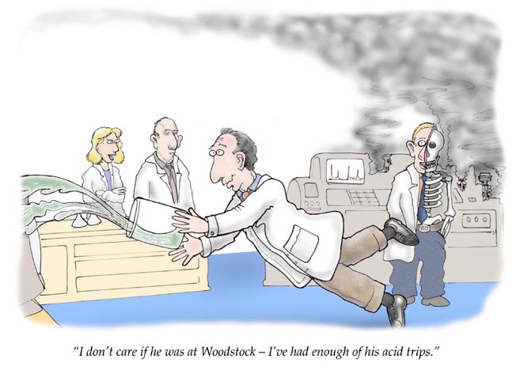
Acids, Bases, Solutions
Physical Science

Slide 2
Acid
Substance that releases hydrogen ions (H⁺) in water [or hydronium (H₃0⁺)]
HCl + H₂O → H₃O⁺ + Cl–

Slide 3
Common Acids and Uses
HCl – cleaning metals, gastric juice
H₂SO₄ - fertilizer, car batteries
H₃PO₄ - soft drinks, fertilizer, detergents
HNO₃ – fertilizers, cleaners, rocket fuels
C₆H₈O₇ – preservatives,
flavorings, soft drinks
HC₂H₃O₂ – vinegar
Many of these start with H,
as they contain an H+ ion!

Slide 4
Base
Substance that releases hydroxide ions (OH⁻) in water
NH₃ + H₂O → NH₄⁺ + OH⁻

Slide 5
Common Bases and Uses
NaOH - lye, drain and oven cleaner
Mg(OH)₂ - laxative, antacid
NH₄OH - cleaners, fertilizer
KOH – soaps, fertilizers, batteries
Ca(OH)₂ – food preparations, hair removal creams
Ba(OH)₂ – clean acid spills
NaHCO₃ – “baking soda” used in cooking and cleaning
Many of these end with OH as they contain an OH⁻ ion!

Slide 6
pH Scale
pH is a measure of the concentration of H⁺ ions in solution
pH ranges from 0 to 14
7 is neutral, less than 7 is acidic, more than 7 is basic

Slide 7
Properties
ACIDS
BASES
pH < 7
sour taste
turn litmus red
react with metals to form H₂ gas
Releases H⁺ ions
Conducts Electricity
pH > 7
bitter taste
turn litmus blue
Slippery feel
Releases OH⁻ ions
Conducts electricity

Slide 8
Indicators
Indicator - substance that changes color when placed in an acid or base
Examples:
litmus - red/blue
phenolphthalein - colorless/pink
goldenrod - yellow/red
red cabbage juice - pink/green

Slide 9
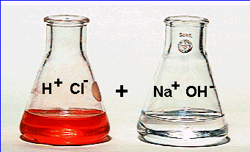
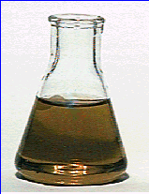
Neutralization Reaction
Chemical reaction between an acid and a base.
Products are a salt (ionic compound) and water.
ACID + BASE → SALT + WATER
HCl + NaOH → NaCl + H₂O
=
Neutralization does not always mean pH = 7.

Slide 10
Neutralization Reaction
Identify each from the following reaction
KOH + HNO₃ → H₂O + KNO₃
Acid?
Base?
Salt?
HNO₃
KOH
KNO₃

Slide 11
Solutions
Physical Science

Slide 12
Classifications of Matter
Recall that matter could either be a pure substance (element or compound) or a mixture
Mixtures are just mingled together, not chemically combined. They can either be
Heterogeneous – does not appear the same throughout
Homogenous – appears the same throughout. Depending on the size of particles, homogenous mixtures can be a
Colloid – with large enough particles to scatter light
Solution – with particles too small to be seen in a microscope

Slide 13
Definitions
Solution – homogenous mixture formed when one substance is uniformly mixed into another
Solute - substance being dissolved
Solvent – substance that dissolves the solute

Slide 14
Types of Solutions
Based on state of solvent.
“Universal solvent” is water (H₂O) as many things dissolve in water
All solid-liquid-gas combos are possible.
EX:
Tooth filling: mercury (liquid) dissolved in silver (solid)
Adult 21+ beverages: alcohol (liquid) dissolved in water (liquid)
Soda: carbon dioxide (gas) dissolved in water (liquid)

Slide 15
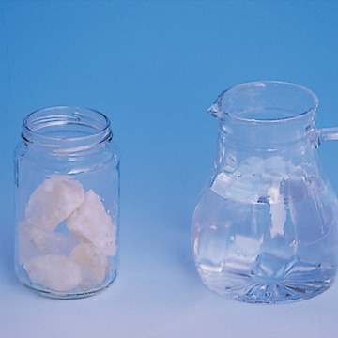
Dissolving: Salt Water
Solute – NaCl
Solvent - H₂O

Slide 16
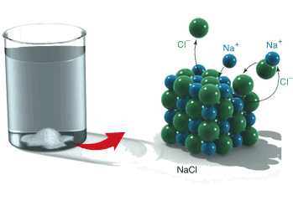
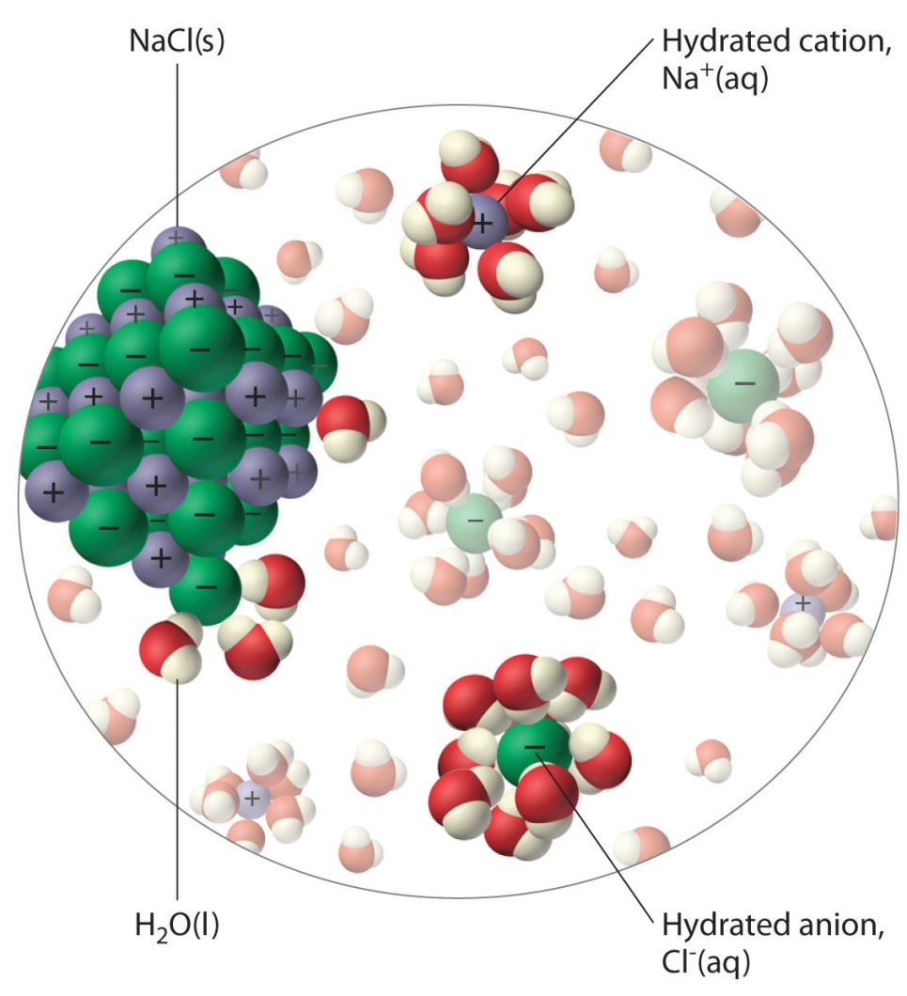
Dissolving
NaCl dissolving in water
Water molecules surround solute particles (+/- attraction)
Solute particles are pulled away from the crystal into solution by attraction from the polar water molecules
An aqueous solution is formed

Slide 17
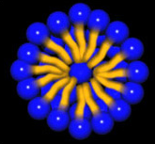
Dissolving
Because of this attraction,
Polar solutes can be dissolved by polar solvents
Nonpolar solutes are dissolved by nonpolar solvents
“Like dissolves like”
Detergents are long molecules with a polar “head” and long nonpolar “tail”
Dissolve and are attracted to both types
Attract both dirt/oil and water

Slide 18
Solubility
Solubility is a measure of how much solute will dissolve in a given amount of solvent at a given temperature
EX: 8 g of water will dissolve in 100 mL of water at 25˚C
Soluble – substance can dissolve in another substance
Insoluble – substance cannot dissolve in another substance

Slide 19
Concentration
Concentration – ratio of the amount of solute dissolved per quantity of solvent
Dilute solution – contains a large amount of solvent and a small amount of solute
Example: A tablespoon of sugar in a bucket of water
Concentrated solution – contains a large amount of solute and a small amount of solvent
Example: Two cups of sugar in a glass of lemonade

Slide 20
Concentration
Unsaturated solution:
The solvent contains less than the maximum amount of solute
More solute can be dissolved
Saturated solution:
Contains the maximum amount of solute dissolved in a given amount of solvent at a specific temperature
No more solute can be dissolved
Supersaturated solution
A solution that contains more solute than a saturated solution at that temperature
Formed by heating a saturated solution until all of the solute dissolves and it remains dissolved after cooling

Slide 21
Concentration
Unsaturated solution
The solvent contains less than the maximum amount of solute
More solute can be dissolved
Saturated solution
The solvent contains the maximum amount of solute dissolved in a given amount of solvent at a specific temperature
No more solute can be dissolved
Supersaturated solution
A solution that contains more solute than a saturated solution at that temperature
Formed by heating a saturated solution until all the solute dissolves and it remains dissolved after cooling
Unsaturated
Saturated

Slide 22
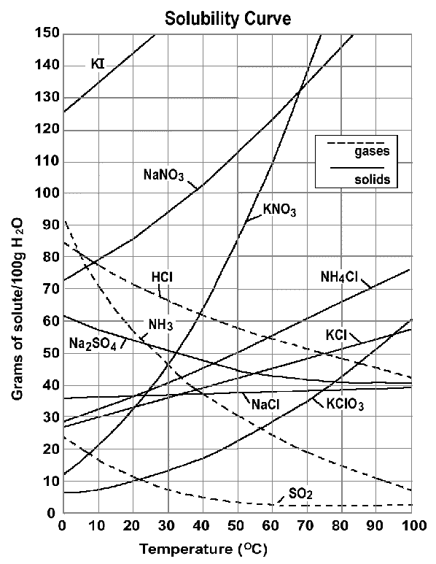
Solubility Curve
Graph showing the solubility of one or more substances at various temperatures
Points on the curves represent the solubility (concentration of a saturated solution) of the substance
EX: 110 g of KNO₃ dissolve into 100 g of H₂0 at 60˚
Shows the dependence of solubility on temperature

Slide 23
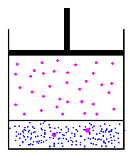
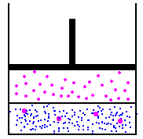
Solubility
Solids are more soluble at...
high temperatures.
Gases are more soluble at...
low temperatures.
high pressures (Henry’s Law).

