Slide 1
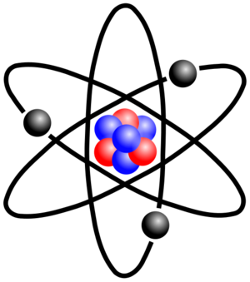
Atomic Structure
Physical Science – Chemistry Unit 2

Slide 2
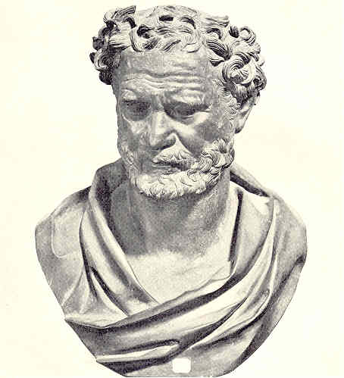
What is stuff made of?
Greek philosopher Democritus began the search for a description of matter more than 2400 years ago, wondering if matter could be divided into smaller and smaller pieces forever.
His theory: Eventually, there would be a smallest possible piece that couldn’t be divided.
He named the smallest piece of matter “atomos,” meaning “indivisible.”

Slide 3
The Atom
Democritus’ idea of atomos became our atoms.
Atom - Smallest particles of an element that retains the properties of that element
Atoms CAN be divided into smaller pieces:
Proton
Neutron
Electron

Slide 4
Parts of the Atom
Nucleus – Central part of the atom that has an overall positive charge
Contains basically all the mass of the atom (protons and neutrons!)
Very small in size compared to the rest of the atom.
Electron cloud – space surrounding the nucleus and is the probable location of the electrons

Slide 5
Electron Cloud:
Because electrons are so small and moving so fast around an atom, it is impossible to determine exactly where the electron is. (Think spokes on a bike wheel)
Depending on their energy, electrons are located in a certain area in the cloud.
Electrons with the lowest energy are found in the energy level closest to the nucleus
Electrons with the highest energy are found in the outermost energy levels, farther from the nucleus.
These outermost electrons are called valence electrons.

Slide 6
Can we go even smaller????
Yes!!!
Protons, Neutrons, and Electrons are made up of even smaller particles called “quarks”

Slide 7
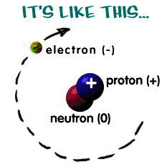
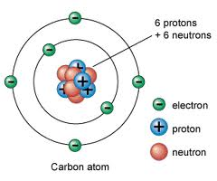
Put it all together to get…

Slide 8
Subatomic Particles
Particle | Symbol | Charge | Relative Mass | Location
Electron cloud
Electron
e⁻¹
-1
0 amu
Inside nucleus
Proton
p⁺¹
+1
1 amu
Neutron
n⁰
0
1 amu
Inside nucleus

Slide 9
So what does Bill Nye have to say about all of this??
http://www.youtube.com/watch?v=uEv8EIXJNwo&feature=related
Notes:
Play to 8:15

Slide 10
Distinguishing Atoms

Slide 11
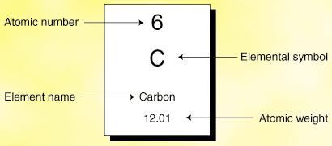
Distinguishing Atoms
Atomic Number - Number of protons in the nucleus
Determines the element. All atoms of the same element have the same number of protons.
Since atoms are neutral, the atomic number also tells us the number of electrons!

Slide 12
Distinguishing Atoms
Mass Number
Number of protons plus the number of neutrons
Mass # = protons + neutrons
These are the two particles that really make up the mass of the atom

Slide 13
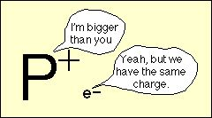
More on Mass
The mass of an atom comes from particles in its nucleus
The electron is sooooo small, we ignore its mass

Slide 14
Notation
Mass #
Atomic #
8
Protons
Electrons
Neutrons
8
15-8 = 7

Slide 15
Notation
Oxygen - 15
Mass #

Slide 16
How to get Atomic and Mass #s
If you are not given the atomic number, simply look at the periodic table.
If you are not given the mass number, add the number of protons and neutrons
To find protons or neutrons, subtract what you know from the mass number.

Slide 17
Name | Symbol | Atomic number | Mass Number |  | # of Protons | # of Neutrons | # of electrons
Sodium |  |  | 23
 | Br |  | 80

Slide 18
Practice
How many protons are there in Lithium-7?
How many neutrons are there in Lithium-7?
How many protons are there in Mg?
How many electrons are there in Mg?
How many neutrons are there in ?
How many neutrons are there in Oxygen-18?

Slide 19
Your BFF in Chemistry…
The Periodic Table has a lot of information to help you with determining the different parts of an atom
Let’s practice using this information
Symbol | Atomic Number | Mass Number | # of Protons | # of Neutrons | # of Electrons
¹²C | 6 | 12 | 6 | 6 | 6
²³Na | 11 | 23 | 11 | 12 | 11
K | 19 | 40 | 19 | 21 | 19
Sr |  |  | 38 | 52

Slide 20
Changing Atoms

Slide 21
Isotopes
Atoms of the same element (same # of protons), but with different numbers of neutrons.
Have different mass numbers (and masses)
Isotopes behave the same chemically because the still have the same number of protons and electrons

Slide 22
Isotopes of Neon
Protons
Electrons
Neutrons
10
10
10
10
10
10
10
11
12

Slide 23
Average Atomic Mass
The weighted average mass of the atoms in a naturally occurring sample of the element
**Have to take isotopes and their relative abundances into account

Slide 24
Average Atomic Mass
Isotope Abundance Mass
Boron-10 19.0% 10 amu
Boron-11 81.0% 11 amu
Boron-10: 0.190 x 10 = 1.90
Boron-11: 0.810 x 11 = 8.91
10.81 amu
Notice that this is somewhere in between 10 and 11, and closer to 11 since Boron-11 is more abundant.
Notes:
Notice mass is never a whole number, yet P=1 and N=1.
The final average mass should be close to the isotope that is most abundant.

Slide 25
Ions
So far, we have focused on neutral atoms
Have an equal number of protons and electrons
When an atom gains or loses electrons, it is called an ion

Slide 26
Negative Ions
Acquired a Negative charge from gaining electrons
Has more electrons than protons
Called an anion
Ex.
Protons | 8
Electrons | 8+2=10
Neutrons | 16-8=8

Slide 27
Positive Ions
Acquired a positive charge from losing electrons
Has fewer electrons than protons
Called a cation
Ex.
Protons | 13
Electrons | 13-3=10
Neutrons | 27-13=14

Slide 28
Particle Changed | Result
Proton
Different Element
Neutron
Isotope (of same element)
Electron
Ion (of same element)

Slide 29
Radioactivity

Slide 30
What is Radioactivity?
If nuclear forces can’t hold together the nucleus of a certain isotope, it is said to be unstable.
The nucleus will decay, or break down, and release particles and energy in a process called radioactivity.
Unstable isotopes tend to be large. All isotopes with more than 83 protons are unstable.
This is also why almost all elements with more than 92 protons are man-made. They decay too fast to occur naturally.

Slide 31
Types of Radiation
Radioactivity is classified by the type of particles and energy emitted, called radiation.
Type | What it is | Symbol | What can stop it
Alpha (α) | Charged helium nucleus |  | Paper
Beta (β) | Electron from the nucleus (neutron becomes proton and electron) |  | Aluminum foil, plastic
Gamma (γ) | Electromagnetic wave (light energy) |  | Thick lead

Slide 32
Alpha Decay
Alpha Decay – an alpha particle (mass number: 4, atomic number: 2) is released
This reduces the unstable atom’s mass by 4 and number of protons by 2

Slide 33
Beta Decay
Beta Decay – a beta particle (mass number: 0, atomic number: -1) is released
This does not change unstable atom’s mass and INCREASES the number of protons by 1

Slide 34
Gamma Radiation
Gamma Rays – a high energy photon (light) that is released
It does not change the original atom by itself. It is given off by a high energy nucleus or along side of alpha or beta decay.

Slide 35
Uses of Radioactive Isotopes
Uranium-235 is used as a fuel in nuclear power plants
Carbon-14 is used to date organic material
Americium-241 is used in smoke detectors
Cobolt-60 is used in food irradiation and in cancer treatment
Iodine-131 is used to detect thyroid problems
Lead-210 is used to date layers of sand and soil

Slide 36
Half-life
The amount of time it takes for half the nuclei in a sample to decay is called the half life.
If the half-life of an isotope is 1 second, every second the amount of radioactive material is cut in half
Example Half-lives
polonium-194 0.7 seconds
lead-212 10.6 hours
iodine-131 8.04 days
carbon-14 5,370 years
uranium-238 4.5 billion years

Slide 37
Half-life
EX: How much of a 200g sample of Carbon-14 is left after 3 half lives?
Each half-life, half the radioactive sample remains
25 g remain
1
2
3
200 g
100 g
50 g
25 g

Slide 38
Other Nuclear Reactions

Slide 39
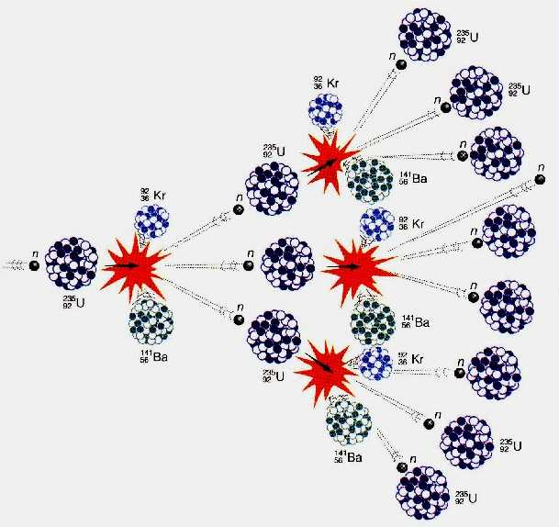
F ission
Splitting of a large nucleus into two or more smaller nuclei
Some mass is converted to large amounts of energy
Can cause a chain reaction – a cascade fission reaction
fission
chain reaction

Slide 40
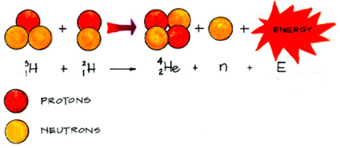
Fusion
The combining of two small nuclei to form one nucleus of larger mass
Produces even more energy than fission
Process that occurs naturally in stars
EX: hydrogen atoms fusing to form helium

Slide 41
Nuclear Power
Cooling Tower
Fission Reactors

Slide 42
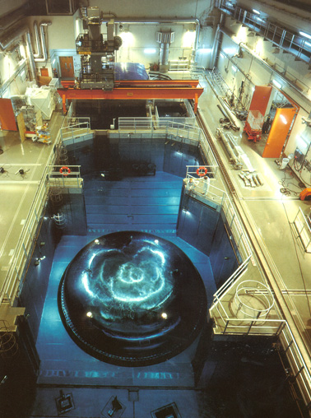
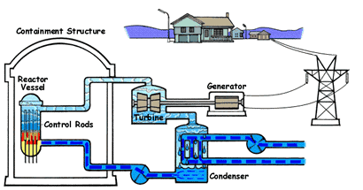
Nuclear Power
Fission Reactors

Slide 43
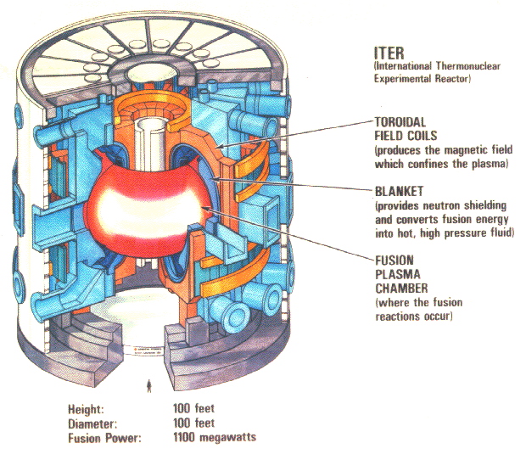
Nuclear Power
Fusion Reactors (not yet sustainable)

Slide 44
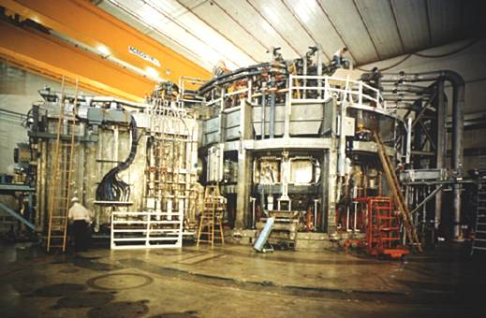
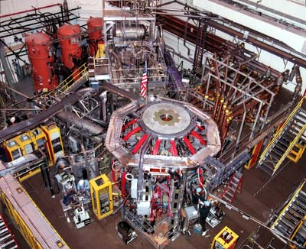
Nuclear Power
Fusion Reactors (not yet sustainable)
National Spherical Torus Experiment
Tokamak Fusion Test Reactor
Princeton University

