Slide 1
Stoichiometry
http://www.unit5.org/chemistry/Stoichiometry.html
Notes:
The Mole - Study Questions
1. What were Avogadro’s 2 major contributions to chemistry?
2. What is the unit for mass used on the periodic table?
3. How does molecular mass differ from molar mass?
4. Convert 200 g of FeO to moles.
5. Convert 3 mol of CO₂ to grams.
6. What is a conversion factor?
7. If 25 g of a substance equals 1 mole, what conversion factor would you use to convert 1.5 mol to grams?
8. What conversion factor would be used to convert 3 mol of the substance in question 10 to grams?
9. What is the unit used for molecular and formula mass?
10. What is the unit of molar mass?
11. The oxidation of 50.0 g of Mn produces 79.1 g of an oxide. Calculate (a) the percent composition, and (b) the empirical formula of this oxide.
12. What two things are conserved in a chemical reaction?
13. Why aren’t moles conserved in a chemical reaction?
For the next 4 questions balance the equation and calculate the indicated quantity.
14. K(s) + H₂O (g) → KOH(aq) + H₂(g) How much KOH will be produced from 100 g of K?
15. Fe₂O₃(s) + C → Fe(l) + CO(g) How much CO will be produced from 100 g of C?
16. CaC₂(s) + H₂O(l) → Ca(OH)₂(s) + CsH₂(g) How much CaC₂ is required to produce 100 g of C₂H₂?
17. C₄H₁₀(g) + O₂ → CO₂(g) + H₂O(l) How much H₂O can be produced using 100 g O₂?
18. What is a mole?
19. How many particles are there in a mole?

Slide 2






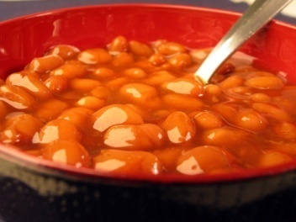
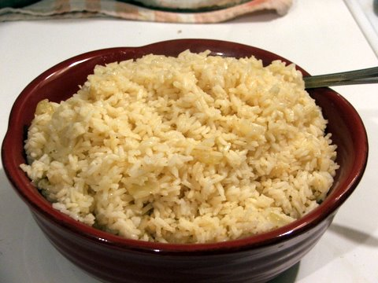
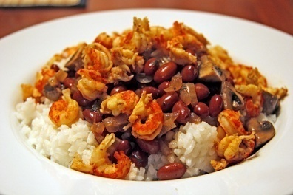
Guiding Questions
How are dosages determined?
How are toxins measured and controlled?
Which is better: eating beans and rice at separate meals
or together?
Notes:
What you should learn:
The dimension analysis method for handling quantities involved in a chemical reaction is based on proportions of the substances involved and is an important tool that allows for the measurement of all quantities in a chemical reactions - mass, volume, concentration, energy, etc.
Stoichiometric calculations allow one to make important measurements to ensure the health of people and animals.
More Specifically...:
State that chemicals react according to stoichiometric ratios (mole ratios)
Calculate concentrations using molarity
Solve Stoichiometry problems to convert the following
mole-mole;
mass-mass;
mole-mass;
mass-volume;
mole-volume; and
volume-volume.
Molarity-molarity
Molecule-molecule
Atom/ion-atom/ion
etc…
Identify the limiting reactant (reagent) in a reaction.
Determine the limiting reactant and calculate theoretical yield and excess reactant.
Solve percent yield problems
http://www.ispcorp.com/products/pharma/content/images/capsules2.jpg
http://images.google.com/imgres?imgurl=http://www.ehs.ufl.edu/Bio/abt_files/image010.jpg&imgrefurl=http://www.ehs.ufl.edu/Bio/toxin.htm&h=340&w=256&sz=12&hl=en&start=5&um=1&tbnid=4iSJ2CKfansiGM:&tbnh=119&tbnw=90&prev=/images%3Fq%3Dtoxins%26um%3D1%26hl%3Den
http://brinestorming.files.wordpress.com/2006/06/baked-beans.jpg

Slide 3
Table of Contents
‘Stoichiometry’
Balancing Chemical Equations
Avogadro’s Number
Molar Mass
Combustion Reactions
Synthesis Reactions
Single Replacement Reactions
Activity Series
Double Replacement Reactions
Mole Island Diagram
Limiting Reactants
Generic Stoichiometry
Air Bag Design
Water from a Camel
Rocket Fuel
Water in Space
Excess Reactant
Classes of Reactions

Slide 4
Stoichiometry
You should understand
  Moles, mass, representative particles (atoms, molecules, formula
  units), molar mass, and Avogadro’s number.
  The percent composition of an element in a compound.
  Balanced chemical equations: for example, for a given mass of a
  reactant, calculate the amount of produced.
  Limiting reactants: calculate the amount of product formed when
  given the amounts of all the reactants present.
  The percent yield of a reaction.
  Reactions in solution: given the molarity and the volume of the reactants,
    calculate the amount of product produced or the amount of reactant
    required to react.
  Molarity; preparation of solutions.
Notes:
Fast Track to a 5 (page 71)

Slide 5
Lecture Outline – Stoichiometry
Lecture Outline – Stoichiometry
student notes outline
textbook questions
Lecture Outline – Stoichiometry
textbook questions
Keys
text
http://www.unit5.org/chemistry/Stoichiometry.html
Notes:
ALL students should;
Be able to write chemical equations in words
Be able to write chemical equations using chemical formulae and chemical symbols (this requires knowledge, and correct use of, chemical nomenclature)
Understand, and be able to use, state symbols as part of chemical equation writing
Be able to balance chemical equations
Understand why balancing chemical equations is important
Understand the concept of percentage by mass
Be able to calculate empirical formulae from percentage by mass data
Be able to convert empirical formulae to molecular formulae by using RMM data
Understand and be able to apply the concept of the mole in chemical calculations (including the application of Avogadro's number)
Be able to use combustion data to calculate empirical formula of compounds
Understand the importance of, and be able to apply, the concept of stoichiometric coefficents relating to reacting ratios
Know how to calculate the number of moles of a solid substance present in a reaction from data
Be able to perform calculations realting to Molarity (will be covered in Solutions Unit of study)
Be able to perform calculations relating to dilution (will be covered in Solutions Unit of study)
Be able to calculate the formula of hydrated salts from experimental data (was covered in Mathematics of the Chemical Formula Unit of study)
Understand, and be able to apply, the concept of a limiting reactant
Understand, and be able to apply, the concept of percentage yield

Slide 6
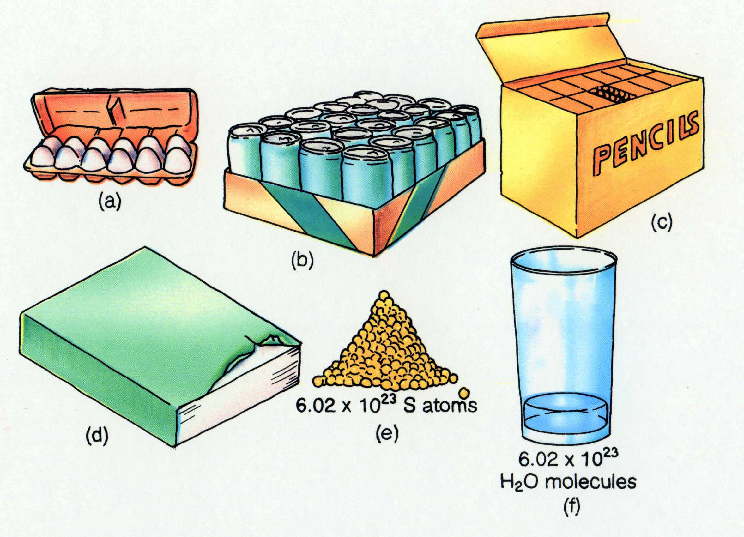
Some common collections and the numbers of items in them.
Timberlake, Chemistry 7th Edition, page 179

Slide 7

Balancing Chemical Equations
Coefficients
Notes:
http://www.woodenstilts.co.uk/images/animations/tightrope_walker_pole_a_hc.gif

Slide 8
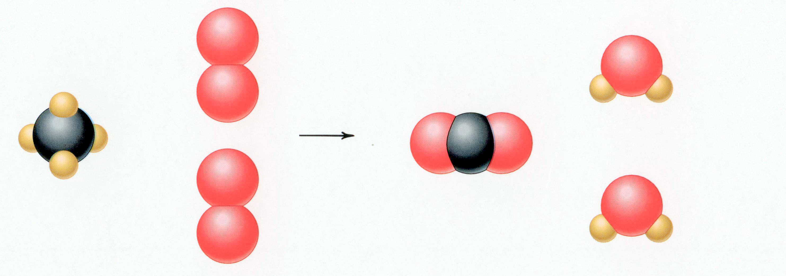
CH₄ + 2 O₂ → CO₂ + 2 H₂O
Reactants Products
1 C atom 1 C atom
4 H atoms 4 H atoms
4 O atoms 4 O atoms
Timberlake, Chemistry 7th Edition, page 167

Slide 9
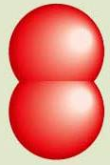
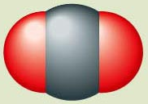
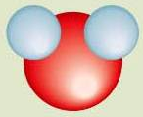

Reactants → Products
+
C(s) + O₂(g) CO₂(g)
carbon oxygen carbon dioxide
Reactants Product
1 carbon atom 1 carbon atom
2 oxygen atoms 2 oxygen atoms
catalyst – speeds up reaction
+
Pt
2
H₂(g) + O₂(g) H₂O (l)
hydrogen oxygen water
2
Pt
Reactants Product
2 hydrogen atoms 2 hydrogen atoms
2 oxygen atoms 1 oxygen atoms
Reactants Product
2 hydrogen atoms 4 hydrogen atoms
2 oxygen atoms 2 oxygen atoms
Reactants Product
4 hydrogen atoms 4 hydrogen atoms
2 oxygen atoms 2 oxygen atoms
Un
balanced
Timberlake, Chemistry 7th Edition, page 164

Slide 10
Unbalanced and Balanced Equations
H
Cl
Cl
Cl
H
H
H
Cl
Cl
Cl
Cl
H
H
H
H₂ + Cl₂ → HCl
(unbalanced)
H₂ + Cl₂ → 2 HCl
(balanced)
reactants products
reactants products
H
2
1
H
2
2
Cl
2
1
Cl
2
2

Slide 11
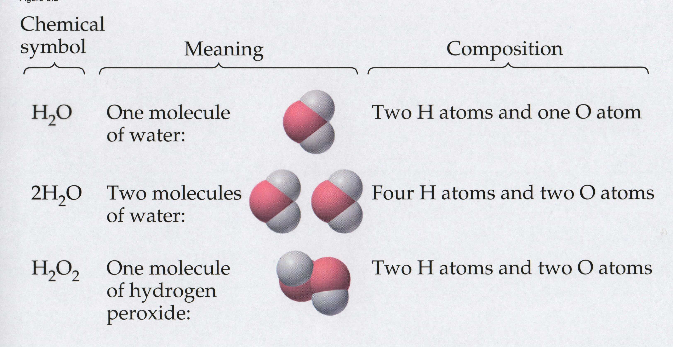
Meaning of Chemical Formula
Chemical
Symbol Meaning Composition
H₂O One molecule
of water:
Two H atoms and one O atom
2 H₂O Two molecules
of water:
Four H atoms and two O atoms
H₂O₂ One molecule
of hydrogen
peroxide:
Two H atoms and two O atoms

Slide 12
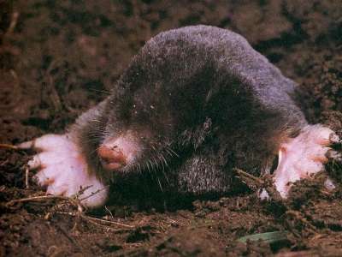
The Mole Concept
Avogadro’s Number = 6.022 x 10²³
Notes:
Objectives:
To state the value of Avogadro’s number: 6.02 x10²³.
To state the mass of Avogadro’s number of atoms for any element by referring to the periodic table.
To relate the moles of a substance to the number of particles.
http://www.birdxcanada.com/sonic/mole_400.jpg

Slide 13

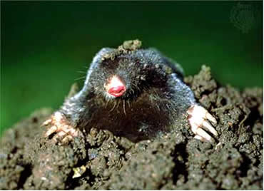
Counting Atoms
Chemistry is a quantitative science - we need a "counting unit."
The MOLE
1 mole is the amount of substance that contains as many particles (atoms or molecules) as there are in 12.0 g of C-12.
Notes:
http://web.syr.edu/~nstefanc/New%20Counting.JPG
http://www.wildcru.org/research/farming/moles/mole1.jpg

Slide 14
The Mole is Developed
AvogadroPaper
Carbon Atoms | Hydrogen Atoms | Mass Ratio
Number Mass (amu) | Number Mass (amu) | Mass carbon / Mass hydrogen
12 | 1 | 12 amu = 12 1 amu 1
24 [2 x 12] | 2 [2 x 1] | 24 amu = 12 2 amu 1
120 [10 x 12] | 10 [10 x 1] | 120 amu = 12 10 amu 1
600 [50 x 12] | 50 [50 x 1] | 600 amu = 12 50 amu 1
(6.02 x 10²³) x (12) | Avogadro’s number (6.02 x 10²³) x (1) | (6.02 x 10²³) x (12) = 12 (6.02 x 10²³) x (1) 1
Avogadro’s
number
Notes:
http://dbhs.wvusd.k12.ca.us/webdocs/ChemTeamIndex2.html (link for Avogadro paper)

Slide 15
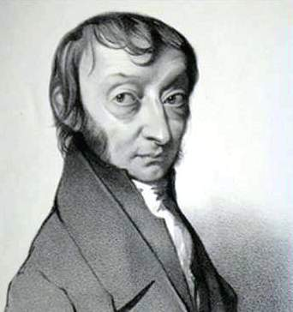
Amadeo
Avogadro
(1776 – 1856)
Particles in a Mole
Amedeo Avogadro (1766-1856)
never knew his own number;
it was named in his honor by a
French scientist in 1909.
its value was first estimated
by Josef Loschmidt, an Austrian
chemistry teacher, in 1895.
?
quadrillions
thousands
trillions
billions
millions
1 mole = 602213673600000000000000
or 6.022 x 10²³
There is Avogadro's number of particles in a mole of any substance.
Notes:
A more precise value of Avagadro’s number = 6.022045 E23.
How could you determine the number of sugar crystals in a bowl of sugar?
Is it possible to get a reasonably close estimate?

Slide 16
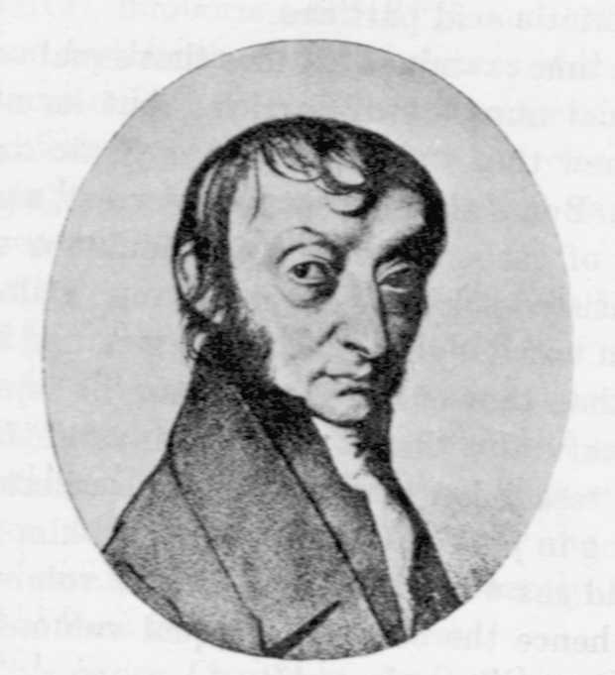
Amadeo
Avogadro
(1776 – 1856)
Particles in a Mole
?
quadrillions
thousands
trillions
billions
millions
1 mole = 602213673600000000000000
or 6.022 x 10²³
There is Avogadro's number of particles in a mole of any substance.
Notes:
A more precise value of Avagadro’s number = 6.022045 E23.
How could you determine the number of sugar crystals in a bowl of sugar?
Is it possible to get a reasonably close estimate?

Slide 17
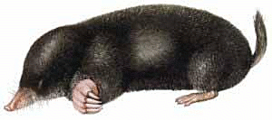
Careers in Chemistry - Philosopher
Q: How much is a mole?
A: A mole is a quantity used by chemists to count atoms and
molecules. A mole of something is equal to 6.02 x 10²³ “somethings.”
1 mole = 602 200 000 000 000 000 000 000
Q: Can you give me an example to put that number in perspective?
A: A computer that can count 10,000,000 atoms per second would
take 2,000,000,000 years to count 1 mole of a substance.
Notes:
The Cray-1 supercomputer prototype was built by Cray Research, Inc. The Cray-1 contained 200,000 integrated circuits and could perform 100 million floating point operations per second (100 MFLOPS). Using this machine it would still take 200 million years to count to 1 mole!

Slide 18
Counting to 1 Mole
Is that right? A computer counting 10 million atoms every second
would need to count for 2 billion years to count just a single mole.
Lets look at the mathematics.
365 days
24 hours
60 min
60 sec
x sec = 1 year
= 31,536,000 sec
1 year
1 day
1 hour
1 min
Therefore 1 year has 31,536,000 seconds or 3.1536 x 10⁷ sec.
A computer counting 10,000,000 atoms every second could count
3.153 x 10¹⁴ atoms every year.
Finally, 6.02 x 10²³ atoms divided by 3.1536 x 10¹⁴ atoms every year
equals 1,908,929,477 years or approximately 2 billion years!

Slide 19
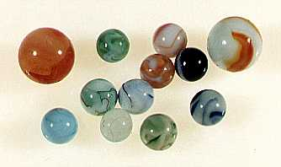
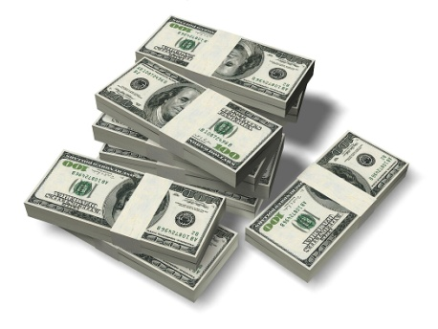
How Big is a Mole?
One mole of marbles would cover the entire Earth
(oceans included) for a depth of three miles.
One mole of $100 bills stacked one on top of another
would reach from the Sun to Pluto and back 7.5 million
times.
It would take light 9500 years to travel from the
bottom to the top of a stack of 1 mole of $1 bills.
Notes:
6.02 x 10²³ softballs = volume of Earth
6.02 x 10²³ Olympic shot puts = mass of Earth
6.02 x 10²³ atoms H laid side by side would encircle Earth ~1,000,000 times

Slide 20
Avogadro’s Number
A MOLE of any substance contains as many elementary units (atoms and molecules) as the number of atoms in 12 g of the isotope of carbon-12.
This number is called AVOGADRO’s number N_{A} = 6.02 x 10²³ particles/mol
The mass of one mole of a substance is called MOLAR MASS symbolized by MM
Units of MM are g/mol
Examples
  H₂ hydrogen 2.02 g/mol
  He helium 4.0 g/mol
  N₂ nitrogen 28.0 g/mol
  O₂ oxygen 32.0 g/mol
  CO₂ carbon dioxide 44.0 g/mol

Slide 21
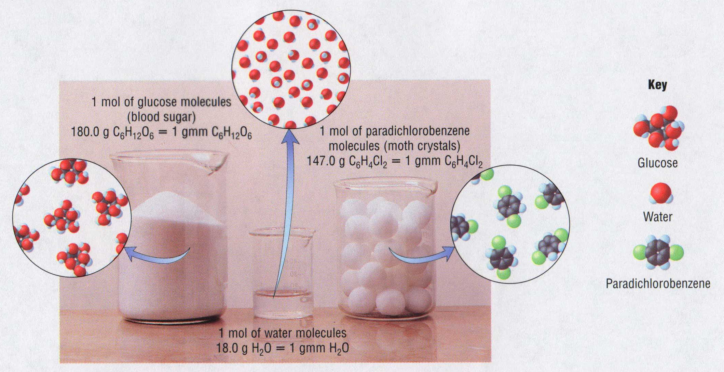
1 Mole of Particles

Slide 22
Molar Mass
Notes:
Objectives:
To calculate the molar mass of a substance given its chemical formula.

Slide 23
Molecular Weight and Molar Mass
Molecular weight is the sum of atomic weights
of all atoms in the molecule.
example: NaCl has a molecular weight of 58.5 a.m.u.
this is composed of a single molecule of NaCl
Molar mass = molecular weight in grams.
example: NaCl has a molar mass of 58.5 grams
this is composed of a 6.02 x10²³ molecules of NaCl

Slide 24
The Molar Mass and Number of Particles in One-Mole Quantities
Substance Molar Mass Number of Particles in One Mole
Carbon (C) 12.0 g 6.02 x 10²³ C atoms
Sodium (Na) 23.0 g 6.02 x 10²³ Na atoms
Iron (Fe) 55.9 g 6.02 x 10²³ Fe atoms
NaF (preventative 42.0 g 6.02 x 10²³ NaF formula units
for dental cavities)
CaCO₃ (antacid) 100.1 g 6.02 x 10²³ CaCO₃ formula units
C₆H₁₂O₆ (glucose) 180.0 g 6.02 x 10²³ glucose molecules
C₈H₁₀N₄O₂ (caffeine) 194.0 g 6.02 x 10²³ caffeine molecules

Slide 25
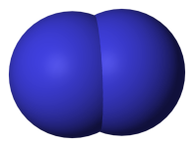
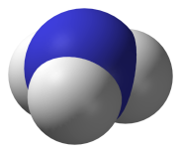
Chemical Equations
Chemical Equations
N₂ (g)
+
3 H₂ (g)
2 NH₃ (g)
+
“Microscopic recipe”
1 molecule N₂
+
3 molecules H₂
2 molecules NH₃
“Macroscopic recipe”
1 mol N₂
+
3 mol H₂
2 mol NH₃
Experimental Conditions Reactants Products
Before reaction
1 mol N₂
+
3 mol H₂
2 mol NH₃
2 molecules N₂
3 molecules H₂
0 molecules NH₃
After reaction
1 molecules N₂
0 molecules H₂
2 molecules NH₃

Slide 26
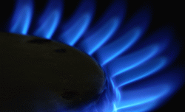
Combustion Reactions
Hydrocarbon + O₂ → CO₂ + H₂O
Notes:
http://www.bollingerenergy.com/images/natgaspic.gif

Slide 27
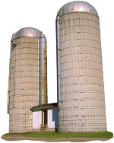

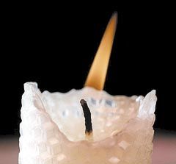
Exploding Flour
FLOUR
EXPLOSION:
Fuel (flour)
Ignition (candle)
Oxygen (combustion)
6” PVC Pipe
As confinement increases,
EXPLOSION is greater.

Slide 28
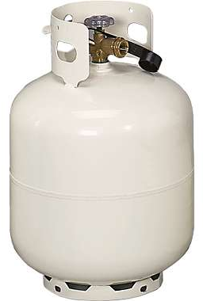
Combustion of a Hydrocarbon
GENERAL FORMULA: CH + O₂ → CO₂ + H₂O
Many homes get heat from propane (C₃H₈) heaters.
Write a balanced chemical equation for the complete
combustion of propane gas.
C₃H₈(g) + O₂(g) → CO₂(g) + H₂O(g)
C₃H₈(g) + O₂(g) → CO₂(g) + H₂O(g)
5
3
4
+ energy
Notes:
http://images.cabelas.com/is/image/cabelas/s7_516602_imageset_01?$main-Large$

Slide 29
Combustion of Hydrocarbon (cont.)
Ideal Stoichiometry
3
C₃H₈(g) + O₂(g) → CO₂(g) + H₂O(g)
5
4
+ energy
Δ
Too ‘rich’ (not enough oxygen – too much fuel)
C₃H₈(g) + O₂(g) → CO (g) + H₂O(g)
3
4
+ energy
Δ
C₃H₈(g) + O₂(g) → C (g) + H₂O(g)
2
3
4
+ energy
SOOT

Slide 30
Air-Fuel Ratio in an Internal Combustion Engine
Stoichiometric ratio
Fuel-rich
mixtures
Fuel-lean
mixtures
NO
Relative emissions of pollutants
RH
CO
12
13
14
15
16
17
Mass ratio of air to fuel
Hill, Petrucci, General Chemistry An Integrated Approach 2nd Edition, page 1087
Notes:
An important variable in the combustion of gasoline in an internal-combustion engine is the air/fuel ratio.
The figure shows how the emission of pollutants is related to the air/fuel ratio.
Provide a plausible interpretation of this figure.
For the complete combustion of gasoline, the mass ratio of air to fuel should be about 14.5 to 1.
RH represents hydrocarbons.

Slide 31
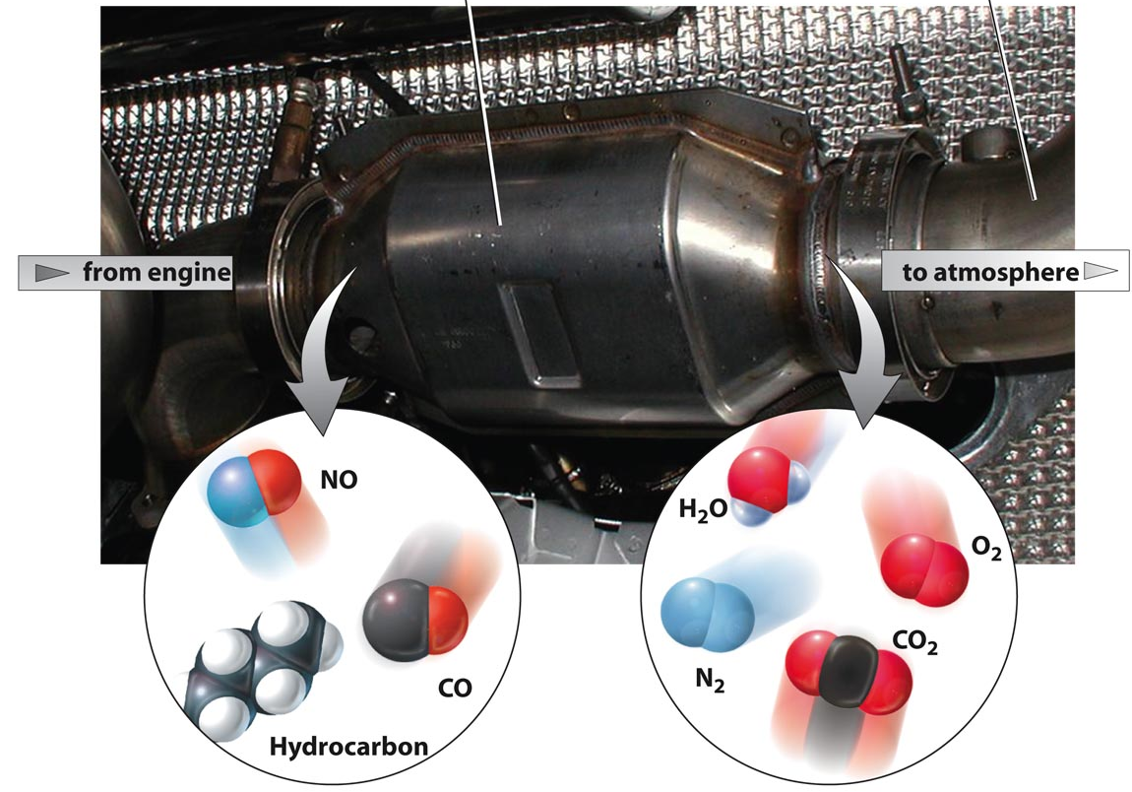
Catalytic converter
Tail pipe
Before it reaches the catalytic converter,
the exhaust contains such pollutants
as NO, CO, and hydrocarbons.
After it has passed through the
catalytic converter, the exhaust
contains water vapors, N₂, O₂, and CO₂.
Copyright © 2007 Pearson Benjamin Cummings. All rights reserved.
Notes:
A catalysts is a substance that participates in a reaction and causes it to occur more rapidly but that can be recovered unchanged at the end of the reaction and reused
Catalysts are not involved in the stoichiometry of the reaction and are usually shown above the arrow in a net chemical equation
A biological catalyst is called an enzyme.
Chemical processes in industry rely heavily on catalysts, which are added to a reaction mixture in trace amounts.
Acceleration of a reaction by a catalyst is called catalysis.

Slide 32
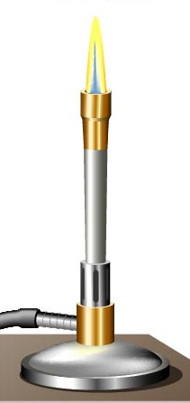
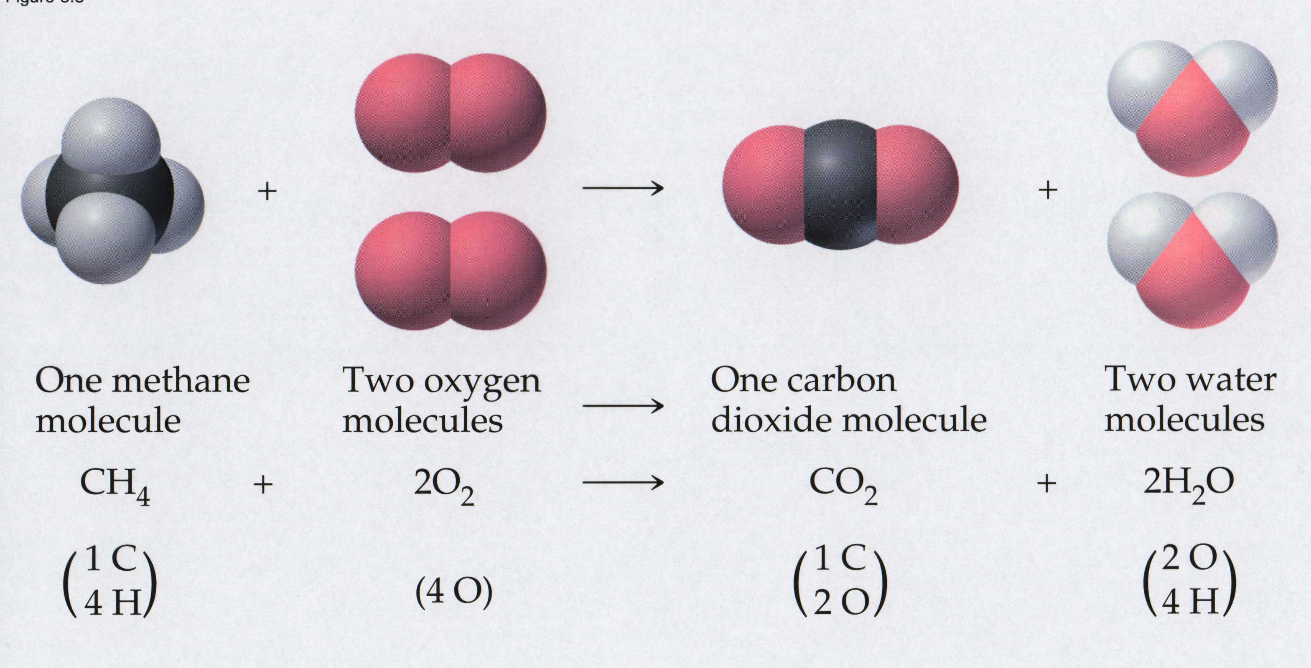
Combustion of
Methane Gas
Davis, Metcalfe, Williams, Castka, Modern Chemistry, 1999, page 245

Slide 33
Combustion of
Methane Gas
One methane
molecule
Two oxygen
molecules
One carbon
dioxide molecule
Two water
molecules
CH₄
+
2 O₂
CO₂
+
2H₂O
1 carbon
+
4 hydrogen
1 carbon
+
2 oxygen
2 oxygen
+
4 hydrogen
4 oxygen
=
Davis, Metcalfe, Williams, Castka, Modern Chemistry, 1999, page 245

Slide 34
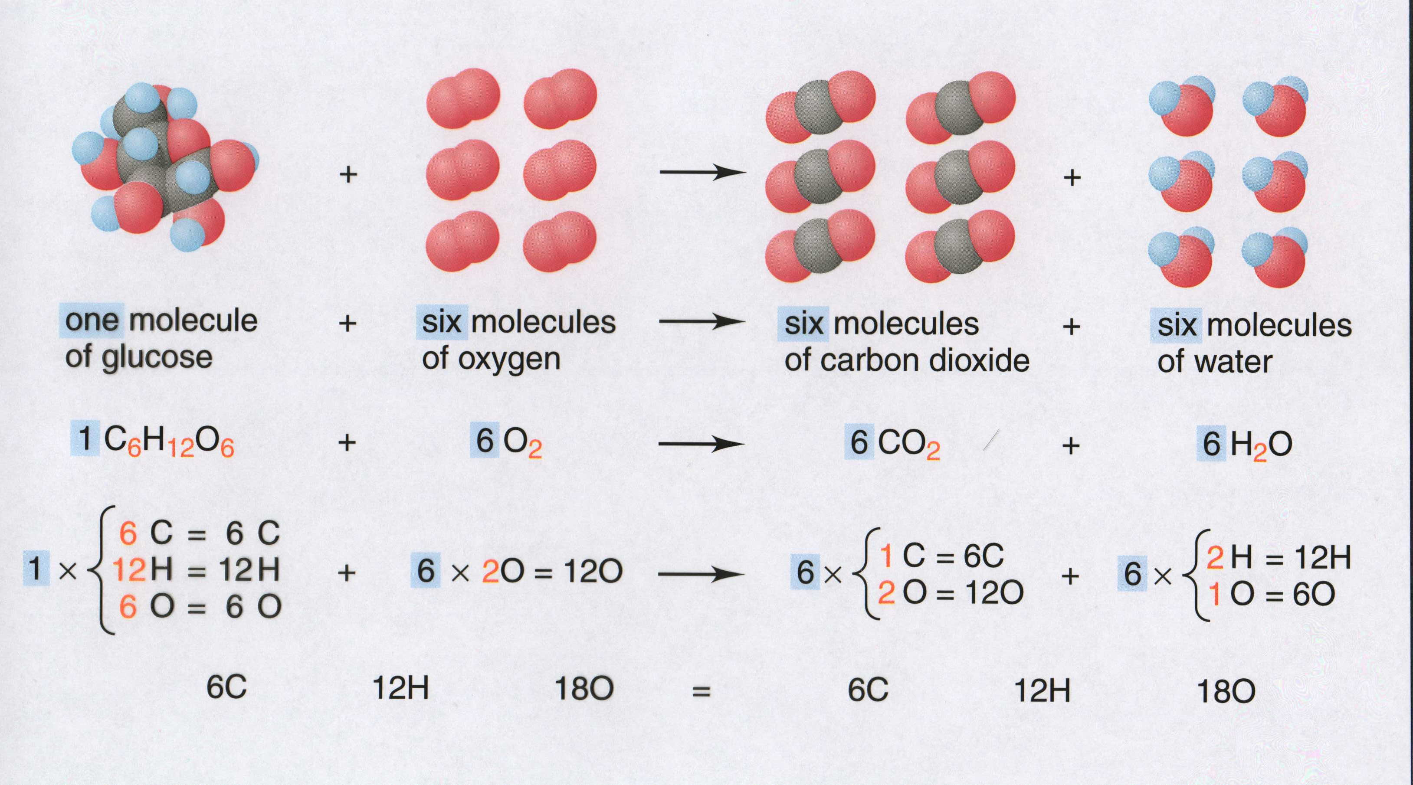
Combustion of Glucose
Kelter, Carr, Scott, Chemistry A World of Choices 1999, page 130

Slide 35
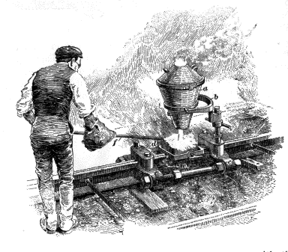
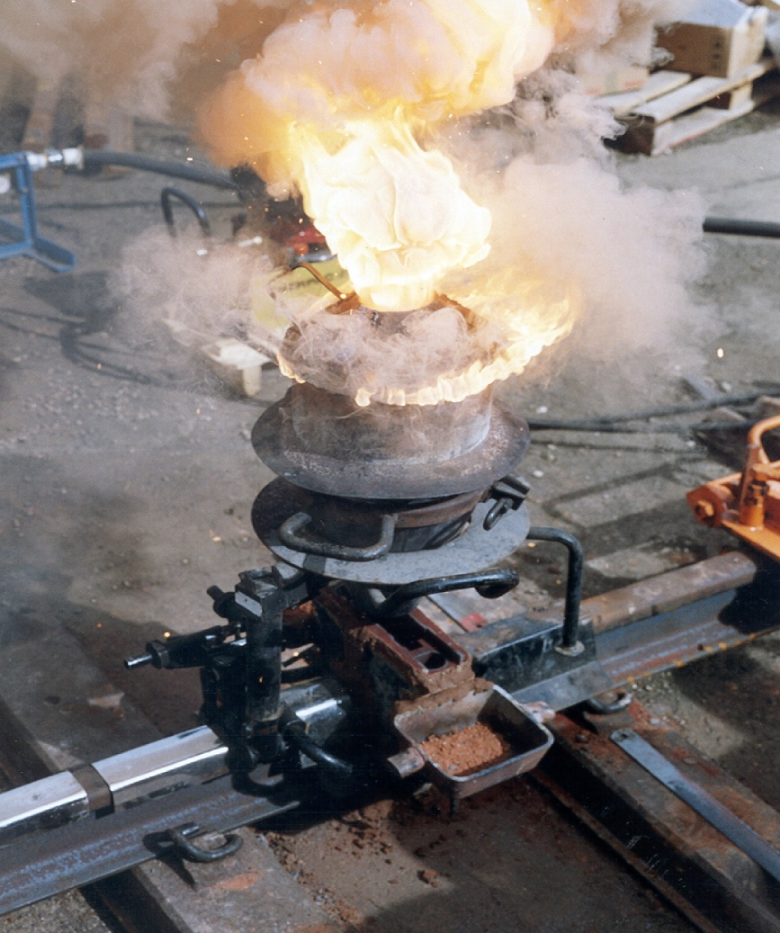
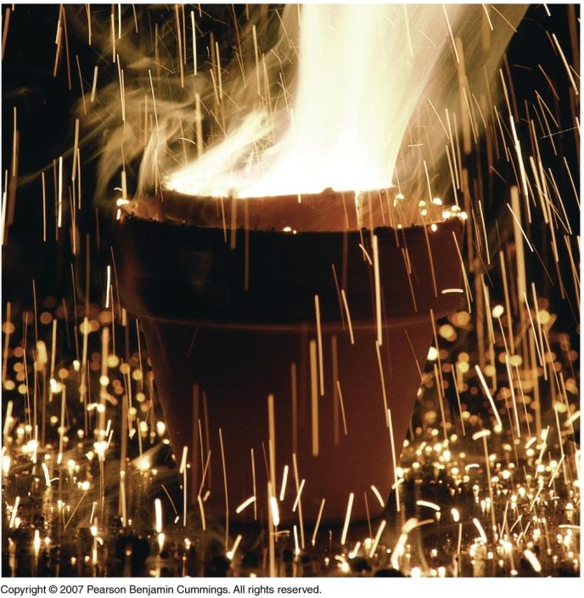
Combustion of Iron
Formation of Rust
Thermite Reaction
    underwater welding
    Temp. = ~3500ºC
4 Fe + O₂ → 2 Fe₂O₃
Fe₂O₃ + 2 Al → 2 Fe + Al₂O₃ + 199 kcal
Notes:
Image Copyright © Pearson Benjamin Cummings. All rights reserved.
Thermite welding in the joining of rails. Photograph courtesy of Howard Smith. http://www.msm.cam.ac.uk/phase-trans/2004/Rails/Rails-Images/2.jpg
http://www.bathtram.org/tfb/Thermit.gif

Slide 36

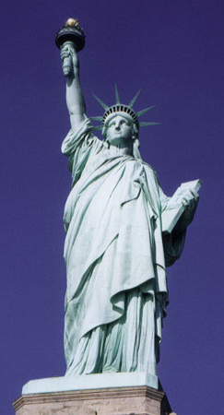
Combustion of Copper
Copper burns with a green color
Copper forms a patina (oxide)
  green in color
    CuO₂
  black in color
    CuO
Statue of Liberty is covered with
copper that has oxidized to form
copper (II) oxide, CuO₂.

Slide 37
Synthesis Reactions
A + B → AB or AB + C → ABC

Slide 38
Synthesis Reaction
Direct combination reaction (Synthesis)
2 Na + Cl₂ → 2 NaCl
Na
Cl
Na
Cl
→
Cl
Cl
Na
Na
General form: A + B → AB
element or element or compound
compound compound

Slide 39
Synthesis Reaction
Direct combination reaction (Synthesis)
2 Na + Cl₂ → 2 NaCl
Na
Cl
Na⁺
Cl ⁻
Cl
Cl ⁻
Na⁺
Na
General form: A + B → AB
element or element or compound
compound compound

Slide 40
Synthesis Reaction
Direct combination reaction (Synthesis)
2 Mg + O₂ → 2 MgO
Mg
Mg²⁺
O²⁻
O
O²⁻
O
Mg
Mg²⁺
General form: A + B → AB
element or element or compound
compound compound

Slide 41
Decomposition Reactions
AB → A + B

Slide 42
Decomposition Reaction
Decomposition reaction
2 H₂O
2 H₂
+
O₂
H
O
H
O
H
H
+
H
O
H
O
H
H
General form: AB
A
+
B
compound
two or more elements
or compounds

Slide 43
Decomposition Reaction
Decomposition reaction
2 H₂O
2 H₂
+
O₂
O
H
H
H
O
H
+
H
O
O
H
H
H
General form: AB
A
+
B
compound
two or more elements
or compounds

Slide 44
Single Replacement Reactions
A + BC → B + AC
Activity Series

Slide 45
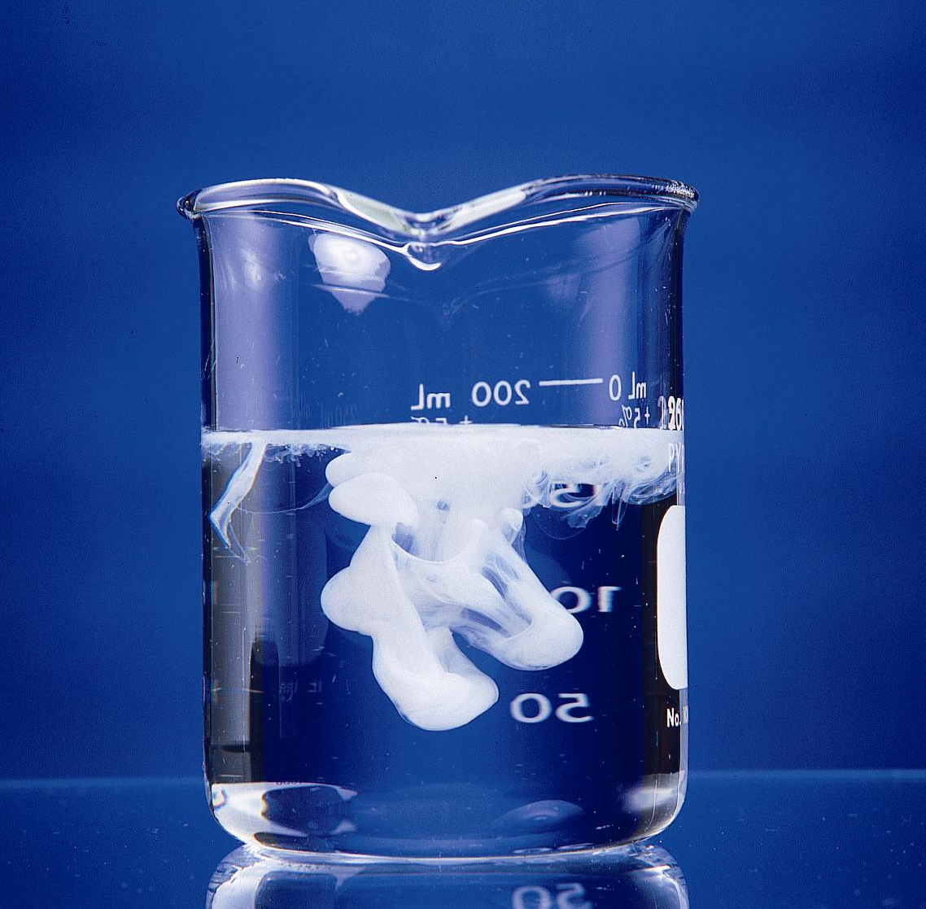
Formation of a solid AgCl
AgNO₃(aq) + KCl(aq) → KNO₃ (aq) + AgCl(s)

Slide 46
Single and Double Replacement Reactions
Single-replacement reaction
Mg + CuSO₄ → MgSO₄ + Cu
General form:
A + BC → AC + B
Double-replacement reaction
CaCO₃ + 2 HCl → CaCl₂ + H₂CO₃
General form:
AB + CD → AD + CB

Slide 47
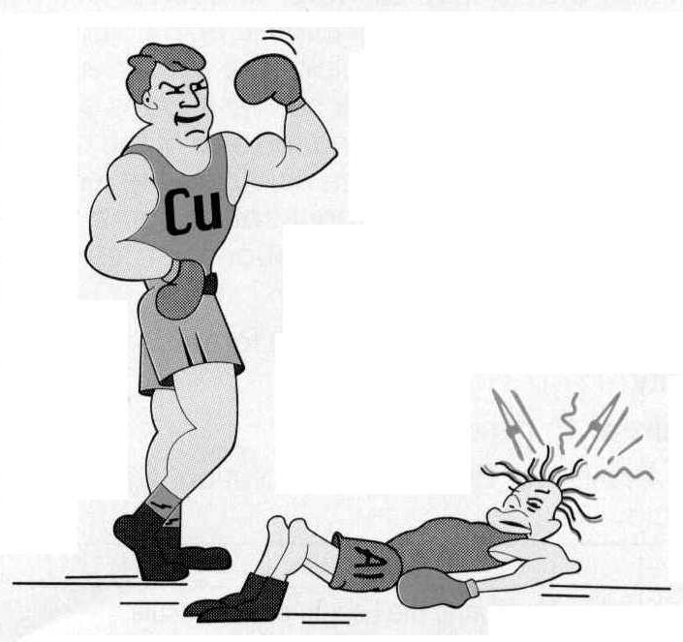
Activity Series
Element Reactivity
Li
Rb
K
Ba
Ca
Na
Mg
Al
Mn
Zn
Cr
Fe
Ni
Sn
Pb
H₂
Cu
Hg
Ag
Pt
Au
Foiled again –
Aluminum loses to Copper
Halogen Reactivity
F₂
Cl₂
Br₂
I₂

Slide 48
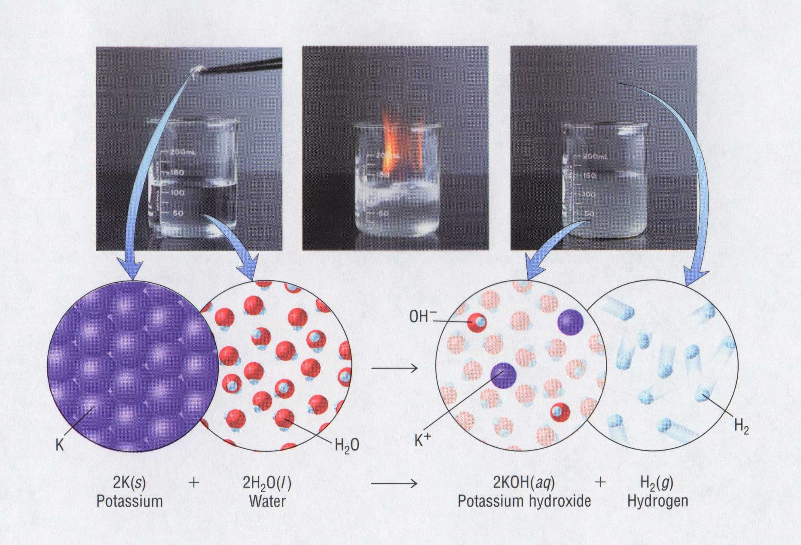
Potassium reacts with Water
P O W !

Slide 49
Double Replacement Reactions
AB + CD → CB + AD
Driving Forces

Slide 50
Single and Double Replacement Reactions
Single-replacement reaction
Mg + CuSO₄ → MgSO₄ + Cu
General form:
A + BC → AC + B
Double-replacement reaction
CaCO₃ + 2 HCl → CaCl₂ + H₂CO₃
General form:
AB + CD → AD + CB

Slide 51
Single and Double Replacement Reactions
Single-replacement reaction
Mg + CuSO₄ → MgSO₄ + Cu
General form:
A + BC → AC + B
Double-replacement reaction
CaCO₃ + 2 HCl → CaCl₂ + H₂CO₃
General form:
AB + CD → AD + CB

Slide 52
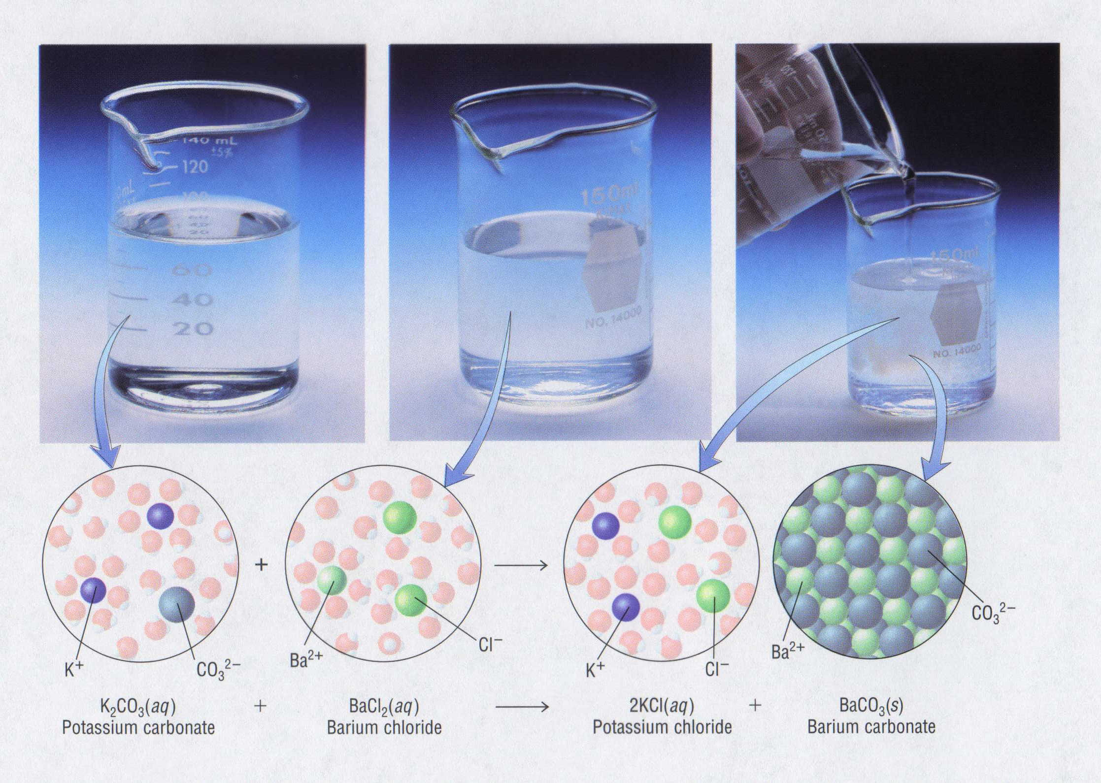
Double Replacement Reaction

Slide 53
Mole Island Diagram

Slide 54
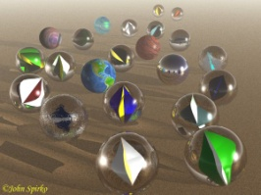
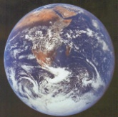
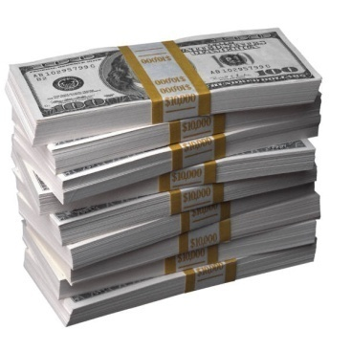
How Big is a Mole?
One mole of marbles would cover the entire Earth
(oceans included) for a depth of two miles.
One mole of $1 bills stacked
one on top of another would
reach from the Sun to Pluto
and back 7.5 million times.
It would take light 9500 years to travel from the bottom
to the top of a stack of 1 mole of $1 bills.

Slide 55

Amedeo
Avogadro
?
quadrillions
thousands
trillions
billions
millions
1 mole = 602213673600000000000000
or 6.022 x 10²³

Slide 56

Welcome to Mole Island
1 mol = molar mass
1 mole = 22.4 L
@ STP
1 mol =
6.02 x 10²³ particles

Slide 57

Stoichiometry Island Diagram
Known Unknown
Substance A Substance B
M
Mass
Mass Mountain
Mass
Mole Island
V
Volume
Mole
Mole
Volume
Liter Lagoon
Particles
Particles
P
Particle Place
Stoichiometry Island Diagram

Slide 58
Stoichiometry Island Diagram
Known Unknown
Substance A Substance B
Mass
Mass
1 mole = molar mass (g)
1 mole = molar mass (g)
Use coefficients
from balanced
chemical equation
Volume
1 mole = 22.4 L @ STP
Mole
Mole
Volume
1 mole = 22.4 L @ STP
(gases)
(gases)
1 mole = 6.022 x 10²³ particles
(atoms or molecules)
Particles
1 mole = 6.022 x 10²³ particles
(atoms or molecules)
Particles
Stoichiometry Island Diagram

Slide 59
Stoichiometry Island Diagram
Known Unknown
Substance A Substance B
M
Mass
Mass Mountain
Mass
V
Volume
Mole
Mole
Volume
Liter Lagoon
Particles
Particles
P
Particle Place
Stoichiometry Island Diagram

Slide 60
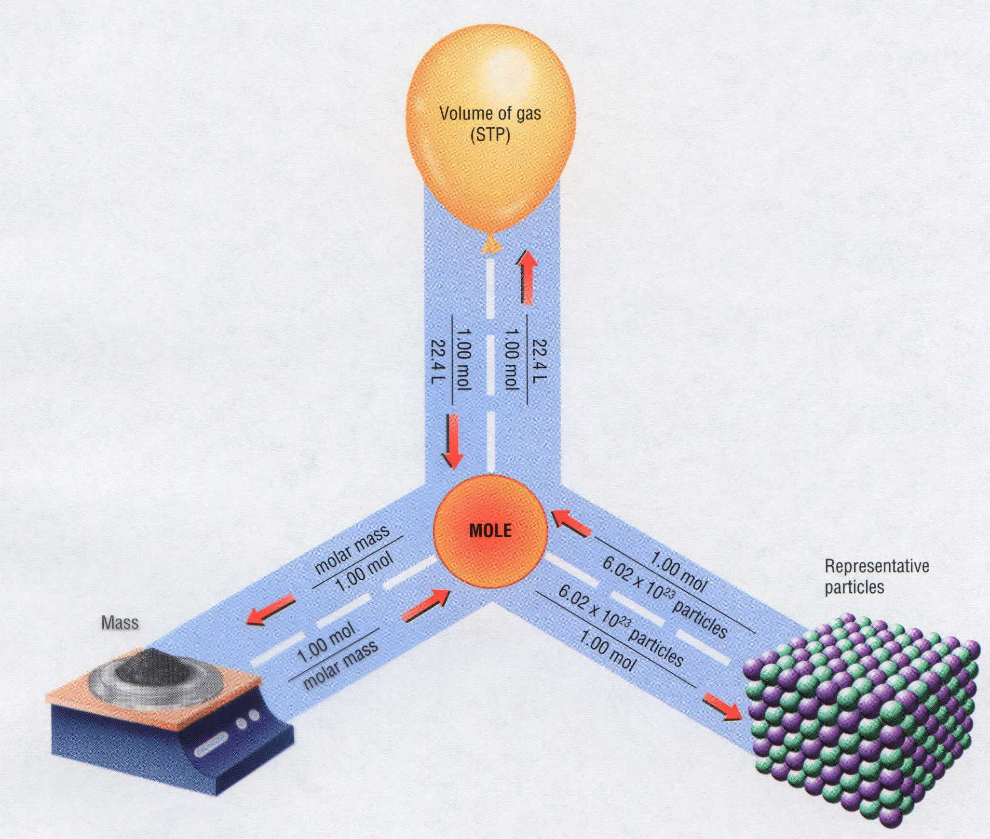
Mass, Volume, Mole Relationship

Slide 61
Mole Calculations
Notes:
Objectives:
To relate the moles of a substance to the number of particles.
To relate the mass of a substance to the number of particles.
To state the value for the molar volume of any gas at STP: 22.4 L/mol.
To relate the density of a gas at STP to its molar mass and volume.
To relate the volume of a gas at STP to its mass and number of particles.

Slide 62
Visualizing a Chemical Reaction
2
2
Na + Cl₂ NaCl
10
5
10
10
10
5
?
___ mole Na
___ mole Cl₂
___ mole NaCl

Slide 63
Visualizing a Chemical Reaction
2
2
Na + Cl₂ NaCl
10
5
10
___ mole Na
___ mole Cl₂
___ mole NaCl

Slide 64
Formation of Ammonia
N₂ (g)
+
3 H₂ (g)
2 NH₃ (g)
+
2 atoms N
+
6 atoms H
2 atoms N and
6 atoms H
1 molecule N₂
+
3 molecules H₂
2 molecules NH₃
10 molecule N₂
+
30 molecules H₂
20 molecules NH₃
1 x
6.02 x 10²³
molecules N₂
+
3 x
6.02 x 10²³
molecules H₂
2 x
6.02 x 10²³
molecules NH₃
1 mol N₂
+
3 mol H₂
2 mol NH₃
28 g N₂
+
3 x 2 g H₂
2 x 17 g NH₃
34 g reactants
34 g products
Assume
STP
22.4
L
+
22.4
L
22.4
L
22.4
L
22.4
L
22.4
L
22.4 L N₂
67.2 L H₂
44.8 L NH₃

Slide 65
Proportional Relationships
2 1/4 c. flour
1 tsp. baking soda
1 tsp. salt
1 c. butter
3/4 c. sugar
3/4 c. brown sugar
1 tsp vanilla extract
2 eggs
2 c. chocolate chips
Makes 5 dozen cookies.
I have 5 eggs. How many cookies can I make?
Ratio of eggs to cookies
5 eggs
5 doz.
2 eggs
150 cookies
= 12.5 dozen cookies
Courtesy Christy Johannesson www.nisd.net/communicationsarts/pages/chem

Slide 66
Proportional Relationships
Stoichiometry
  mass relationships between substances in a chemical reaction
  based on the mole ratio
Mole Ratio
  indicated by coefficients in a balanced equation
2 Mg + O₂ → 2 MgO
Courtesy Christy Johannesson www.nisd.net/communicationsarts/pages/chem
Notes:
A balanced chemical equation gives the identity of the reactants and products and the accurate number of molecules or moles of each that are consumed or produced.
Stoichiometry is a collective term for the quantitative relationships between the masses, numbers of moles, and numbers of particles (atoms, molecules, and ions) of the reactants and products in a balanced reaction.
A stoichiometric quantity is the amount of product or reactant specified by the coefficients in a balanced chemical equation.

Slide 67
Stoichiometry Steps
1. Write a balanced equation.
2. Identify known & unknown.
3. Line up conversion factors.
  Mole ratio - moles ↔ moles
  Molar mass - moles ↔ grams
  Molarity - moles ↔ liters soln
  Molar volume - moles ↔ liters gas
  Mole ratio - moles ↔ moles
Core step in all stoichiometry problems!!
4. Check answer.
Courtesy Christy Johannesson www.nisd.net/communicationsarts/pages/chem

Slide 68
Molar Volume at STP
1 mol of a gas=22.4 L
at STP
Standard Temperature & Pressure
0°C and 1 atm
Courtesy Christy Johannesson www.nisd.net/communicationsarts/pages/chem

Slide 69
Molar Volume at STP
LITERS
OF GAS
AT STP
Molar Volume
(22.4 L/mol)
MASS
IN
GRAMS
MOLES
NUMBER
OF
PARTICLES
Molar Mass
(g/mol)
6.02 × 10²³
particles/mol
Molarity (mol/L)
LITERS
OF
SOLUTION
Courtesy Christy Johannesson www.nisd.net/communicationsarts/pages/chem

Slide 70
Stoichiometry Problems
How many moles of KClO₃ must decompose in order to produce 9 moles of oxygen gas?
2KClO₃ → 2KCl + 3O₂
? mol
9 mol
9 mol O₂
2 mol KClO₃
3 mol O₂
= 6 mol KClO₃
Courtesy Christy Johannesson www.nisd.net/communicationsarts/pages/chem

Slide 71
How many moles of KClO₃ must decompose in order to produce 9 moles of oxygen gas?
2KClO₃ → 2KCl + 3O₂
? mol
9 mol
9 mol O₂
2 mol KClO₃
3 mol O₂
= 6 mol KClO₃
x mol KClO₃ = 9 mol O₂
2 mol KClO₃
6 mol
3 mol O₂
= 6 mol KClO₃
O₂
KClO₃
Courtesy Christy Johannesson www.nisd.net/communicationsarts/pages/chem

Slide 72
Stoichiometry Problems
How many grams of KClO₃ are required to produce 9.00 L of O₂ at STP?
2KClO₃ → 2KCl + 3O₂
? g
9.00 L
9.00 L
O₂
1 mol
O₂
22.4 L
O₂
2 mol
KClO₃
3 mol
O₂
122.55
g KClO₃
1 mol
KClO₃
= 32.8 g
KClO₃
Courtesy Christy Johannesson www.nisd.net/communicationsarts/pages/chem

Slide 73
Stoichiometry Problems
How many grams of KClO₃ are required to produce 9.00 L of O₂ at STP?
2KClO₃ → 2KCl + 3O₂
? g
9.00 L
1 mol O₂
2 mol KClO₃
122.55 g KClO₃
32.8 g
x g KClO₃ = 9.00 L O₂
3 mol O₂
1 mol KClO₃
= 32.8 g KClO₃
22.4 L O₂
O₂
KClO₃
Courtesy Christy Johannesson www.nisd.net/communicationsarts/pages/chem

Slide 74
How many grams of KClO₃ are required to produce 9.00 L of O₂ at STP?
2KClO₃ → 2KCl + 3O₂
? g
9.00 L
9.00 L
O₂
1 mol
O₂
22.4 L
O₂
2 mol
KClO₃
3 mol
O₂
122.55
g KClO₃
1 mol
KClO₃
= 32.8 g
KClO₃
1 mol O₂
2 mol KClO₃
122.55 g KClO₃
32.8 g
x g KClO₃ = 9.00 L O₂
3 mol O₂
1 mol KClO₃
= 32.8 g KClO₃
22.4 L O₂
O₂
KClO₃
Courtesy Christy Johannesson www.nisd.net/communicationsarts/pages/chem

Slide 75
How many grams of silver will be formed from 12.0 g copper?
Cu + 2 AgNO₃ → 2 Ag + Cu(NO₃)₂
12.0 g
? g
12.0
g Cu
1 mol
Cu
63.55
g Cu
2 mol
Ag
1 mol
Cu
107.87
g Ag
1 mol
Ag
= 40.7 g
Ag
1 mol Cu
2 mol Ag
107.87 g Ag
40.7 g
x g Ag = 12.0 g Cu
1 mol Cu
1 mol Ag
= 40.7 g Ag
63.55 g Cu
Cu
Ag
Courtesy Christy Johannesson www.nisd.net/communicationsarts/pages/chem

Slide 76
Mole Calculations
A graduated cylinder holds 25.4 cm³ of mercury. If the density of mercury
at 25 ºC is 13.534 g / cm³, how many moles of mercury are in the cylinder?
How many atoms of mercury are there?
HINT: Volume of solids/liquids and moles are not directly connected. You must first use the density to
convert the volume to a mass, and then derive the quantity of mercury, in moles, from the mass.
Finally, the number of atoms is obtained from the number of moles.
g
cm³
mol
g
atoms
mol
x
x
x
Volume, cm³
Mass, g
Moles
Atoms
use density
use
molar mass
use
Avogadro’s
number
Kotz & Treichel, Chemistry & Chemical Reactivity, 3rd Edition , 1996, page 93

Slide 77
A
B
C
g
cm³
mol
g
atoms
mol
x
x
x
Volume, cm³
Mass, g
Moles
Atoms
use density
use
molar mass
use
Avogadro’s
number
A
Therefore, the mass of mercury is found to be equivalent to 344 g of mercury.
25.4 cm³ Hg
. 13.534 g Hg
1 cm³ Hg
=
344 g Hg
344 g Hg
B
Knowing the mass, you can now find the quantity in moles.
344 g Hg
. 1 mol Hg .
200.6 g Hg
=
1.71 mol Hg
1.71 mol Hg
C
Finally, because you know the relation between atoms and moles (Avogodro’s
number), you can now find the number of atoms in the sample.
A graduated cylinder holds 25.4 cm³ of mercury. If the density of mercury
at 25 ºC is 13.534 g / cm³, how many moles of mercury are in the cylinder?
How many atoms of mercury are there?
1.71 mol Hg
. 6.02 x 10²³ atoms Hg .
1 mol Hg
=
1.03 x 10²⁴ atoms Hg
Kotz & Treichel, Chemistry & Chemical Reactivity, 3rd Edition , 1996, page 93

Slide 78
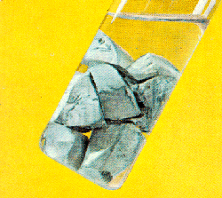
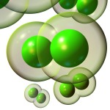
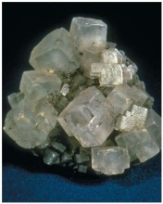
2 Na + Cl₂ 2 NaCl
100 g
x L
x g
W R O N G
2 grams 1 gram 2 grams
Violates Law of Conservation of Matter
1 mol Na
1 mol Cl₂
22.4 L Cl₂
2 atoms 1 molecule 2 molecules*
x L Cl₂ = 100 g Na
= 49 L Cl₂
23 g Na
2 mol Na
1 mol Cl₂
48.69 L
Na
Cl₂
2 moles 1 mole 2 moles
Right side of room…calculate how many grams of NaCl will be produced from 100 g of Na.
x g NaCl = 100 g Na
1 mol Na
2 mol NaCl
58.5 g NaCl
23 g Na
2 mol Na
1 mol NaCl
= 254 g NaCl
Na
NaCl
Left side of room…calculate how many grams of NaCl will be produced from 48.69 L of Cl₂.
x g NaCl = 48.69 L Cl₂
1 mol Cl₂
2 mol NaCl
58.5 g NaCl
22.4 L Cl₂
1 mol Cl₂
1 mol NaCl
= 254 g NaCl
Cl₂
NaCl
*Better name would be “formula unit”
Notes:
http://nobel.scas.bcit.ca/resource/ptable/ptblegif/na.gif
http://www.rkm.com.au/imagelibrary/thumbnails/CHLORINE-Cl2-2-150.jpg
http://www.scienceclarified.com/images/uesc_03_img0170.jpg

Slide 79
Stoichiometry
2
KClO₃
2
KCl
+ O₂
3
500 g
x g
x L
(196 g)
x L O₂ = 500 g KClO₃
1 mol KClO₃
3 mol O₂
22.4 L O₂
= 137 L O₂
122.5 g KClO₃
2 mol KClO₃
1 mol O₂
137 L
KClO₃
O₂
x g O₂ = 137 L O₂
1 mol O₂
32 g O₂
22.4 L O₂
1 mol O₂
= 196 g O₂
x g KCl = 500 g KClO₃
1 mol KClO₃
2 mol KCl
74.5 g KCl
= 304 g KCl
122.5 g KClO₃
2 mol KClO₃
1 mol KCl
(304 g)
KClO₃
KCl

Slide 80
Stoichiometry
2 TiO₂ + 4 Cl₂ + 3 C
CO₂ + 2 CO + 2 TiCl₄
115 g
x mol
4.55 mol
x molecules
x g
How many moles of chlorine will react with 4.55 moles of carbon?
x mol Cl₂ = 4.55 mol C
4 mol Cl₂
3 mol C
= 6.07 mol C
C
Cl₂
How many grams of titanium (IV) oxide will react with 4.55 moles of carbon?
x g TiO₂ = 4.55 mol C
2 mol TiO₂
80 g TiO₂
3 mol C
1 mol TiO₂
= 243 g TiO₂
C
TiO₂
How many molecules of TiCl₄ will react with 115 g TiO₂?
x molecules TiCl₄ = 115 g TiO₂
1 mol TiO₂
2 mol TiCl₄
6.02x10²³ molecules TiCl₄
80 g TiO₂
2 mol TiO₂
1 mol TiCl₄
= 8.66x10²³ molecules TiCl₄
TiO₂
TiCl₄

Slide 81
Stoichiometry Problems 1
Stoichiometry Problems 1
Stoichiometry Problems 1
Keys

Slide 82
Which has more atoms:
30 g aluminum metal or 18 mL distilled water?
How many atoms of aluminum are in 30 g of aluminum?
x atoms Al = 30 g Al
1 mol Al
6.02x10²³ atoms Al
= 6.69x10²³ atoms Al
27 g Al
1 mol Al
Al
x atoms Al = 30 g Al
6.02x10²³ atoms Al
= 6.69x10²³ atoms Al
27 g Al
Al
How many atoms are in 18 mL of water?
W R O N G
H₂O
3 atoms
6.02x10²³ atoms H₂O
1 L H₂O
1 mol H₂O
6.02x10²³ molecules H₂O
x atoms = 18 mL H₂O
22.4 L H₂O
1 mol H₂O
1 molecule H₂O
1000 mL H₂O
LITERS is ONLY used for GASES @ STP
= 1.45x10²¹ atoms
How many atoms are in 18 mL of water?
x atoms = 18 mL H₂O
1 g H₂O
1 mol H₂O
6.02x10²³ molecules H₂O
3 atoms
1 mL H₂O
18 g H₂O
1 moL H₂O
1 molecule H₂O
Recall, density of water
= 1.81x10²⁴ atoms

Slide 83
Limiting Reactants
Caution: this stuff is difficult to follow at first.
Be patient.

Slide 84




Limiting Reactants
+
plus 16 tires
excess
8 car bodies
48 tires
8 cars
CB + 4 T CT₄
Notes:
http://www.brettschmidt.com/3d_images/garage/samples/car_body.jpg

Slide 85
Limiting Reactants
Methane, CH₄
+
plus 8
hydrogen
molecules
excess
plus 16
hydrogen
atoms
excess
8 carbon
atoms
24 hydrogen
molecules
8 methane
molecules
C + 2 H₂ CH₄
Notes:
http://www.brettschmidt.com/3d_images/garage/samples/car_body.jpg

Slide 86
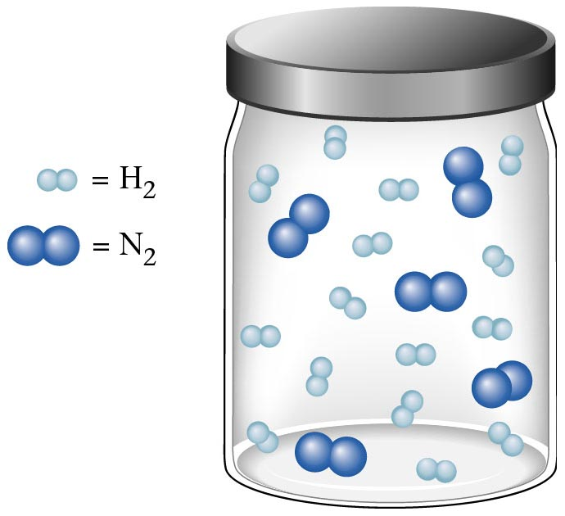
Container 1
Zumdahl, Zumdahl, DeCoste, World of Chemistry 2002, page 269

Slide 87
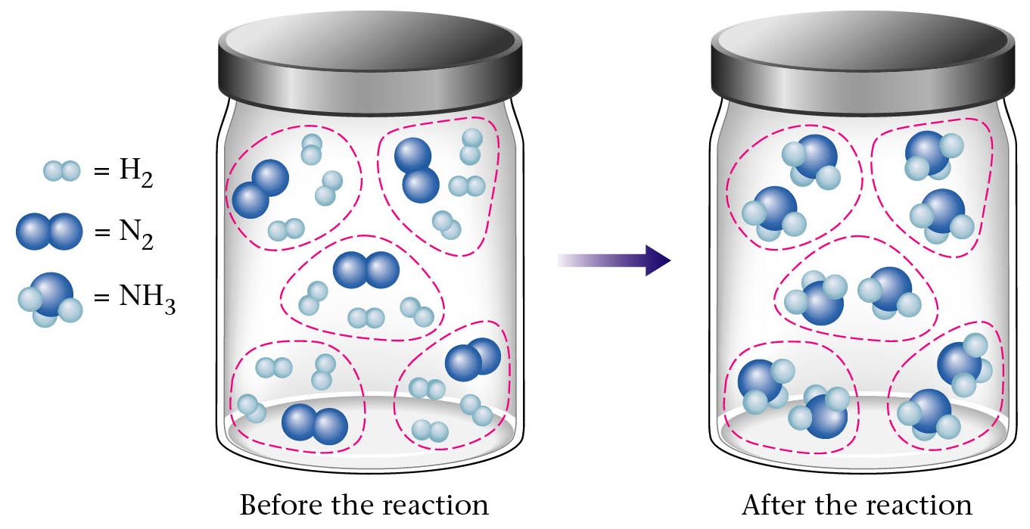
Before and After Reaction 1
2
N₂ + H₂ NH₃
3
Before the reaction
After the reaction
All the hydrogen and nitrogen atoms combine.
Zumdahl, Zumdahl, DeCoste, World of Chemistry 2002, page 269

Slide 88
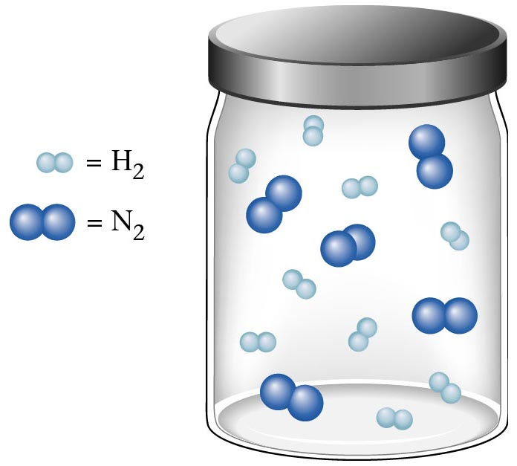
Container 2
Zumdahl, Zumdahl, DeCoste, World of Chemistry 2002, page 270

Slide 89
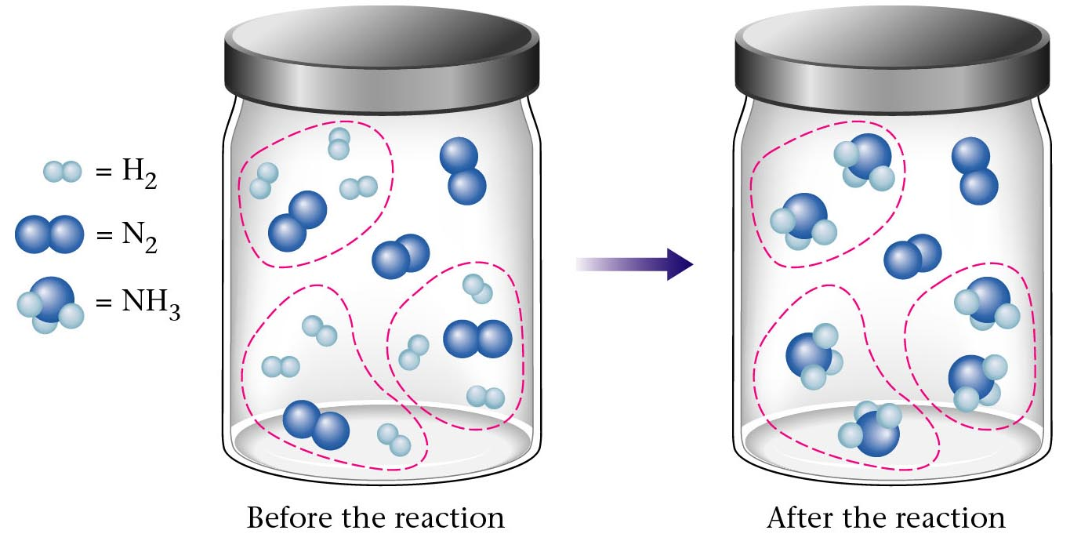
Before and After Reaction 2
2
N₂ + H₂ NH₃
3
excess
limiting
Before the reaction
After the reaction
LIMITING REACTANT DETERMINES AMOUNT OF PRODUCT
Zumdahl, Zumdahl, DeCoste, World of Chemistry 2002, page 270

Slide 90
Real-World Stoichiometry:
Limiting Reactants
Fe + S FeS
Ideal
Stoichiometry
Limiting
Reactants
S =
Fe =
excess
LeMay Jr, Beall, Robblee, Brower, Chemistry Connections to Our Changing World , 1996, page 366

Slide 91

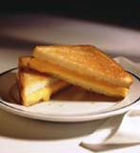
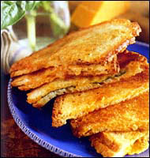
Grilled Cheese Sandwich
Bread + Cheese → ‘Cheese Melt’
2 B + C → B₂C
100 bread
30 slices
30 sandwiches
? sandwiches
Multiple Guess:
130 sandwiches
100 sandwiches
90 sandwiches
60 sandwiches
30 sandwiches
Not enough information given

Slide 92
Limiting Reactants
Available Ingredients
  4 slices of bread
  1 jar of peanut butter
  1/2 jar of jelly
Limiting Reactant
  bread
Excess Reactants
  peanut butter and jelly
Courtesy Christy Johannesson www.nisd.net/communicationsarts/pages/chem

Slide 93
Limiting Reactants
Limiting Reactant
  used up in a reaction
  determines the amount of product
Excess Reactant
  added to ensure that the other reactant is completely used up
  cheaper & easier to recycle
Courtesy Christy Johannesson www.nisd.net/communicationsarts/pages/chem
Notes:
If one or more of the reactants is not used up completely but is left over when the reaction is completed, then the amount of product that can be obtained is limited by the amount of only one of the reactants
A limiting reactant is the reactant that restricts the amount of product obtained. The reactant that remains after a reaction has gone to completion is present in excess.

Slide 94
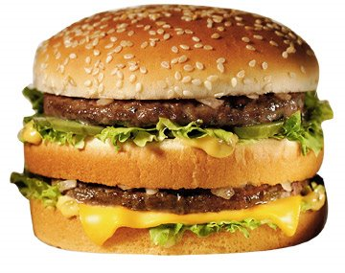
The Limiting Reactant
A balanced equation for making a Big Mac® might be:
3 B + 2 M + EE B₃M₂EE
With… | …and… | …one can make…
excess B and
excess EE
30 M
15 B₃M₂EE
excess M and
excess EE
30 B
10 B₃M₂EE
30 B and
excess EE
30 M
10 B₃M₂EE

Slide 95
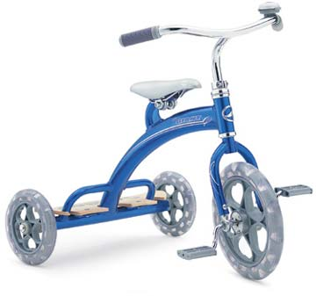
The Limiting Reactant
A balanced equation for making a tricycle might be:
3 W + 2 P + S + H + F W₃P₂SHF
With… | …and… | …one can make…
50 P
excess of all
other reactants
25 W₃P₂SHF
50 S
excess of all
other reactants
50 W₃P₂SHF
50 S and
excess of all
other reactants
50 P
25 W₃P₂SHF

Slide 96

Limiting Reactants
aluminum + chlorine gas → aluminum chloride
Al(s) + Cl₂(g) → AlCl₃
2 Al(s) + 3 Cl₂(g) → 2 AlCl₃
100 g 100 g ? g
A. 200 g B. 125 g C. 667 g D. 494 g

Slide 97
Limiting Reactants
aluminum + chlorine gas → aluminum chloride
2 Al(s) + 3 Cl₂(g) → 2 AlCl₃
100 g 100 g x g
How much product would be made if we begin with 100 g of aluminum?
x g AlCl₃ = 100 g Al
1 mol Al
2 mol AlCl₃
133.5 g AlCl₃
27 g Al
2 mol Al
1 mol AlCl₃
= 494 g AlCl₃
Al
AlCl₃
How much product would be made if we begin with 100 g of chlorine gas?
x g AlCl₃ = 100 g Cl₂
1 mol Cl₂
2 mol AlCl₃
133.5 g AlCl₃
71 g Cl₂
3 mol Cl₂
1 mol AlCl₃
= 125 g AlCl₃
Cl₂
AlCl₃

Slide 98
Limiting Reactants – Method 1
1. Write a balanced equation.
2. For each reactant, calculate the amount of product formed.
3. Smaller answer indicates:
  limiting reactant
  amount of product
Courtesy Christy Johannesson www.nisd.net/communicationsarts/pages/chem

Slide 99
Limiting Reactants – Method 2
Begin by writing a correctly balanced chemical equation
Write down all quantitative values under equation (include units)
Convert ALL reactants to units of moles
Divide by the coefficient in front of each reactant
The smallest value is the limiting reactant!

Slide 100
Stoichiometry Problems 2
Stoichiometry Problems 2
Stoichiometry Problems 2
Keys

Slide 101
Generic Stoichiometry

Slide 102
Generic Stoichiometry
Z (aq) + 2 Y (aq) → 5 M (s) + T₂ (g)
Given the following information:
Z = 20 g/mol
Y = 10 g/mol
M = 6 g/mol
T = 5 g/mol
If you combine 100 g of solution Z with 1.8 x 10²⁴ molecules of solution Y:
How many moles of M will precipitate out of the solution?
What volume of T₂ gas will be produced at STP?

Slide 103
EXCESS
LIMITING
Z (aq) + 2 Y (aq) → 5 M (s) + T ₂(g)
100 g 1.8 x 10²⁴ molecules
x mol
7.5 mol M
33.6 L T₂
/ 20 g /mol
/ 6.02 x 10²³ molecules/mol
2
3 mol Y
5
x mol M
=
x 22.4L/mol
2 : 5
15 = 2x
HAVE
5 mol Z
3 mol Y
Easy
x = 7.5 mol
1
2
2 : 1
1.5 mol T₂
NEED
1.5 mol Z
10 mol Y
5 mol
1.5 mol
LIMITING
SMALLER Number is LIMITING Reactant
EXCESS
x mol M = 1.8 x 10²⁴ molecules Y
1 mol Y
5 mol M
6.02 x 10²³ molecules Y
2 mol Y
= 7.5 mol M
x L T₂ = 3 mol Y
1 mol T₂
22.4 L T₂
2 mol Y
1 mol T₂
= 33.6 L T₂

Slide 104
Z (aq) + 2 Y (aq) → 5 M (s) + T ₂(g)
1.8 x 10²⁴ molecules
x mol
3 mol Y
x mol M = 3 mol Y
5 mol M
2 mol Y
= 7.5 mol M
Y
M

Slide 105
Real Life Stoichiometry

Slide 106



Stoichiometry in the Real World

Slide 107
Air Bag Design
Exact quantity of nitrogen gas must be produced in an instant.
Use a catalyst to speed up the reaction
2 NaN₃(s) → 2 Na(s) + 3 N₂(g)
6 Na(s) + Fe₂O₃(s) → 3 Na₂O(s) + 2 Fe (s)

Slide 108
Airbag Design
2 NaN₃(s) → 2 Na(s) + 3 N₂(g)
6 Na(s) + Fe₂O₃(s) → 3 Na₂O(s) + 2 Fe(s)
Assume that 65.1 L of N₂ gas are needed to inflate an air bag to the
proper size. How many grams of NaN₃ must be included in the gas
generant to generate this amount of N₂?
(Hint: The density of N₂ gas at this temperature is about 0.916 g/L).
65.1 L N₂
x 0.916 g/L N₂
1 mol N₂
2 mol NaN₃
65 g NaN₃
x g NaN₃ = 59.6 g N₂
28 g N₂
3 mol N₂
1 mol NaN₃
59.6 g N₂
X = 92.2 g NaN₃
How much Fe₂O₃ must be added to the gas generant for this amount of NaN₃?
1 mol NaN₃
2 mol Na
1 mol Fe₂O₃
159.6 g Fe₂O₃
x g Fe₂O₃ = 92.2 g NaN₃
65 g NaN₃
2 mol NaN₃
6 mol Na
1 mol Fe₂O₃
X = 37.7 g Fe₂O₃

Slide 109

Water from a Camel
Camels store the fat tristearin (C₅₇H₁₁₀O₆) in the hump. As well as
being a source of energy, the fat is a source of water, because when
it is used the reaction
takes place.
2 C₅₇H₁₁₀O₆(s) + 163 O₂(g) → 114 CO₂(g) + 110 H₂O(l)
What mass of water can be made from 1.0 kg of fat?
1000 g “fat”
1 mol “fat”
110 mol H₂O
18 g H₂O
x g H₂O = 1 kg ‘fat”
1 kg “fat”
890 g “fat”
2 mol “fat”
1 mol H₂O
X = 1112 g H₂O
or 1.112 liters water

Slide 110


Rocket Fuel
The compound diborane (B₂H₆) was at one time
considered for use as a rocket fuel. How many grams
of liquid oxygen would a rocket have to carry to burn
10 kg of diborane completely?
(The products are B₂O₃ and H₂O).
Chemical equation
B₂H₆ + O₂
B₂O₃ + H₂O
Balanced chemical equation
B₂H₆ + O₂ B₂O₃ + H₂O
3
3
10 kg x g
1000 g B₂H₆
1 mol B₂H₆
3 mol O₂
32 g O₂
x g O₂ = 10 kg B₂H₆
1 kg B₂H₆
28 g B₂H₆
1 mol B₂H₆
1 mol O₂
X = 34,286 g O₂

Slide 111

Water in Space
Click
Here
In the space shuttle, the CO₂ that the crew exhales is removed from the
air by a reaction within canisters of lithium hydroxide. On average, each
astronaut exhales about 20.0 mol of CO₂ daily. What volume of water will
be produced when this amount of CO₂ reacts with an excess of LiOH?
(Hint: The density of water is about 1.00 g/mL.)
CO₂(g) + 2 LiOH(s) → Li₂CO₃(aq) + H₂O(l)
20.0 mol
excess
x g
Water is NOT at STP!
1 mol H₂O
18 g H₂O
22.4 L H₂O
1 mL H₂O
x mL H₂O = 20.0 mol CO₂
1 mol CO₂
1 mol H₂O
1 g H₂O
X = 360 mL H₂O

Slide 112


Lithium Hydroxide Scrubber
Modified by Apollo 13 Mission
Astronaut John L. Swigert holds the
jury-rigged lithium hydroxide scrubber
used to remove excess carbon dioxide
from the damaged Apollo 13 spacecraft.
Notes:
http://images.google.com/imgres?imgurl=http://www.space1.com/Artifacts/Apollo_Artifacts/LiOH_Canister/apollo_13_photo2_600.jpg&imgrefurl=http://www.space1.com/Artifacts/Apollo_Artifacts/LiOH_Canister/lioh_canister.html&h=609&w=600&sz=99&hl=en&start=7&tbnid=IN4zfhqzwnHKYM:&tbnh=136&tbnw=134&prev=/images%3Fq%3DApollo%2B%2B13%2Blithium%2Bhydroxide%2Bscrubber%26gbv%3D2%26svnum%3D10%26hl%3Den
http://www.spurgeonworld.com/blog/images/as13-62-9004.jpg
Interior view of the Apollo 13 Lunar Module (LM) as the astronauts jerry-rig a system to use the Command Module lithium hydroxide canisters to purge carbon dioxide from the LM. Photo: NASA/JSC

Slide 113
Water in Space
In the space shuttle, the CO₂ that the crew exhales is removed from the
air by a reaction within canisters of lithium hydroxide. On average, each
astronaut exhales about 20.0 mol of CO₂ daily. What volume of water will
be produced when this amount of CO₂ reacts with an excess of LiOH?
(Hint: The density of water is about 1.00 g/mL.)
CO₂(g) + 2 LiOH(s) → Li₂CO₃(aq) + H₂O(l)
20.0 mol
excess
x g
Water is NOT at STP!
1 mol H₂O
18 g H₂O
22.4 L H₂O
1 mL H₂O
x mL H₂O = 20.0 mol CO₂
1 mol CO₂
1 mol H₂O
1 g H₂O
X = 360 mL H₂O

Slide 114

Real Life Problem Solving
Determine the amount of LiOH required for a seven-day mission in space
for three astronauts and one ‘happy’ chimpanzee. Assume each passenger
expels 20 mol of CO₂ per day.
Note: The lithium hydroxide scrubbers are only 85% efficient.
(4 passengers) x (10 days) x (20 mol/day) = 800 mol CO₂
Plan for a delay
CO₂(g) + 2 LiOH(s) → Li₂CO₃(aq) + H₂O(l)
800 mol X g
Notes:
http://www.nasa.gov/images/content/64569main_ffs_gallery_mcc_image3.jpg

Slide 115
CO₂(g) + 2 LiOH(s) → Li₂CO₃(aq) + H₂O(l)
800 mol
38,240 g
x g
x 23.9 g/mol
800 mol
1:2
1600 mol
Needed
(actual yield)
2 mol LiOH
23.9 g LiOH
X g LiOH = 800 mol CO₂
= 38,240 g LiOH
1 mol CO₂
1 mol LiOH
Note: The lithium hydroxide scrubbers are only 85% efficient.
Actual Yield
Theoretical Yield
38,240 g LiOH
% Yield =
0.85
=
x g LiOH
Amount of LiOH to
be taken into space
x = 44,988 g LiOH

Slide 116
Careers in Chemistry: Farming
Farming is big business in the United States with profits for the lucky and
possible bankruptcy for the less fortunate. Farmers should not be ignorant of
chemistry. For instance, to be profitable, a farmer must know when to plant,
harvest, and sell his/her crops to maximize profit. In order to get the greatest
yield farmers often add fertilizers to the soil to replenish vital nutrients removed
by the previous season’s crop.
Corn is one product that removes a tremendous amount of phosphorous
from the soil. For this reason, farmers will rotate crops and/or add fertilizer to
the ground before planting crops for the following year. On average, an acre
of corn will remove 6 kilograms of phosphorous from the ground.
Assume you inherit a farm and must now have to purchase fertilizer for the
farm. The farm is 340 acres and had corn planted the previous year. You must
add fertilizer to the soil before you plant this years’ crop. You go to the local
fertilizer store and find SuperPhosphateTM brand fertilizer. You read the fertilizer
bag and can recognize from your high school chemistry class a molecular formula Ca₃P₂H₁₄S₂O₂₁ (you don’t understand anything else written on the bag because it
is imported fertilizer from Japan). You must decide how much fertilizer to buy for application to your corn fields. If each bag costs $54.73; how many bags of
fertilizer must you purchase and how much will it cost you to add the necessary fertilizer to your fields?
Given: 1 bag of fertilizer weighs 10,000 g [454 g = 1 pound]

Slide 117



Careers in Chemistry: Farming
How much fertilizer will you need?
Conversion Factor: 1 acre corn = 6 kg phosphorous
If a bag of fertilizer has the formula Ca₃P₂H₁₄S₂O₂₁,
The molar mass of it is 596 g/mol.
3 Ca @ 40g/mol = 120 g
2 P@ 31 g/mol = 62 g
14 H@ 1 g/mol = 14 g
2 S@ 32 g/mol = 64 g
21 O @ 16 g/mol = 335 g
Ca₃P₂H₁₄S₂O₂₁
In a bag of fertilizer you have 10.4 % (by mass) phosphorous.
A bag of fertilizer weighs 10,000 g (about 22 pounds).
10.4 % of 10,000 g =
2.04 x 10⁶ g P
1040 g/bag
Total Cost
x g P = 340 acres
6 kg P
1000 g P
=
2.04 x 10⁶ g P
1 acre
1 kg P
part
62 g
x 100
%
% P =
whole
596 g
10.4 % Phosphorous
= 596 g
1040 g phosphorous / bag of fertilizer
= 1962 bags of fertilizer
(1962 bags of fertilizer)($54.73 / bag) =
$107,380
Notes:
http://www.wylie-caseih.com/images/NEW2004/DMI/NutriPlacr_2800_7.jpg
http://www.greenprolawncare.com/art/yard-picture.jpg
http://www.oh.nrcs.usda.gov/programs/Lake_Erie_Buffer/images/grass_fs_wise2.jpg

Slide 118
Careers in Chemistry: Dentistry
We learned that fluoride is an essential element to be taken to reduce
teeth cavities. Too much fluoride can produce yellow spots on the teeth
and too little will have no effect. After years of study it was determined
that a quantity of 1 part per million (ppm) fluoride in the water supply is
enough to significantly reduce cavities and not stain teeth yellow.
Measure the mass of the mineral fluorite (chemically, CaF₂). Use this
sample to determine how much water must be added to yield a 1 ppm
fluoride solution. Sounds difficult? Lets apply what we’ve learned this
unit to solve this problem.
1 part per million = 1 atom of fluorine per 999,999 water molecules
What information do we know:
  1 mol CaF₂ = 78.08 g CaF₂ = 6.02 x 10²³ molecules of CaF₂
  1 molecules of CaF₂ = 2 atoms of F
  1 mol H₂O = 18 g H₂O Density of water is 1 g/mL
  1000 mL = 1 L and 3.78 L = 1 gallon
  mass of sample of CaF₂ = 92.135 g

Slide 119


Careers in Chemistry: Dentistry
Calcium Fluoride
x atoms F = 92.135 g CaF₂
1 mol CaF₂
6.02 x 10²³ molecules CaF₂
2 atoms F
=
1.42 x 10²⁴ atoms F
78 g CaF₂
1 mol CaF₂
1 molecules CaF₂
x gallons H₂O = 1.42 x 10²⁴ F atoms
999,999 H₂O molecules
1 mol H₂O
18 g H₂O
1 mL H₂O
1 L H₂O
1 gallon H₂O
=
1 F atom
6.02 x 10²³ H₂O molecules
1 mol H₂O
1 g H₂O
1000 mL H₂O
3.78 L H₂O
Need 11,238 gallons of water needed to dissolve 91.235 g CaF₂ to yield a 1 ppm F¹⁻ solution.

Slide 120
Energy with Stoichiometry
Energy with Stoichiometry
Energy with Stoichiometry
Keys

Slide 121
Energy with Stoichiometry
350 kJ
Given: 1 mol O₂ yields 350 kJ
?
methane
+
oxygen
carbon dioxide
+
water
+
energy
Excess
Limiting
CH₄
+
2
O₂
CO₂
+
2
H₂O
+
700 kJ
100 g
100 g
? kJ
/ 16 g/mol
/ 32 g/mol
700 kJ
x kJ = 3.125 mol O₂
=
1094 kJ
2 mol O₂
6.25 mol CH₄
3.125 mol O₂
1
2
6.25
1.56
smaller number
is limiting reactant

Slide 122
Excess Reactant

Slide 124
Visualizing Limiting Reactant
H₂ + O₂ H₂O
2
2
2.5
1.5
4.5
7
3.5
1
1
5
5
8
3
0
0
4
8
3
2
6
4
2
4
2
6
3
5
7
1
___ mole H₂
___ mole O₂
___ mole H₂O
Limiting Reactant
Excess
Limiting reactant determines amount of product.

Slide 125
Visualizing Limiting Reactant
H₂ + O₂ H₂O
2
2
2.5
1.5
4.5
7
3.5
1
1
5
5
8
3
0
0
4
8
3
2
6
4
2
4
2
6
3
5
7
1
___ mole H₂
___ mole O₂
___ mole H₂O
Limiting Reactant
Excess
Limiting reactant determines amount of product.

Slide 126
Moles and Mass Relationships
Moles and Mass Relationships
Visualizing the Limiting Reactant
Keys

Slide 127
Visualizing the Limiting Reactants
Visualizing the Limiting Reactant
Visualizing the Limiting Reactant
Keys

Slide 128

Key
Chemistry: Visualizing the Limiting Reactant
Use the balanced chemical equation 2 H₂(g) + O₂(g) 2 H₂O(g) for all the problems on this sheet.
Directions: Assuming that each molecule shown in the first two containers represents one mole of that
substance, write the correct number of moles of substance s below the containers. Then, assume
that the contents of the first two containers are combined in the third container. In the third
container, draw the correct number of moles of water produced.
1.
6 mol H₂(g) 3 mol O₂(g) 6 mol H₂O(g)
2.
8 mol H₂(g) 4 mol O₂(g) 8 mol H₂O(g)
Notice: Ratio is the same in both…
2 mol H₂(g) + 1 mol O₂(g) 2 mol H₂O(g)

Slide 129
Key
In the questions above, all the H₂ and O₂ reacted. In most reactions, though, the reactants DO NOT combine perfectly;
one reactant will be used up before the other; there is too much of one and not enough of the other. The reactant used
up first is called the limiting reactant, the other(s) is/are called the excess reactant(s).
Directions cont: For each question below, write the number of moles of substances beneath the corresponding
containers. In the third container, draw in the correct number of moles of water produced and any unreacted,
excess reactant that is left over. To the right of each question, write the limiting and excess reactant.
limiting reactant = H₂
excess reactant = O₂
6 mol H₂(g) 4 mol O₂(g) 6 mol H₂O(g) + 1 mol O₂ left over
3.
limiting reactant = H₂
excess reactant = O₂
2 mol H₂(g) 3 mol O₂(g) 2 mol H₂O(g) + 2 mol O₂ left over
4.

Slide 130
Excess Reactant
2 Na + Cl₂ → 2 NaCl
81.9 g NaCl
50 g 50 g x g
/ 23 g/mol
/ 71 g/mol
x 58.5 g/mol
1 : 2
1.40 mol
“Have”
2.17 mol
0.70 mol
coefficients
“Need”
1.40 mol
EXCESS
LIMITING

Slide 131
Excess Reactant (continued)
excess
limiting
2 Na + Cl₂ → 2 NaCl
81.9 g NaCl
50 g 50 g x g
All the chlorine is used up…
81.9 g NaCl
50.0 g Cl₂
31.9 g
Na is consumed in reaction.
How much Na is unreacted?
50.0 g - 31.9 g =
18.1 g Na
total used “excess”

Slide 132
Conservation of Mass is Obeyed
2 Na + Cl₂ → 2 NaCl
81.9 g NaCl
50 g 50 g x g
2 Na + Cl₂ → 2 NaCl
+ Na
50 g
81.9 g NaCl
50 g x g
18.1 g
31.9 g +
18.1 g
100 g product
81.9 g product
100 g reactant
81.9 g reactant

Slide 133
Solid aluminum react with chlorine gas to yield solid aluminum chloride.
2
Al(s) + Cl₂(g) AlCl₃(s)
3
2
excess
excess
x g
125 g
125 g
If 125 g aluminum react with excess chlorine, how many grams of aluminum chloride are made?
x g AlCl₃ = 125 g Al
1 mol Al
2 mol AlCl₃
133.5 g AlCl₃
27 g Al
2 mol Al
1 mol AlCl₃
= 618 g AlCl₃
Al
AlCl₃
If 125 g chlorine react with excess aluminum, how many grams of aluminum chloride are made?
x g AlCl₃ = 125 g Cl₂
1 mol Cl₂
2 mol AlCl₃
133.5 g AlCl₃
71 g Cl₂
3 mol Cl₂
1 mol AlCl₃
= 157 g AlCl₃
Cl₂
AlCl₃
If 125 g aluminum react with 125 g chlorine, how many grams of aluminum chloride are made?
157 g AlCl₃
We’re out of Cl₂

Slide 134
Solid aluminum react with chlorine gas to yield solid aluminum chloride.
If 125 g aluminum react with excess chlorine, how many grams of aluminum chloride are made?
2
Al(s) + Cl₂(g) AlCl₃(s)
3
2
125 g
excess
x g
618 g AlCl₃
/ 27 g/mol
x 133.5 g/mol
2:2
4.6 mol Al
4.6 mol AlCl₃
Step 1
Step 2
Step 3
x g AlCl₃ = 125 g Al
1 mol Al
2 mol AlCl₃
133.5 g AlCl₃
27 g Al
2 mol Al
1 mol AlCl₃
= 618 g AlCl₃
Al
AlCl₃

Slide 135
Solid aluminum react with chlorine gas to yield solid aluminum chloride.
If 125 g chlorine react with excess aluminum, how many grams of aluminum chloride are made?
2
Al(s) + Cl₂(g) AlCl₃(s)
3
2
excess
125 g
x g
157 g AlCl₃
/ 71 g/mol
x 133.5 g/mol
3:2
1.76 mol Cl₂
1.17 mol AlCl₃
3
1.76 mol Al
=
2
x mol Al
3x = 3.52
x = 1.17 mol
Step 1
Step 2
Step 3
x g AlCl₃ = 125 g Cl₂
1 mol Cl₂
2 mol AlCl₃
133.5 g AlCl₃
71 g Cl₂
3 mol Cl₂
1 mol AlCl₃
= 157 g AlCl₃
Cl₂
AlCl₃

Slide 136
Limiting Reactants
Limiting Reactant Problems
Limiting Reactant Problems
Keys

Slide 137
Limiting Reactant Problems
1. According to the balanced chemical equation, how many atoms of silver will be produced from combining
100 g of copper with 200 g of silver nitrate?
Easy
Cu(s) + 2 AgNO₃(aq) Cu(NO₃)₂(aq) + 2 Ag(s)
2. At STP, what volume of “laughing gas” (dinitrogen monoxide) will be produced from 50 g of nitrogen gas
and 75 g of oxygen gas?
Easy
3. Carbon monoxide can be combined with hydrogen to produce methanol, CH₃OH. Methanol is used as an
industrial solvent, as a reactant in some synthesis reactions, and as a clean-burning fuel for some
racing cars. If you had 152 kg of carbon monoxide and 24.5 kg of hydrogen gas, how many kilograms
of methanol could be produced?
Easy
4. How many grams of water will be produced from 50 g of hydrogen and 100 g of oxygen?
Easy
Answers: 1. 7.1 x 10²³ atoms Ag 2. 40 dm³ N₂O 3. 174.3 kg CH₃OH 4. 112.5 g H₂O

Slide 138
Limiting Reactant Problems
1. According to the balanced chemical equation, how many atoms of silver will be produced from combining
100 g of copper with 200 g of silver nitrate?
Back
Cu(s) + 2 AgNO₃(aq) Cu(NO₃)₂(aq) + 2 Ag(s)
Excess
Limiting
x atoms
100 g
200 g
/ 63.5 g/mol
/ 170 g/mol
1.57 mol Cu
1.18 mol AgNO₃
1
2
1.57
0.59
smaller number
is limiting reactant
2 mol Ag
6.02 x 10²³ atoms Ag
=
7.1 x 10²³ atoms Ag
x atoms Ag = 1.18 mol AgNO₃
7.1 x 10²³ atoms
2 mol AgNO₃
1 mol Ag

Slide 139
Limiting Reactant Problems
2. At STP, what volume of “laughing gas” (dinitrogen monoxide) will be produced from 50 g of nitrogen gas
and 75 g of oxygen gas?
Back
2 N₂(g) + O₂(g) 2 N₂O(g)
Limiting
Excess
x L
50 g
75 g
/ 28 g/mol
/ 32 g/mol
1.79 mol N₂
2.34 mol O₂
2
1
0.89
2.34
smaller number
is limiting reactant
2 mol N₂O
22.4 L N₂O
=
40 L N₂O
x L N₂O = 1.79 mol N₂
40 L N₂O
2 mol N₂
1 mol N₂O

Slide 140
Limiting Reactant Problems
3. Carbon monoxide can be combined with hydrogen to produce methanol, CH₃OH. Methanol is used as an
industrial solvent, as a reactant in some synthesis reactions, and as a clean-burning fuel for some
racing cars. If you had 152 kg of carbon monoxide and 24.5 kg of hydrogen gas, how many kilograms
of methanol could be produced?
Back
CO (g) + 2 H₂(g) CH₃OH (g)
Limiting
Excess
x g
174.3 kg
152.5 g
24.5 g
/ 28 g/mol
/ 2 g/mol
Work the entire problem with the mass
in grams. At the end, change answer
to units of kilograms.
5.45 mol CO
12.25 mol H₂
1
2
5.45
6.125
smaller number
is limiting reactant
1 mol CH₃OH
32 g CH₃OH
=
174.3 g
x g CH₃OH = 5.45 mol CO
174.3 g CH₃OH
1 mol CO
1 mol CH₃OH

Slide 141
Limiting Reactant Problems
4. How many grams of water will be produced from 50 g of hydrogen and 100 g of oxygen?
Back
2 H₂(g) + O₂(g) 2 H₂O(g)
Excess
Limiting
x g
50 g
100 g
/ 2 g/mol
/ 32 g/mol
25 mol H₂
3.125 mol O₂
2
1
12.5
3.125
smaller number
is limiting reactant
2 mol H₂O
18 g H₂O
=
112.5 g H₂O
x g H₂O = 3.125 mol O₂
112.5 g
1 mol O₂
1 mol H₂O

Slide 142
Limiting Reactant Problems - continued
5. An unbalanced chemical equation is given as __N₂H₄(l) + __N₂O₄(l) __N₂(g) + __ H₂O(g).
If you begin with 400 g of N₂H₄ and 900 g of N₂O₄…
2
3
4
Easy
A. Find the number of liters of water produced (at STP), assuming the reaction goes to completion.
Easy
B. Find the number of liters of nitrogen produced at STP, assuming the reaction goes to completion.
Easy
C. Find the mass of excess reactant left over at the conclusion of the reaction.
4
2
6. An unbalanced chemical equation is given as __Na(s) + __O₂(g) __Na₂O (s)
If you have 100 g of sodium and 60 g of oxygen…
Easy
A. Find the number of moles of sodium oxide produced.
Easy
B. Find the mass of excess reactant left over at the conclusion of the reaction.
Answers: 5A. 560 L H₂O (@STP - gas) 5B. 420 L N₂ 5C. 325 g N₂O₄ excess 6A. 2.17 mol Na₂O 6B. 25.2 g O₂ excess
or 0.45 L H₂O
Notes:
Number 5A is not a reasonable question. Water at STP is NOT a gas. I also have a slide (next slide) that shows how the problem should be phrased and worked out.

Slide 143
Limiting Reactant Problems
5. An unbalanced chemical equation is given as __N₂H₄(l) + __N₂O₄(l) __N₂(g) + __ H₂O(g).
If you begin with 400 g of N₂H₄ and 900 g of N₂O₄…
2
3
4
A. Find the number of liters of water produced at STP, assuming the reaction goes to completion.
Back
2 N₂H₄(l) + N₂O₄(l) 3 N₂(g) + 4 H₂O(g)
400 g
x L
900 g
x L
/ 32 g/mol
/ 92 g/mol
12.5 mol N₂H₄
9.78 mol N₂O₄
2
1
Water is a SOLID at STP
… this isn’t possible!
Density of water
is 1.0 g/mL
6.25
9.78
smaller number
is limiting reactant
4 mol H₂O
22.4 L H₂O
4 mol H₂O
18 g H₂O
1 mL H₂O
=
1 L H₂O
560 L H₂O
x L H₂O = 12.5 mol N₂H₄
560 L H₂O
=
0.45 L H₂O
x L H₂O = 12.5 mol N₂H₄
2 mol N₂H₄
1 mol H₂O
0.45 L H₂O
2 mol N₂H₄
1 mol H₂O
1.0 g H₂O
1000 mL H₂O

Slide 144
Limiting Reactant Problems
5. An unbalanced chemical equation is given as __N₂H₄(l) + __N₂O₄(l) __N₂(g) + __ H₂O(l).
If you begin with 400 g of N₂H₄ and 900 g of N₂O₄…
2
3
4
A. Find the number of liters of water produced, assuming the reaction goes to completion.
Back
2 N₂H₄(l) + N₂O₄(l) 3 N₂(g) + 4 H₂O(g)
400 g
900 g
x L
/ 32 g/mol
/ 92 g/mol
12.5 mol N₂H₄
9.78 mol N₂O₄
2
1
Density of water
is 1.0 g/mL
6.25
9.78
smaller number
is limiting reactant
4 mol H₂O
18 g H₂O
1 mL H₂O
1 L H₂O
=
0.45 L H₂O
x L H₂O = 12.5 mol N₂H₄
0.45 L H₂O
2 mol N₂H₄
1 mol H₂O
1.0 g H₂O
1000 mL H₂O

Slide 145
Limiting Reactant Problems
5. An unbalanced chemical equation is given as __N₂H₄(l) + __N₂O₄(l) __N₂(g) + __ H₂O(g).
If you begin with 400 g of N₂H₄ and 900 g of N₂O₄…
2
3
4
B. Find the number of liters of nitrogen produced at STP, assuming the reaction goes to completion.
Back
2 N₂H₄(l) + N₂O₄(l) 3 N₂(g) + 4 H₂O(g)
400 g
900 g
x L
/ 32 g/mol
/ 92 g/mol
12.5 mol N₂H₄
9.78 mol N₂O₄
2
1
6.25
9.78
smaller number
is limiting reactant
3 mol N₂
22.4 L N₂
=
420 L N₂
x L N₂ = 12.5 mol N₂H₄
420 L N₂
2 mol N₂H₄
1 mol N₂

Slide 146
Limiting Reactant Problems
5. An unbalanced chemical equation is given as __N₂H₄(l) + __N₂O₄(l) __N₂(g) + __ H₂O(g).
If you begin with 400 g of N₂H₄ and 900 g of N₂O₄…
2
3
4
C. Find the mass of excess reactant left over at the conclusion of the reaction.
Back
2 N₂H₄(l) + N₂O₄(l) N₂(g) + H₂O(g)
400 g
x g
575 g
/ 32 g/mol
x 92 g/mol
900 g N₂O₄ have
- needed
325 g N₂O₄ excess
12.5 mol N₂H₄
6.25 mol N₂O₄
1 mol N₂O₄
92 g N₂O₄
=
575 g N₂O₄
x g N₂O₄ = 12.5 mol N₂H₄
575 g N₂O₄
2 mol N₂H₄
1 mol N₂O₄

Slide 147
Limiting Reactant Problems
6. An unbalanced chemical equation is given as __Na(s) + __O₂(g) __Na₂O (s)
If you have 100 g of sodium and 60 g of oxygen…
4
2
Back
A. Find the number of moles of sodium oxide produced.
4 Na(s) + O₂ (g) 2 Na₂O (s)
100 g
60 g
x mol
/ 23 g/mol
/ 32 g/mol
4.35 mol Na
1.875 mol O₂
4
1
1.087
1.875
smaller number
is limiting reactant
2 mol Na₂O
=
2.17 mol Na₂O
x mol Na₂O = 4.35 mol Na
2.17 mol
4 mol Na

Slide 148
Limiting Reactant Problems
6. An unbalanced chemical equation is given as __Na(s) + __O₂(g) __Na₂O (s)
If you have 100 g of sodium and 60 g of oxygen…
4
2
B. Find the mass of excess reactant left over at the conclusion of the reaction.
Back
4 Na(s) + O₂ (g) 2 Na₂O (s)
100 g
x g
34.8 g
/ 23 g/mol
x 32 g/mol
60 g O₂ have
- needed
25.2 g O₂ excess
4.35 mol Na
1.087 mol O₂
1 mol O₂
32 g O₂
=
34.8 g O₂
x g O₂ = 4.35 mol Na
34.8 g O₂
4 mol Na
1 mol O₂

Slide 149
Percent Yield
measured in lab
actual yield
=
x 100
% yield
theoretical yield
calculated on paper
Notes:
Courtesy Christy Johannesson www.nisd.net/communicationsarts/pages/chem
Limiting reactant determines the maximum amount of product that can be formed from the reactants when reactants are not present in stoichiometric quantities.
Amount of product calculated in this way is the theoretical yield, the amount you would obtain if the reaction occurred perfectly and your method of purifying the product was 100% efficient.
Always obtain less product than is theoretically possible. Actual yield, the measured mass of products obtained from a reaction, is less than the theoretical yield.
Percent yield of a reaction is the ratio of the actual yield to the theoretical yield, multiplied by 100% to give a percentage.

Slide 150
When 45.8 g of K₂CO₃ react with excess HCl, 46.3 g of KCl are formed. Calculate the theoretical and % yields of KCl.
actual yield
46.3 g
K₂CO₃ +
2
HCl
2
KCl
+ H₂O + CO₂
+ H₂CO₃
45.8 g
excess
? g
theoretical yield
Theoretical yield
1 mol K₂CO₃
2 mol KCl
74.5 g KCl
x g KCl = 45.8 g K₂CO₃
= 49.4 g KCl
49.4 g
49.4 g KCl
138 g K₂CO₃
1 mol K₂CO₃
1 mol KCl
Actual Yield
Theoretical Yield
46.3 g KCl
% Yield =
% Yield
=
x 100
% Yield = 93.7% efficient
Notes:
Example courtesy Christy Johannesson www.nisd.net/communicationsarts/pages/chem

Slide 151
Percent Yield
actual yield
Need 500 g of Y
500 g
500 g
…% yield = 80%
0.80
=
% yield =
80
x 100 %
x g
theoretical yield
actual yield
0.80 x = 500 g
0.80
0.80
W₂ + 2X Y
625 g
x = 625 g
x atoms
x L @STP
x g
theoretical yield
1 mol Y
1 mol W₂
6.02 x 10²³ molecules W₂
2 atoms W
x atoms W = 625 g Y
89 g Y
1 mol Y
1 mol W₂
1 molecule W₂
1 mol Y
2 mol X
22.4 L X
=
315 L X
x L X = 625 g Y
8.45 x 10²⁴ atoms W
315 L X
8.45 x 10²⁴ atoms W
89 g Y
1 mol Y
1 mol X

Slide 152

Cartoon courtesy of NearingZero.net

Slide 153
Percent Yield
Percent Yield
Percent Yield
Keys

Slide 154

Baking Soda Lab
Print
Copy of Lab
Na
NaHCO₃
HCl
+
HCO₃
+
H
Cl
H₂CO₃
H₂CO₃
sodium bicarbonate
hydrochloric acid
sodium chloride
baking soda
table salt
H₂O
(g)
+
CO₂
(l)
(g)
Δ
heat
actual yield
? g
gas
gas
NaHCO₃ + HCl NaCl + H₂O + CO₂
Δ
5 g
excess
x g
theoretical yield
actual yield
% yield =
x 100
%
theoretical yield
Notes:
http://www.thefinalsprint.com/images/2007/04/arm-hammer-baking-soda.jpg

Slide 155
Baking Soda Lab
Power
Point
Baking Soda Lab
Baking Soda Lab
Keys

Slide 156

Nuts & Bolts Stoichiometry Lab
Nuts & Bolts Lab
Nuts & Bolts Lab
Keys
Notes:
After student complete the lab using 8 bolts and 14 nuts have them turn in all pieces and grab out a handful (~150 – 175 g of “hardware”) and assemble these to find out the limiting material.
Students should construct a data table to summarize the results of this second activity.

Slide 157
Smore’s Lab
Smore’s Lab
Smore’s Lab
Keys

Slide 158
Reactions of Copper Lab
Power
Point
Reactions of Copper and Percent Yield
Reactions of Copper and Percent Yield
Keys

Slide 159
KEYS - Stoichiometry
Objectives - stoichiometry
Objectives - mole / chemical formula
Lab - baking soda lab
Lab – nuts and bolts
S’mores activity
Worksheet - careers in chemistry: farming key
Worksheet - careers in chemistry: dentistry key
Worksheet - easy stoichiometry
Worksheet - energy
Worksheet - generic
Worksheet – moles and mass relationships
Worksheet - vocabulary
Worksheet – percent yield limiting reactants
Worksheet - lecture outline
Worksheet - stoichiometry problems 1 2
Textbook - questions
Worksheet – limiting reactants
Worksheet – visualizing limiting reactant
Outline (general)

Slide 160
Resources - Stoichiometry
Objectives - stoichiometry
Episode 11 – The Mole
Objectives - mole / chemical formula
Lab - baking soda lab
Lab – nuts and bolts
S’mores activity
Worksheet - careers in chemistry: farming key
Worksheet - careers in chemistry: dentistry key
Worksheet - easy stoichiometry
Worksheet - energy
Worksheet - generic
Worksheet – moles and mass relationships
Worksheet - percent yield
Worksheet - vocabulary
Worksheet - stoichiometry problems 1
Worksheet - lecture outline
Worksheet - limiting reactants
Textbook - questions
Worksheet – visualizing limiting reactant
Outline (general)
Notes:
Video 11: Mole
Using Avogadro's law, the mass of a substance can be related to the number of particles contained in that mass. (added 2006/10/08)
World of Chemistry > http://www.learner.org/vod/vod_window.html?pid=803

