Slide 1
Chemistry Unit 4 - Chemical Bonds
Physical Science

Slide 2
Chemical Bond
Strong attractive force between atoms or ions in a molecule or compound.
Formed by:
transferring e⁻ (losing or gaining)
sharing e⁻
Valence Electrons play the biggest role in determining how atoms combine

Slide 3
Stability
Octet Rule
most atoms form bonds in order to have 8 valence e⁻
full outer energy level
Noble Gas configuration
Want to be like the noble gases
8 is great!
Ne
Stability is the driving force behind bond formation!

Slide 4
Review…
Ion – atom that has lost or gained electrons to become charged
Example –
Sodium – Na¹⁺
Magnesium – Mg²⁺
Chlorine – Cl¹⁻
Oxygen – O²⁻

Slide 5
Ionic Bond
Attraction between 2 oppositely charged ions
Formed by transferring e⁻ from a metal to a nonmetal

Slide 6
Ionic Bond
Example: sodium chloride
Sodium gives an electron to chlorine
Sodium becomes a positively charged ion and chlorine becomes a negatively charged ion.
The result of the bond between the ions is a compound, sodium chloride

Slide 7
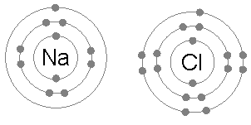
Ionic Bond
Bohr diagrams – show all of the electrons in their energy levels
First energy level has 2, others have 8
Outermost are valence electrons

Slide 8
Ionic Bond
Lithium and bromine
Lithium ion lost electron, bromine ion gained electron
Result is lithium bromine with ionic bond

Slide 9
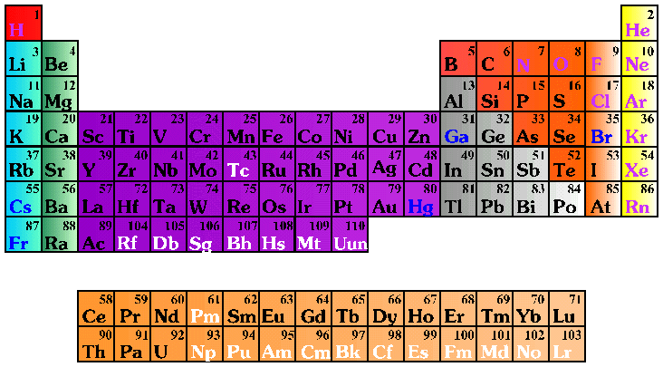
Oxidation Number
The charge on an ion.
Indicates the # of e⁻ gained/lost to become stable.
1+
0
2+
3+
4+
3-
2-
1-

Slide 10
Oxidation Number
Noble gasses are already stable – 0
Elements with a low number (1,2) valence electrons want to LOSE electrons to become positive
Elements with a high number (6,7) valence electrons want to GAIN electrons to become negative
1+
0
2+
3+
4+
3-
2-
1-

Slide 11
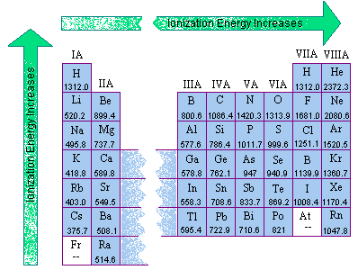
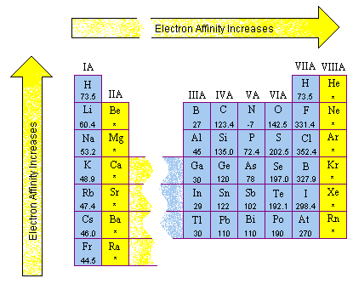
More about ions…
Ionization – process of removing electrons and forming ions
Ionization Energy – energy needed for ionization to occur
Few valence electrons = low ionization energy
Many valence electrons = high ionization energy

Slide 12
More about ions…
Electron affinity – tendency of an atom to attract electrons

Slide 13
Ionic Bond
Form a 3-D crystal lattice
Placement of ions in an ionic compound that results in a regular repeating arrangement
Gives compound Structure

Slide 14
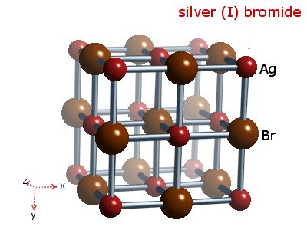
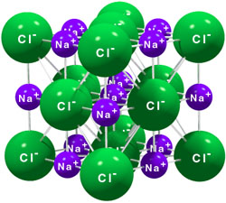
Ionic Bond
Examples of the 3-D Crystal lattice:
Sodium chloride silver (I) bromide

Slide 15
Covalent Bond
Bond formed by sharing e⁻ between two nonmetals
Usually occurs between atoms that have similar ionizations energies and electron affinities.
Shared electrons are in the outermost Energy Level of both atoms at the same time. (Covalent, co – jointly/together, valent – valence (outermost) electrons)

Slide 16
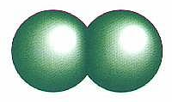
Covalent Bond
Example: two chlorine atoms share valence electrons
Cl₂

Slide 17
Covalent Bond
Two hydrogen atoms share valence electrons
Hydrogen only has one energy level, so it only needs 2 valence electrons to be stable.

Slide 18
Covalent Bond
Nonpolar Covalent Bond
e⁻ are shared equally
usually identical atoms
Examples: Cl₂, O₂

Slide 19
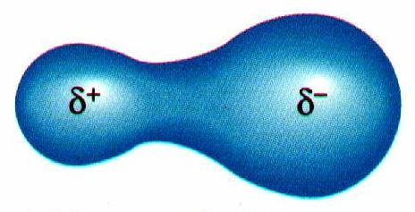
Covalent Bond
Polar Covalent Bond
e⁻ are shared unequally between 2 different atoms
results in partial opposite charges
Example: H₂O

Slide 20
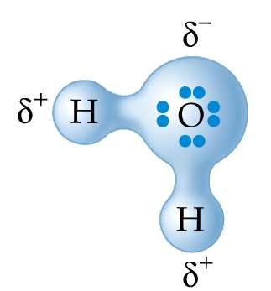
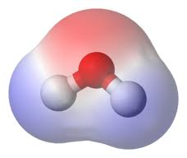
Covalent Bond
Water is polar covalent bond
Oxygen has a greater electron affinity, pulls the electrons more toward it

Slide 21
Chemical Formula
Shows:
1) elements in the compound
2) ratio of their atoms
H₂O
1 oxygen atom
2 hydrogen atoms

Slide 22
Chemical Formulas
Examples:
Salt– NaCl
Water – H₂O
Sand – SiO₂
Sugar – C₆H₁₂O₆
Alcohol – C₂H₅OH
Magnesium hydroxide – Mg(OH)₂

Slide 23
Diatomic Elements
Covalent bond that occurs between atoms of the same element
The Seven Diatomic Elements
Br₂ I₂ N₂ Cl₂ H₂ O₂ F₂

Slide 24
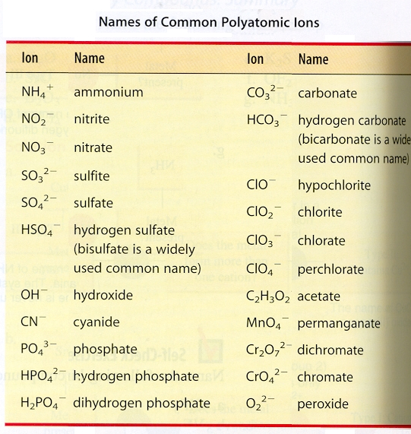
Polyatomic Ions
A group of covalently bonded atoms that have an overall charge
Bonds within the group of atoms are covalent
Bonds between polyatomic ions and other ions are ionic

Slide 25
Comparison Chart
IONIC
COVALENT
transferred from metal to nonmetal
shared between nonmetals
Electrons
Melting
Point
high
low
Soluble in
Water
yes
usually not
Conduct Electricity
yes (solution or liquid)
no
Other
Properties
crystal lattice of ions, crystalline solids
molecules, odorous liquids & gases

Slide 26
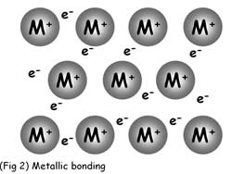
Metallic Bonding
Bond between metals
Described as a “sea of electrons”
Electrons continuously move around the atoms of the metal

Slide 27
Ionic Names
Write the names of both elements, positive ion first.
Change the negative ion’s ending to -ide.
Write the names of polyatomic ions in place of the positive or negative ion

Slide 28
Example: NaBr
Write the names of both elements, positive ion first.
sodium bromine
Change the negative ion’s ending to -ide.
sodium bromide
Write the names of polyatomic ions in place of the positive or negative ion
No polyatomic ions

Slide 29
Example: Na₂CO₃
Write the names of both elements, positive ion first.
With more than 2 elements, there must be a polyatomic ion. Check the table of polyatomic ions. CO₃ is carbonate
sodium carbonate
Change the negative ion’s ending to -ide.
Write the names of polyatomic ions in place of the positive or negative ion
sodium carbonate

Slide 30
Example: Li₂O
Write the names of both elements, positive ion first.
lithium oxygen
Change the negative ion’s ending to -ide.
lithium oxide
(note that that for ionic compounds, the subscript doesn’t affect the name)

Slide 31
Covalent Naming
Write the names of both elements in the order that they are shown
Change the second element’s ending to –ide
Add the greek prefix to note the number of each element shown
If there is only one of the first element, it does not need a greek prefix

Slide 32
Covalent Naming
When naming molecular compounds, we use Greek prefixes to tell us the number of atoms present in the compound
One = mono
Two = di
Three = tri
Four = tetra
Five = penta
Six = hexa
Seven = hepta
Eight = octa

Slide 33
Example: H₂O
Write the names of both elements in the order that they are shown
Hydrogen oxygen
Change the second element’s ending to –ide
Hydrogen oxide
Add the greek prefix to note the number of each element
Dihydrogen monoxide
If there is only one of the first element, it does not need a greek prefix

Slide 34
Example: CO
Write the names of both elements in the order that they are shown
Carbon oxygen
Change the second element’s ending to –ide
Carbon oxide
Add the greek prefix to note the number of each element
Monocarbon monoxide
If there is only one of the first element, it does not need a greek prefix
Carbon monoxide

Slide 35
Example: CO₂
Write the names of both elements in the order that they are shown
Carbon oxygen
Change the second element’s ending to –ide
Carbon oxide
Add the greek prefix to note the number of each element
Monocarbon dioxide
If there is only one of the first element, it does not need a greek prefix
Carbon dioxide

Slide 36
Ionic Formulas
Write each ion. Put the positive ion first.
Overall charge must equal zero.
If charges cancel, just write the symbols.
If not, crisscross the charges to find subscripts.
Use parentheses when more than one polyatomic ion is needed.

Slide 37
Example: Potassium chloride
Write each ion. Put the positive ion first.
K¹⁺ Cl¹⁻
Overall charge must equal zero.
If charges cancel, just write the symbols.
If not, crisscross the charges to find subscripts.
KCl
Use parentheses when more than one polyatomic ion is needed.
No polyatomic ions. KCl

Slide 38
Example: Magnesium nitrate
Write each ion. Put the positive ion first.
Mg²⁺ Nitrate is a polyatomic ion: NO₃¹⁻
Overall charge must equal zero.
If charges cancel, just write the symbols.
If not, crisscross the charges to find subscripts.
Mg₁ NO₃ ₂
Use parentheses when more than one polyatomic ion is needed.
Mg(NO₃)₂

Slide 39
Example: Copper chloride
Write each ion. Put the positive ion first.
Cu²⁺ Cl¹⁻
Overall charge must equal zero.
If charges cancel, just write the symbols.
If not, crisscross the charges to find subscripts.
Cu₁Cl₂
Use parentheses when more than one polyatomic ion is needed.
No polyatomic ions. CuCl₂

