Slide 1
Bonding and Molecular Geometry
Unit 6

Slide 2
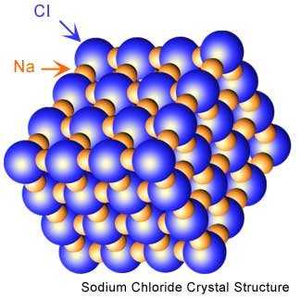
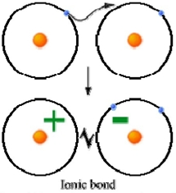
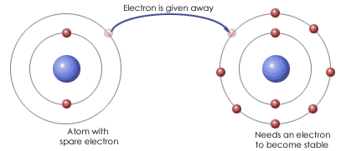
Bond Types
Ionic Bond – A transfer of electron(s) between two atoms due to the large difference in electronegativity. The result is two ions (one positive and one negative) that are held together by an electrostatic force of attraction.
Electrostatic Force – an attraction between two oppositely charged particles.

Slide 3
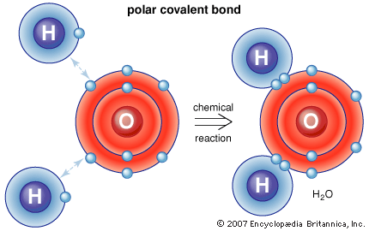
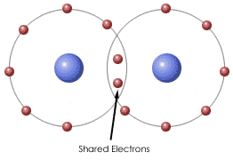
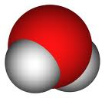
Bond Types
Covalent Bond – A bond that results form the sharing of electrons between two atoms due to a small difference in electronegativity.
Difference in Electronegativity of < 1.7

Slide 4
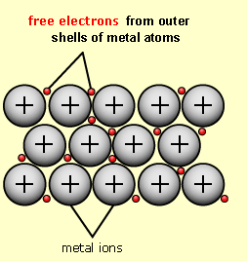
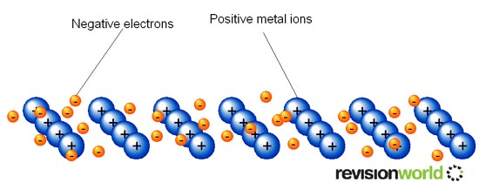
Bond Types
Metallic Bonds – Delocalized electrons holding metals together. Any one valence electron is not part of any particular atom but shared by all atoms, but they flow through the orbitals of all the atoms. Like a “sea of electrons.”

Slide 5
Inferring Bond Types
Properties of Compounds (the best way)
For example: ionic compounds have high MP/Covalent have low MP
Difference in Electronegativity (too black and white)
Need to know the electronegativity value of each element (or have a chart)
∆>1.7 - Ionic
∆ <1.7 - Covalent
Location of Periodic Table (ok for now)
2 nonmetals – covalent bond
metal and a nonmetal – ionic bond
2 metals – metallic bond

Slide 6
Comparing Bond Types
Dog Analogy
Compare the substances below. Can you draw any conclusions about strength between particles?
Substance | MP (Celsius) | BP (Celsius) | Bond Type
NaCl | 801 | 1413 | Ionic
Li₂O | 1570 | Decomposes | Ionic
NO | -164 | -152 | Covalent
CH₃OH | -94 | 65 | Covalent
Cl₂ | -101 | -35 | Covalent
Al | 660 | ------- | Metallic
Cu | 1083 | ------- | Metallic

Slide 7
Properties of Ionic Compounds
Because of stronger forces holding the particles together ionic compounds:
Are more brittle
Have high melting points
Have high boiling points
Ionic Compounds in the molten state or in aqueous solutions can conduct electricity due to the presence of ions.

Slide 8
Properties of Covalent Compounds
Because of weak forces holding the particles together in a covalent compound:
Form inert gases
Have low melting points
Have low boiling points
Polar Nature

Slide 9
Properties of Metals
Malleable and Ductile
Can be explained by the sea of electrons allowing for movement of the metal ions with out breaking the bond.
Luster
The electrons allow the light to be reflected off the surface of the metal.
Conducts Electricity
The ‘sea of electrons’ allows for a medium for electricity to pass through

Slide 10
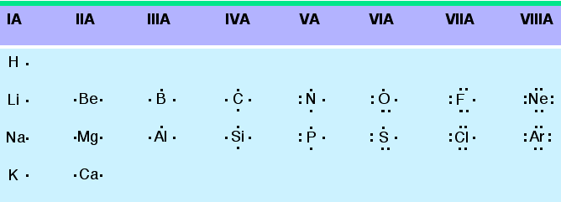
Valence electrons for Elements
Recall that the valence electrons for the elements can be determined based on the elements position on the periodic table.
Lewis Dot Symbol

Slide 11
Valence electrons and number of bonds
Number of bonds elements prefers depending on the number of valence electrons. In general -
→
#
C
o
v
a
l
e
n
F
a
m
i
t
B
o
n
d
s*
l
y
H
→
a
l
o
g
e
n
s
X
1 bond often
F
,
B
r
,
C
l
,
I
→
2 bond often
C
a
l
c
o
g
e
n
s
O
O
,
S
→
3 bond often
N
i
t
r
o
g
e
n
N
N
,
P
→
4 bond always
C
a
r
b
o
n
C
C
,
S
i
The above chart is a guide on the number of bonds formed by these atoms.

Slide 12
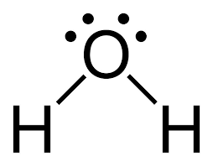
Lewis Structures
Shared Pair - a line or two dots between element symbols.
Lone Pair – a line or two dots on the side of an element by it(their)self.
I was looking for an example of lone pairs being reprented as a line but could not find one on google

Slide 13
Lewis Structure, Octet Rule Guidelines
When compounds are formed they tend to follow the Octet Rule.
Octet Rule: Atoms will share electrons (e⁻) until it is surrounded by eight valence electrons.
Rules of the (VSEPR) game-
i) O.R. works mostly for second period elements.
Many exceptions especially with 3rd period elements (d-orbitals)
ii) H prefers 2 e⁻ (electron deficient)
iii) :C: N: :O: :F:
4 unpaired 3unpaired 2unpaired 1unpaired up = unpaired e-
4 bonds 3 bonds 2 bonds 1 bond
O=C=O N≡ N O = O F - F
iv) H & F are terminal in the structural formula (Never central)
.
.
.
.
.
.
.
.

Slide 14
Atomic Connectivity
The atomic arrangement for a molecule is usually given.
CH₂ClF HNO₃ CH₃COOH H₂Se H₂SO₄ O₃
Cl
O
N
O
H
O
O
H
Se
H
O
O
O
H
C
F
O
H
H C
C
H O
S
O H
H
O H
H
O
In general when there is a single central atom in the molecule, CH₂ClF, SeCl₂, O₃ (CO₂, NH₃, PO₄³⁻), the central atom is the first atom in the chemical formula.
Except when the first atom in the chemical formula is Hydrogen (H) or fluorine (F). In which case the central atom is the second atom in the chemical formula.
Find the central atom for the following:
1) H₂O a) H b) O 2) PCl₃ a) P b) Cl
3) SO₃ a) S b) O 4) CO₃²⁻ a) C b) O
5) BeH₂ a) Be b) H 6) IO³⁻ a) I b) O

Slide 15
Skeletal structures
Because there are exceptions to the octet rule, we need a set of rules to determine how many electrons surround atoms
The first step is to determine how the atoms are bonded in a molecule
Generally, if there is only one of one element and multiple copies of another element, the unique element is central
Commonly, H is peripheral, bonded to O

Slide 16
Counting total electrons
Once we have determined the basic structure of the molecule we can start placing electrons around atoms
The first step is to determine the total number of electrons that are available
We use the group number of an element to indicate the number of valence electrons that it contributes to the molecule.
E.g. O in group VIA (6A), contributes 6 e–s

Slide 17
Lewis Structures
Once we have determined the number of total valence electrons we can start distributing them throughout the molecule
These rules are also in the study guide.
When we represent electrons they will be in pairs (since an orbital holds 2 electrons)
Electron pairs can be represented with 2 dots or a solid line …

Slide 18
Placing electrons around atoms
Compound |  | 4) Octet for peripheral atoms
1) Skeletal Structure |  | 5) Remain- ing e–s on center atom
2) Count electrons |  | 6) Create multiple bonds?
3) Electron pairs in bonds |  | Final structure
ClO₂–
O
Cl
O
16 - 12 = 4
O
Cl
O
O
Cl
O
4 - 4 = 0
7x1 + 6x2 +1 = 20
No need
-
O
Cl
O
O
Cl
O
or
-
20 - 4 = 16
O
Cl
O

Slide 19
Compound |  | 4) Octet for peripheral atoms
1) Skeletal Structure |  | 5) Remain- ing e–s on center atom
2) Count electrons |  | 6) Create multiple bonds?
3) Electron pairs in bonds |  | Final structure
CO
C
O
8 - 6 = 2
C
O
C
O
2 - 2 = 0
4x1 + 6x1 = 10
C
O
C
O
C
O
or
10 - 2 = 8
C
O

Slide 20
Chemical Bonds
Bond Type | Single | Double | Triple
# of e’s | 2 | 4 | 6
Notation | — | = | ≡
Bond order | 1 | 2 | 3
Bond energy | Increases from Single to Triple
Bond length | Decreases from Single to Triple

Slide 21
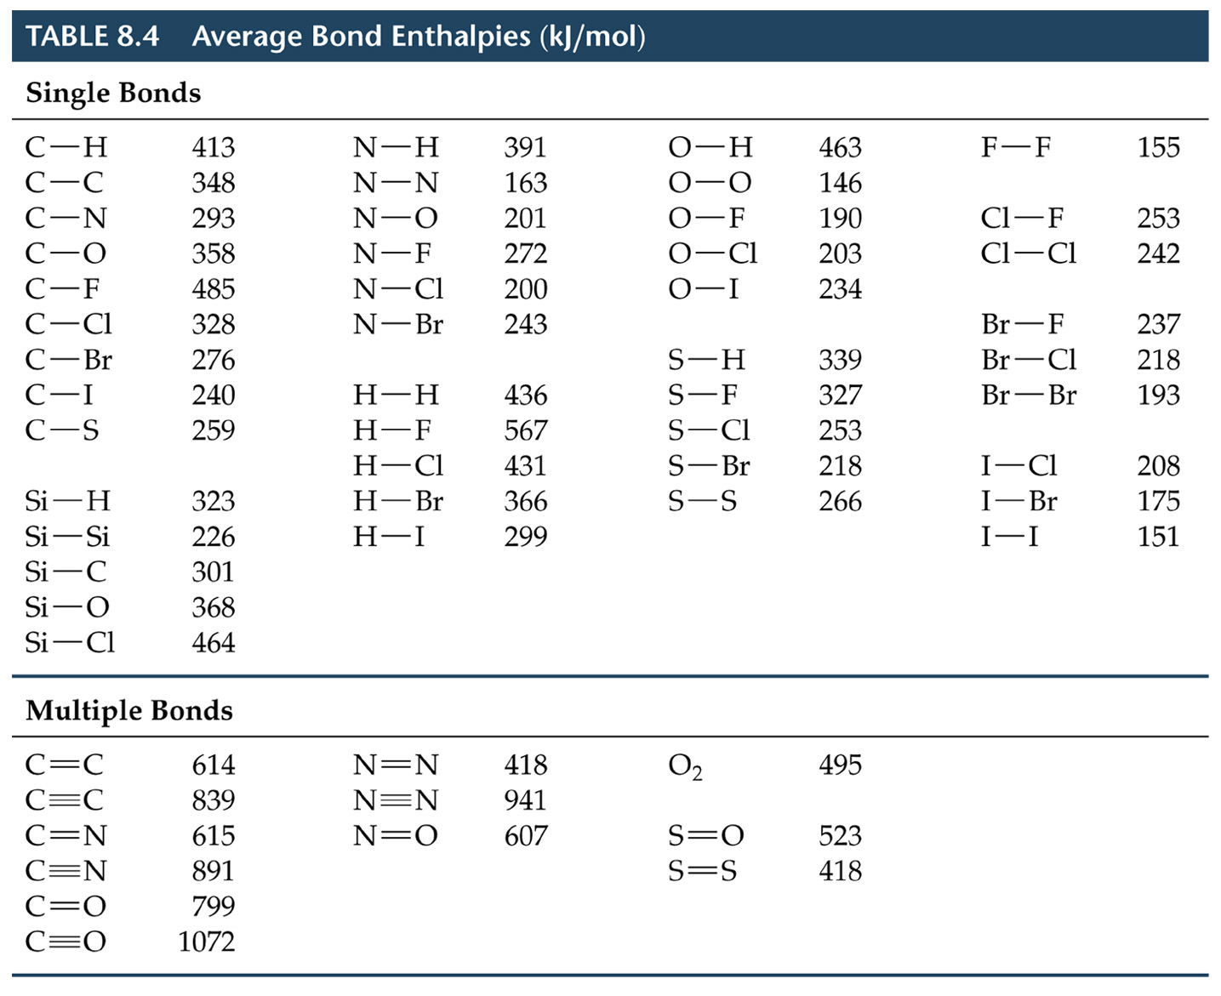

Slide 22
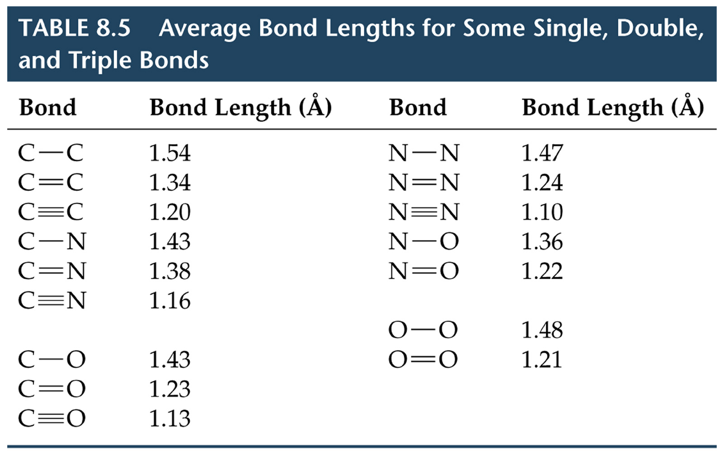
Strengths of Covalent Bonds

Slide 23
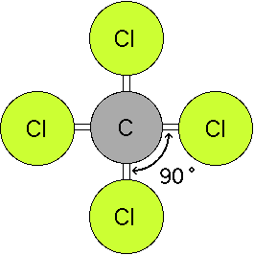
VSEPR Theory
Valence Shell Electron Pair Repulsion

Slide 24
VSEPR Theory
Predicts the molecular shape of a bonded molecule
Electrons around the central atom arrange themselves as far apart from each other as possible
Unshared pairs of electrons (lone pairs) on the central atom repel the most
So only look at what is connected to the central atom

Slide 25
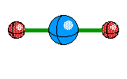
Linear
2 atoms attached to center atom
0 unshared pairs (lone pairs)
Bond angle = 180º
Type: AB₂
Ex. : BeF₂

Slide 26
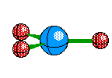
Trigonal Planar
3 atoms attached to center atom
0 lone pairs
Bond angle = 120º
Type: AB₃
Ex. : AlF₃

Slide 27
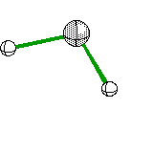
Bent (w/ 1 lone pair)
2 atoms attached to center atom
1 lone pairs
Bond angle < 120º
Type: AB₂E
Ex. : SO₂

Slide 28
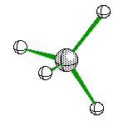
Tetrahedral
4 atoms attached to center atom
0 lone pairs
Bond angle = 109.5º
Type: AB₄
Ex. : CH₄

Slide 29
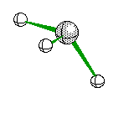
Trigonal Pyramidal
3 atoms attached to center atom
1 lone pair
Bond angle = 107º
Type: AB₃E
Ex. : NH₃

Slide 30
Bent (w/ 2 lone pairs)
2 atoms attached to center atom
2 lone pairs
Bond angle = 104.5º
Type: AB₂E₂
Ex. : H₂O

Slide 31
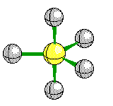
Trigonal Bipyramidal
5 atoms attached to center atom
0 lone pairs
Bond angle =
equatorial -> 120º
axial -> 90º
Type: AB₅
Ex. : PF₅

Slide 32
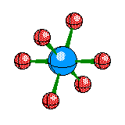
Octahedral
6 atoms attached to center atom
0 lone pairs
Bond angle = 90º
Type: AB₆
Ex. : SF₆

Slide 33
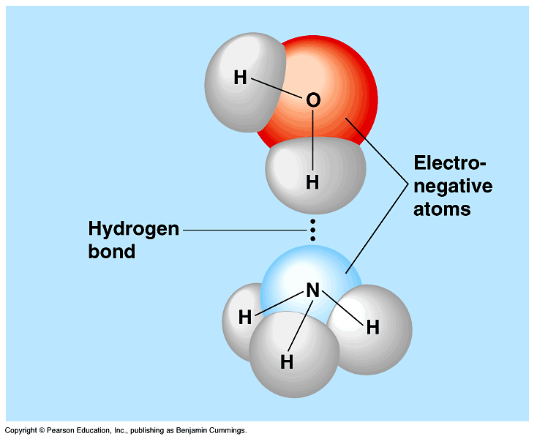
Polarity and Intermolecular Forces

Slide 34
Types of bonds
Ionic – transfer of e- from one atom to another
Covalent - sharing of e- between atoms
a) nonpolar covalent – equal sharing of e-
b) polar covalent – unequal sharing of e-

Slide 35
Polar bonds and Electronegativity
Electronegativity is the ability of an atom to attract electrons in a chemical bond
Polar bonds result when a highly electronegative atom bonds to a less electronegative atom

Slide 36
Determining Polarity
A covalent bond is polar if there is a significant difference between the electronegativities of the two atoms (see below):
Electronegativity Difference | Type of Bond
0 | Nonpolar covalent
Between 0 and1.7 | Polar covalent
Greater than 1.7 | Ionic

Slide 37
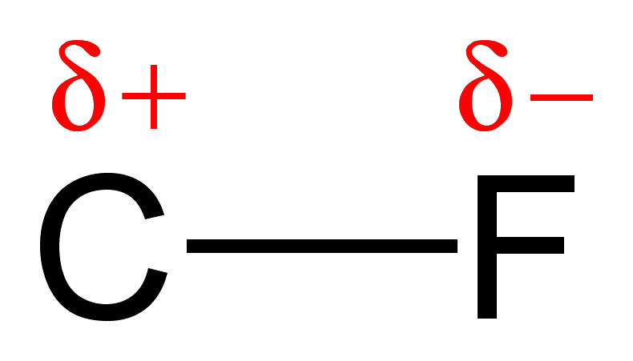
Polar-covalent bonds and Dipoles
Electronegativity of
2.5
Electronegativity of
4.0
Fluorine has a stronger attraction for the electrons. They are still shared, but spend more time around the fluorine giving partial opposite charges to opposite ends of the bond (a dipole)

Slide 38
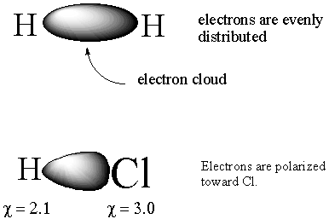
Nonpolar Bond (no dipole) vs. Polar Bond (dipole)
+
+
-

Slide 39
Showing Polarity of a Bond

Slide 40
Give the electronegativity difference and determine the bond type in the following bonds. Choices: polar, nonpolar, ionic.
C-H
H-Cl
Na-F
Br-Br
S-O
N-H
H-O
K-Cl
Cs-F
Cl-Cl
polar
polar
ionic
nonpolar
polar
polar
polar
ionic
ionic
nonpolar

Slide 41
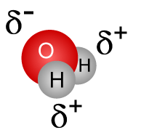
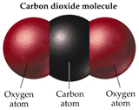
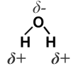
Determining Polarity of Molecules
If one end of a molecule is slightly positive and another end is slightly negative the molecule is polar
Polarity depends on the shape of the molecule
Ex. CO₂ (nonpolar) and H₂O (polar)

Slide 42
To determine polarity of a molecule you need the following:
Lewis Structure
ABE designation and molecular shape (using your chart)
Symmetrical molecules are nonpolar.
1. The surrounding atoms are identical
2. There are no lone pairs of electrons on the central atom
The molecule has no dipole and is nonpolar.
Molecules that are linear, trigonal planar, tetrahedral with the same surrounding atoms are nonpolar.

Slide 43
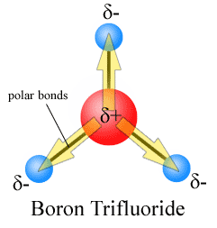

Slide 44
Determine the Polarity of the following molecules:
Water
Carbon tetrachloride
Carbon monoxide
Carbon dioxide
Ammonia (NH₃)
Methyl chloride (CH₃Cl)
Sulfur dioxide
Boron trichloride
ICl₄⁻

Slide 45
Intermolecular v. Intra-particle
Intra-particle forces are forces between atoms or ions within the structure of a molecule or formula unit.
Ex: Covalent, Ionic Bonds, and Metallic Bond.

Slide 46
Intermolecular forces – the attractions between molecules
Determine whether a compound is a solid, liquid or gas at a given temperature (determine melting and boiling points of substances)
3 Main Types:
a) Hydrogen bonding
b) Dipole-dipole interactions
c) Dispersion forces

Slide 47
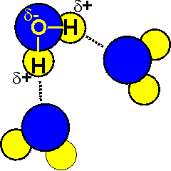
Hydrogen Bonding
Attraction formed between the hydrogen atom of one molecule and a highly electronegative atom (only O, N, or F) of an adjacent molecule.
A type of dipole interaction and the strongest intermolecular force

Slide 48
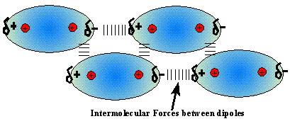
Dipole-dipole interactions
Dipoles interact by the positive end of one molecule being attracted to the negative end of another molecule (similar to but much weaker than ionic bonds)

Slide 49
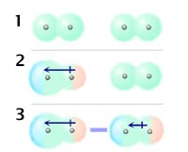
Dispersion Forces
Caused by electron motion. Electrons around one molecule momentarily repel electrons on a nearby molecule creating a momentary charge difference
Can exist between nonpolar molecules as well as polar
Weakest intermolecular force.

Slide 50
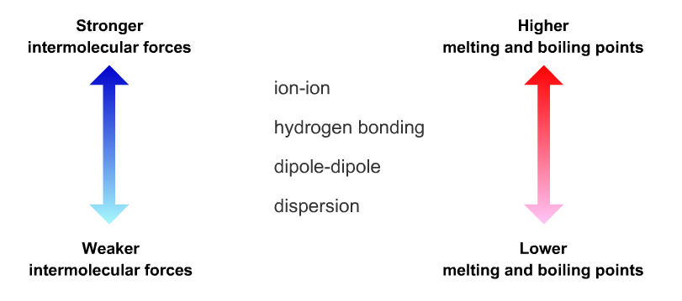
Forces and melting/boiling point

Slide 51
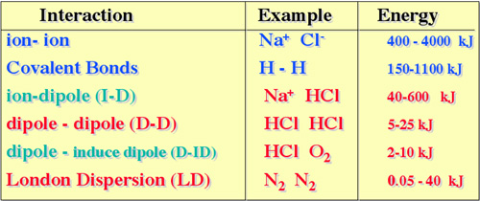
Intermolecualr v. Intra-particle strength

Slide 52
