Slide 1
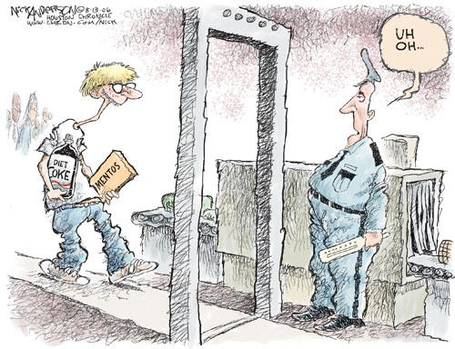
Chemical Reactions

Slide 2
Chemical Reaction
A change in which one or more substances are converted to different substances.
A+B→C+D
REACTANTS
(What you start with)
PRODUCTS
(What is produced)

Slide 3
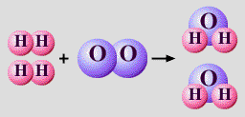
Law of Conservation of Mass
In a chemical reaction, matter is neither created or destroyed.
Atoms can only rearrange.
# atoms of elements stay the same!
4H
2O
4H
2O

Slide 4
Chemical Equations
An expression using symbols, formulas, and numbers to represent a chemical reaction
Magnesium and oxygen combine to form magnesium oxide.
2Mg(s)+O₂(g)→2MgO (s)
Coefficient - # of units of each substance

Slide 5
Chemical Equations Con’t

Slide 6
Chemical Equations
Describing Coefficients:
individual atom = “atom”
2Mg ⇒ 2 atoms of magnesium
covalent substance = “molecule”
3CO₂ ⇒ 3 molecules of carbon dioxide
ionic substance = “unit”
4MgO ⇒ 4 units of magnesium oxide

Slide 7
Types of Reactions

Slide 8
Synthesis
2 or more simple substances combine to form a new compound
only one product forms
A + B → AB
2Na + Cl₂ → 2NaCl

Slide 9
Synthesis
Example: growth (substances combine)

Slide 10
Decomposition
A compound breaks down into 2 or more simpler substances
Only one reactant
AB → A + B
2H₂O₂ → 2H₂O + O₂

Slide 11
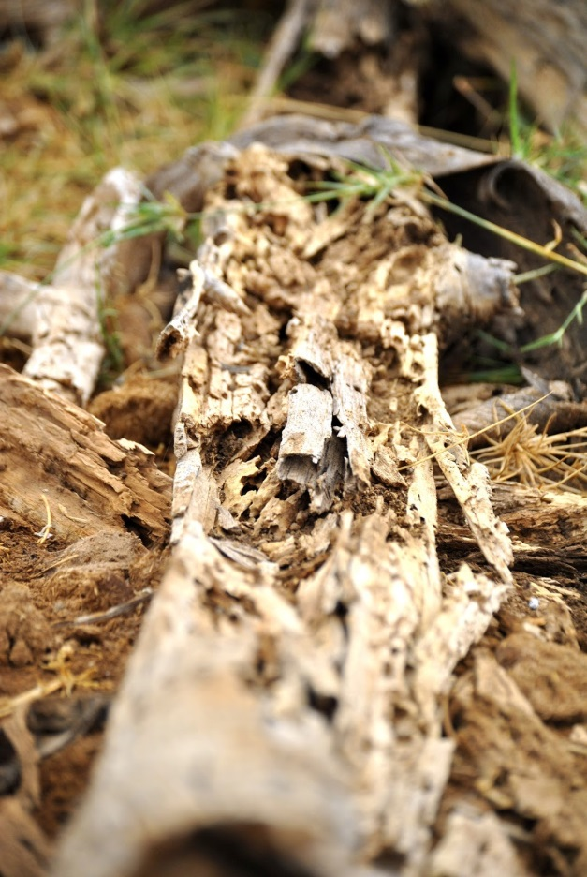
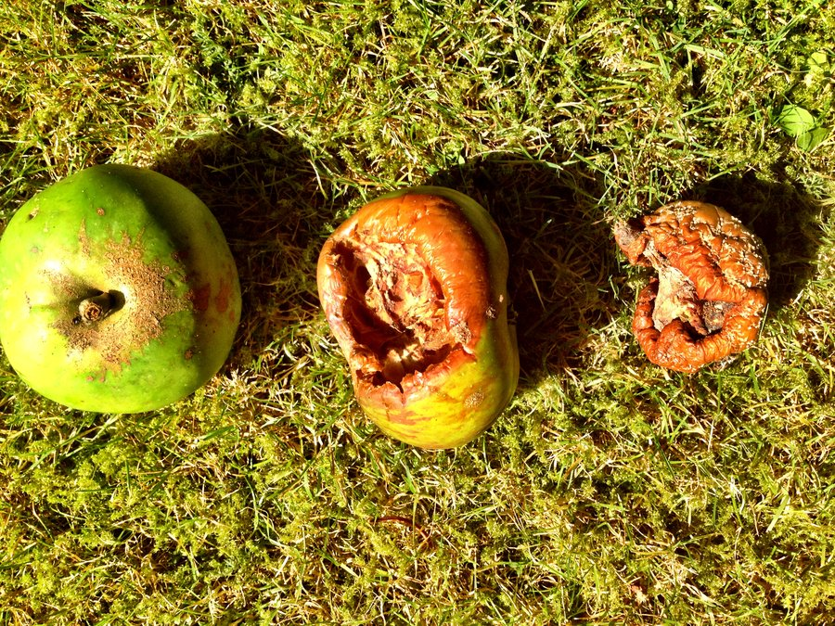
Decomposition
Example: plant decay (substances break down)

Slide 12
Single Replacement
One element replaces another in a compound
metal replaces metal (+)
nonmetal replaces nonmetal (-)
A + BC → AC + B
Zn + 2HCl → ZnCl₂ + H₂

Slide 13
Double Replacement
ions in two compounds “change partners”
+ ion of first compound combines with – ion of the second compound
AB + CD → AD + CB
MgCO₃ + 2HCl → MgCl₂ + H₂CO₃

Slide 14
Combustion
the burning of a substance in O₂ to produce heat
hydrocarbons (C_{x}H_{y}) always form CO₂ and H₂O
C_{x}H_{y}+O₂ → CO₂+H₂O
CH₄ + 2O₂ → CO₂ + 2H₂O

Slide 15
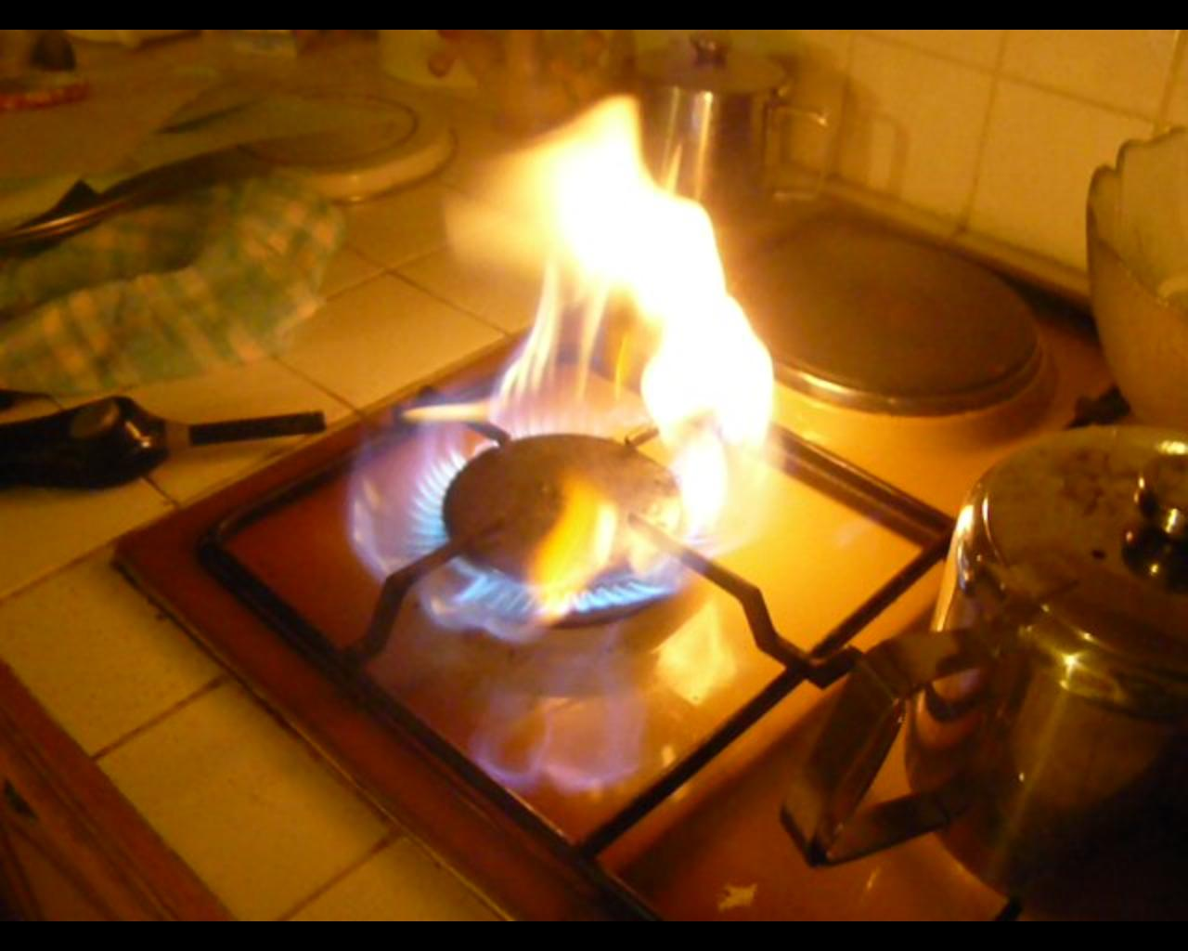
Combustion
Example: gas stove

Slide 16
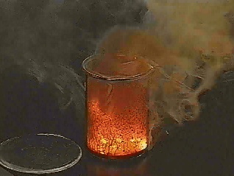
Energy & Chemical Reactions

Slide 17
Energy Changes
During a chemical reaction…
energy is used to break bonds
energy is released when new bonds are formed
breaking
bonds
making
bonds

Slide 18
Exothermic Reaction
reaction that releases energy
energy released by making new bonds outweighs energy required to break old bonds
H₂(l) + O₂(l) → H₂O(g) + energy
reaction that powers the space shuttle lift-off

Slide 19
Endothermic Reaction
reaction that absorbs energy
energy required to break old bonds outweighs energy released by making new bonds
2Al₂O₃ + energy → 4Al + 3O₂
process used to obtain aluminum from aluminum ore

Slide 20
Indicators of a Chemical Change
Recall learning about physical and chemical changes
We discussed ways to know when a chemical changed occurred:
Formation of gas
Formation of a precipitate
Temperature (Energy) change
Color change

Slide 21
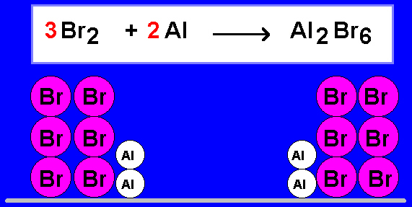
Balancing Equations

Slide 22
Counting Atoms
When you have one element present, you have one atom of that element
Mg = 1 atom of Magnesium
Subscripts tell you how many of that particular atom you have
Cl₂ = 2 atoms of Chlorine
When there is a coefficient in front, you multiply through
2Mg = 2 x 1 Mg = 2 atoms
2NaCl = 2 x 1 Na + 2 x 1 Cl = 2+2 = 4 atoms
2Cl₂ = 2 x 2 Cl = 4 atoms

Slide 23
Counting Atoms
Mg = 1 Mg = 1 atom
2Mg = 2 Mg = 2 atoms
Cl₂ = 2 Cl = 2 atoms
KCl = 1 K + 1 Cl = 2 atoms
MgCl₂ = 1 Mg + 2 Cl = 3 atoms
3Mg = 3 Mg = 3 atoms
2KCl = 2 K + 2 Cl = 4 atoms
2Al₂O₃ = 2x2 Al + 2x3 O = 4 Al + 6 O = 10 atoms

Slide 24
Balancing Steps
1. Write the unbalanced equation.
2. Count atoms on each side.
3. Add coefficients to make #s equal.
DO NOT change subscripts
4. Reduce coefficients to lowest possible ratio, if necessary.
5. Double check atom balance!!!

Slide 25
Balancing Example
Water splits into hydrogen (H₂) and oxygen (O₂) gas.
H₂O → H₂ + O₂
2
2
4 ⁄
2 ⁄
⁄ 4
2 2
1 2
H
O

Slide 26
Balancing Example
Aluminum and copper(II) chloride form copper and aluminum chloride.
Al + CuCl₂ → Cu + AlCl₃
2 3 3 2
3 2
2 3 2
2 ⁄
⁄ 2
3 ⁄
6 ⁄ ⁄ 6
⁄ 3
1 1
1 1
2 3
Al
Cu
Cl

