Slide 1
Physical and chemical Properties and changes
Chemistry Unit 1

Slide 2
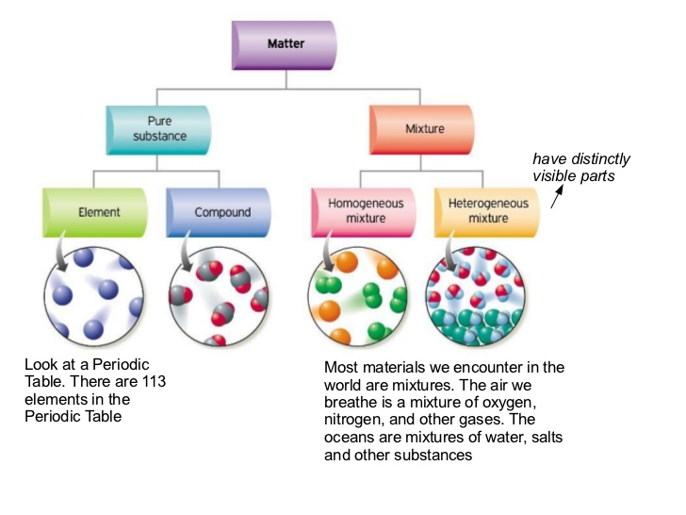
Matter is anything that has mass and volume
All matter is either a pure substance or a mixture

Slide 3
Types of pure Substances
Element – any substance made up of only one
type of atom
oxygen, helium, silver, carbon
http://periodictable.com/
Compound – a substance in which two or more elements are combined
Chlorine Gas + Sodium metal = Sodium Chloride (salt)
Cl₂ + Na = NaCl

Slide 4
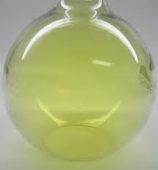
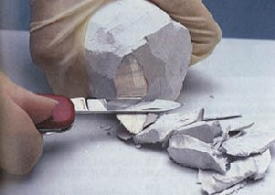
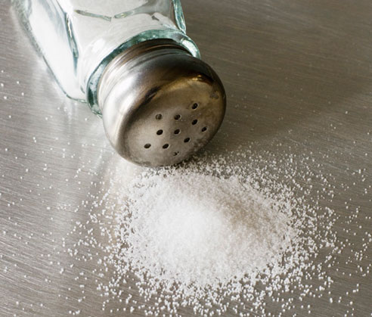
Forming Compounds: Sodium metal + chlorine gas = Sodium Chloride (salt) Na + Cl₂ NaCl
chlorine
sodium
Sodium chloride

Slide 5
Each pure substance is unique because it always has a constant composition and can be identified by a chemical symbol or chemical formula and distinct properties.
Examples:
Water is known as H₂0. It has a melting point of 0º and a boiling point of 100º.
“Salt” commonly means NaCl and is a white crystal that tastes good on food
Aluminum has the symbol Al and is a shiny, silver metal.

Slide 6
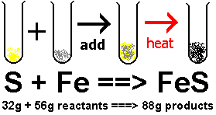
The Law of conservation of Mass
Matter cannot be created or destroyed

Slide 7
What do you think?
What comes to mind when you think about a physical characteristic of yourself??
Notes:
Don’t print

Slide 8
Physical Properties
Characteristics that can be observed or measured without changing the composition
Examples:
Phase
Density
Viscosity
Conductivity
Solubility
Boiling/Condensing Point
Melting/Freezing Point
Mass
Volume
Color
Shape
Specific heat

Slide 9
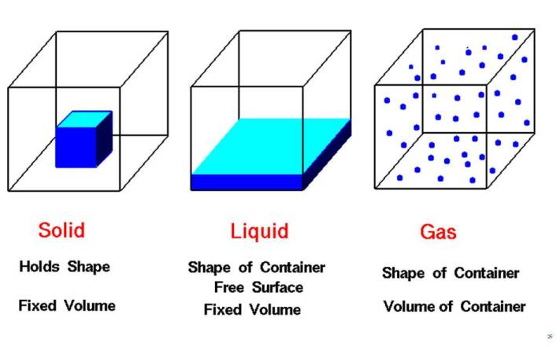
Phases of matter
Phase (or state) of matter refers to its form
Solid – particles are very close together and vibrating in fixed positions. It has a definite shape and volume
Liquid – particles are more disorganized and can move relative to the other particles. It has a definite volume, no definite shape
Gas – particles are completely free to move and have no order or structure. It has no definite volume or definite shape

Slide 10
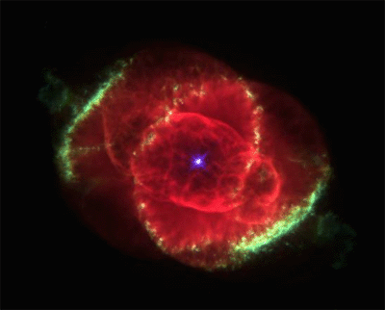
Other Phases of matter
Plasma
very high KE - particles collide with enough energy to break into charged particles (+/-)
gas-like, indefinite shape & volume
stars, fluorescent light bulbs, TV tubes

Slide 11
Other Phases of matter
Bose-Einstein condensates
In 1995, technology enabled scientists to create a new state of matter, the Bose-Einstein condensate (BEC).
At an extremely low temperature, molecular motion comes very close to stopping altogether. Since there is almost no kinetic energy being transferred from one atom to another, the atoms begin to clump together.
There are no longer thousands of separate atoms, just one “super atom”
A BEC also has many of the properties of a superfluid — flowing without friction.
BECs are also used to simulate conditions that might apply in black holes.

Slide 12
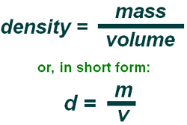
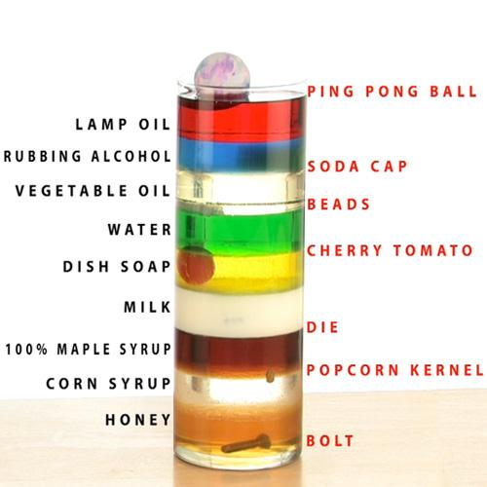
More Physical properties:
M
D
V

Slide 13
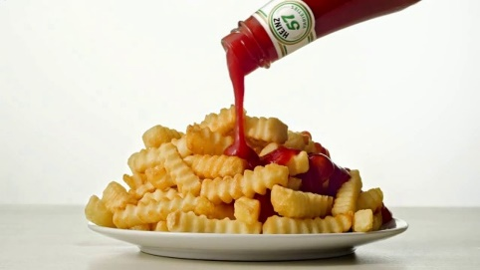
Even More Physical properties!
Viscosity – measure of a fluids resistance to flow
Conductivity – measure of a material’s ability to move electrical current
Solubility – maximum amount of a substance that will dissolve under standard conditions
Think sugar and water

Slide 14
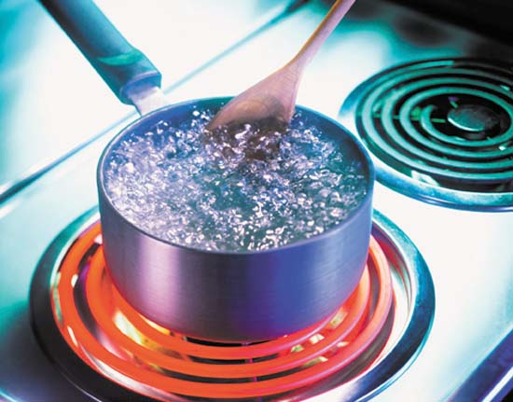
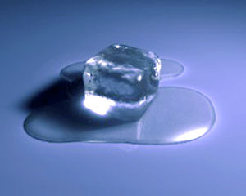
Physical Properties
Boiling point is the temperature at which a liquid becomes a gas or a gas becomes a liquid.
Melting point is the temperature at which a solid becomes a liquid. The same temperature is known as the freezing point when a liquid becomes a solid.

Slide 15
More physical Properties!
Mass is the measurement of the quantity of matter and is measured in grams
Volume is the measurement of the space occupied by matter and is measured in mL or cm³
Color is the property of things that is caused by differing qualities of the light reflected or emitted by them
Shape is the characteristic surface outline or contour of an object

Slide 16
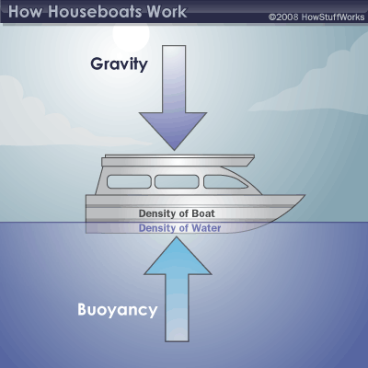
Buoyancy is the tendency of matter to float in a liquid or rise up in the air

Slide 17
Physical properties

Slide 18
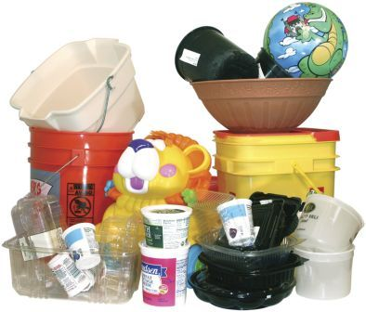
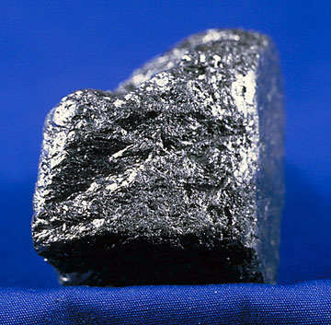
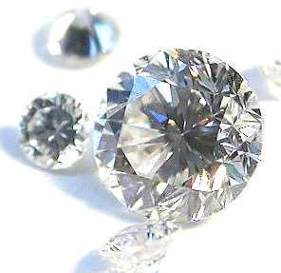
So what??
Physical properties help determine a substance’s usefulness as a material of construction or manufacture
Strength
Elasticity
Hardness
Toughness

Slide 19
Physical Change
is the change in a substance’s appearance such as size, shape, color or phase that does not change the composition of the matter.

Slide 20
What are some Physical Changes?
Evaporating
Condensing
Freezing
Melting
Sublimation
Deposition
Expanding
Cutting
Breaking
Conducting
Mixing
Bending

Slide 21
Physical changes Phase changes
Melting
solid to liquid
Freezing
liquid to solid melting point = freezing point
Vaporization (boiling)
liquid to gas at the boiling point
Evaporation
liquid to gas below the boiling point
Condensation
gas to liquid
Sublimation
solid to gas
EX: dry ice, freeze drying, iodine

Slide 23
Cutting, breaking and tearing matter into smaller pieces.
Mixing is when two or more substances are blended and each substance keeps its unique properties.

Slide 24
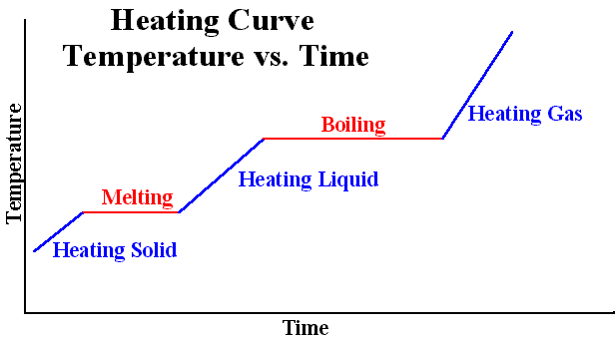
Lets Heat things up!!!
We can use a heating curve to help us understand how substances undergo a phase change from a solid to a gas

Slide 25
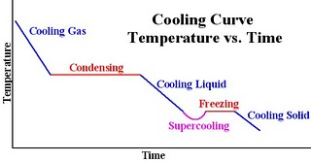
Now cool it down…
Opposite of heating is cooling
Phase change of a gas to a solid

Slide 26
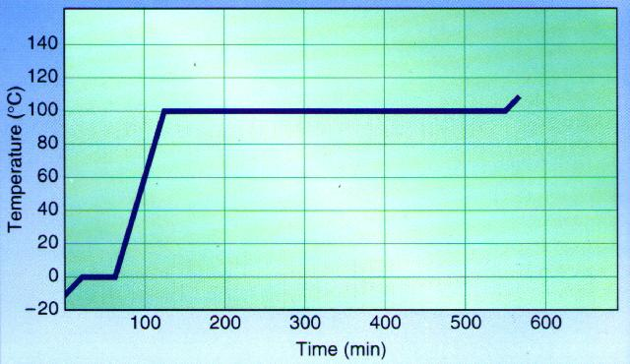
Gas - KE ↑
Boiling - PE ↑
Liquid - KE ↑
Melting - PE ↑
Solid - KE ↑

Slide 27
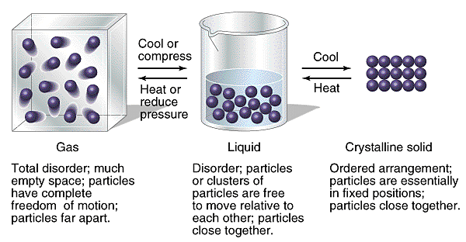
Kinetic Molecular Theory
Kinetic Theory KMT of matter describes the movement of matter.
Kinetic Energy is the energy of motion. Temperature is the measure of the average kinetic energy of the particles in matter
Potential energy is the energy of position. Temperature is constant when the average distance between particles changes

Slide 28
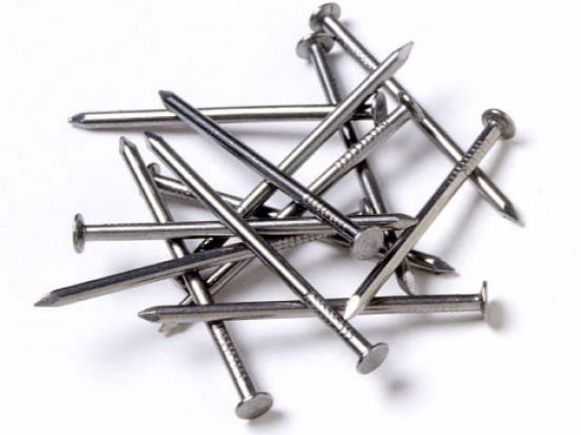
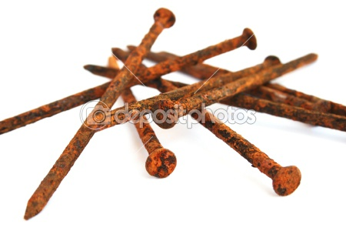
Chemical Properties
Describes a specific chemical change that alters the composition of a substance
Reactivity-is the tendency of a substance to undergo chemical reaction, either by itself or with other materials.
Flammability- is the tendency of a substance to burn in the presence of oxygen
Light Exposure

Slide 29
Chemical Changes
Any change that results in the formation of new substances
Examples:
Combustion – combines with oxygen and burns
Corrosion – weakening/discoloration of metals
Oxidation – substances combine with oxygen
Growth – combines small substances to form larger more complex substances
Decomposition and decay – breaks down large structures into smaller ones
In all examples… the key is that there is a formation of a new material!

Slide 30
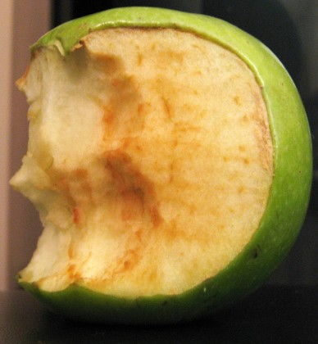
Something to think about…
Ever bite into an apple… then leave it on the counter and come back to it later and it looks like this??
Why do you think this happened?

Slide 31
The Chemistry Behind the Science Fair Project Volcano
What do you notice happening when you mix baking soda and vinegar together??

Slide 32
Indications of Chemical Change
Gas Formation (Bubbles/Vapors) are observed
Temperature Change
Endothermic – Energy is absorbed; temperature decreases
Exothermic – Energy is released; temperature increases
Formation of a precipitate
Precipitate – solid that forms when two liquids are mixed
Light Energy is produced: flame or the light from a fire fly
Color Change

