Slide 1
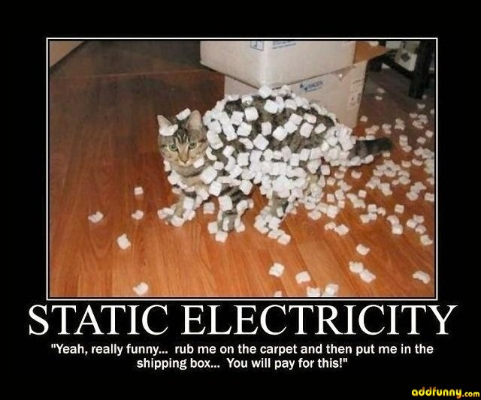
Physics Unit 5 - Electricity
Notes:
1
1

Slide 2
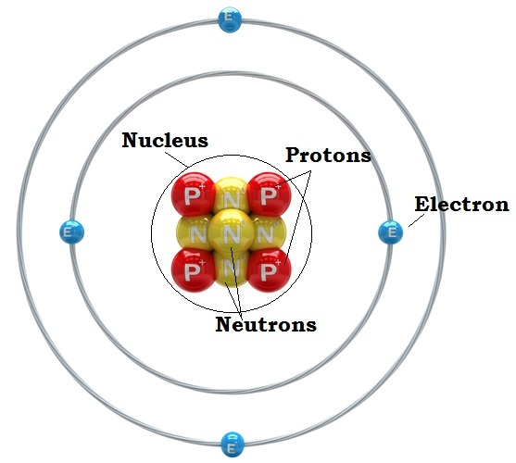
Electric Charges
In chemistry: matter is made up of atoms which are made of protons, electrons, and neutrons
Electric charges of these particles:
Protons – positive
Electrons – negative
Neutrons – neutral
(no charge)

Slide 3
Electric Charges
Force is exerted between any two things that have an electric charge
opposite charges attract
like charges repel

Slide 4
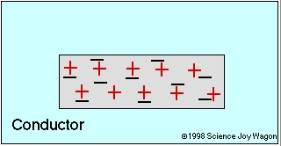
Conductors
Conductor – material that allows electrons to move through it easily
e⁻ (electrons) are loosely held
ex: metals like copper and silver

Slide 5
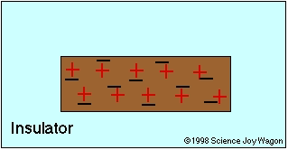
Insulators
Insulator – material that doesn’t allow electrons to move through it easily
e⁻ are tightly held
ex: plastic, wood, rubber, glass

Slide 6
Static Electricity
Static Electricity – the net accumulation of electric charges on an object
Charging – electric charges are transferred from one object to another, total charge is conserved

Slide 7
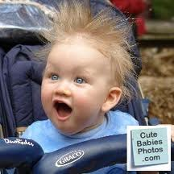
Methods of Charging
Friction – the charging of an object by rubbing two items together
Charges separate (one object becomes more negative, the other more positive)
EX:

Slide 8
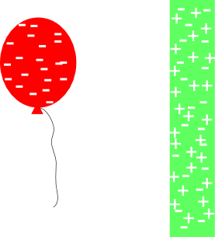
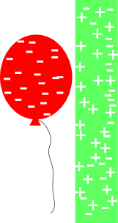
Methods of Charging
Induction – rearrangement of particles to produce a positive side and negative side
Charges move within an object, not between objects
EX:

Slide 9
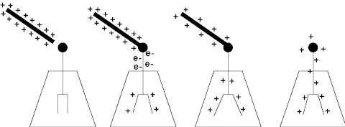
Methods of Charging
Conduction – transfer of charge from one object to another by direct contact
Charges even out between objects
EX:
electroscope

Slide 10
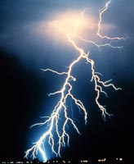
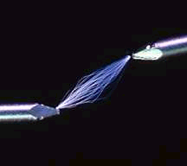
Static Discharge
The movement of electrons to relieve a separation in charge
EX: sparks, lightning

Slide 11
Electrical Quantities
Potential Difference
Current
Resistance

Slide 12
Potential Difference
Potential Difference/Voltage (V) – difference in electrical potential between two places
large separation of charge creates high voltage
the “push” that causes e⁻ to move from - to +
measured in volts (V)

Slide 13
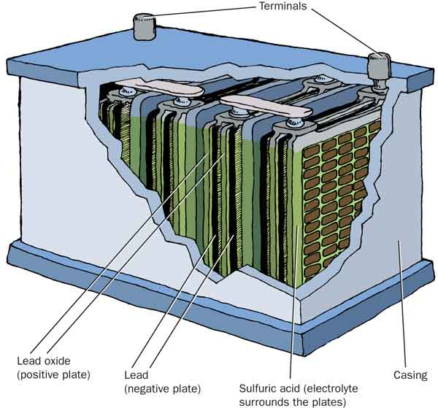
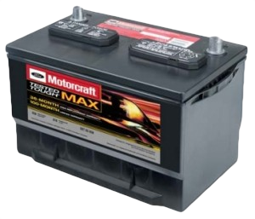
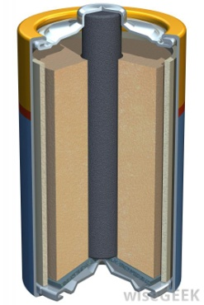
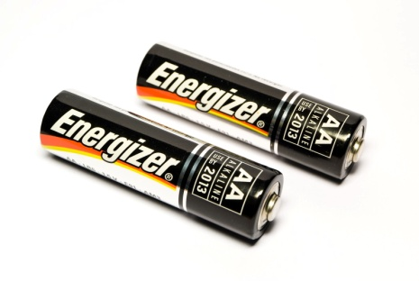
Batteries
Battery – device that converts chemical energy into electrical energy
Provides a consistent voltage (Ex: 9V)
Uses an electrolyte that allows charges to move from one electrode to another
Wet cell – uses a liquid (wet) electrolyte.
Ex: car battery
Dry cell – uses a non-liquid (dry) electrolyte.
Ex: flashlight battery, AA, AAA, C, D

Slide 14
Current
Current (I) – flow of electrons through a conductor
depends on # of e⁻ passing a point in a given time
measured in amperes (A)

Slide 15
Resistance
Resistance (R) – opposition to the flow of electrons
Converts electrical energy to thermal energy & light
measured in ohms (Ω)
Copper - low resistance
Tungsten - high resistance

Slide 16
Resistance Depends on:
Resistivity/type of material
Conductors have low resistivity, insulators have high resistivity
Thickness of wire
Increasing thickness decreases resistance (easier to drink from a wide straw)
Length of wire
Increasing length increases resistance (harder to drink from a long straw)
Temperature
Increasing temperature increases resistance

Slide 17
Ohm’s Law
Ohm’s Law
V = I × R
V: potential
difference (V)
I: current (A)
R: resistance (Ω)

Slide 18
Ohm’s Law
Ohm’s law: V=IR is like Newton’s 2nd Law: F=ma
Current increases when voltage increases.
Stronger push in the circuit, more flow.
Like stronger force = larger acceleration
Current decreases when resistance increases
More resistance to flow, less flow
Like larger mass = smaller acceleration

Slide 19
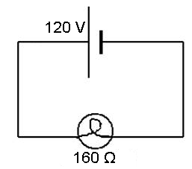
Ohm’s Law
A lightbulb with a resistance of 160 Ω is plugged into a 120-V outlet. What is the current flowing through the bulb?
GIVEN:
R = 160 Ω
V = 120 V
I = ?
WORK:
I = V ÷ R
I = (120 V) ÷ (160 Ω)
I = 0.75 A
V
I
R

Slide 20
Electrical Power
Electrical Power
rate at which electrical energy is converted to another form of energy
P = I × V
P: power (W)
I: current (A)
V: potential
difference (V)

Slide 21
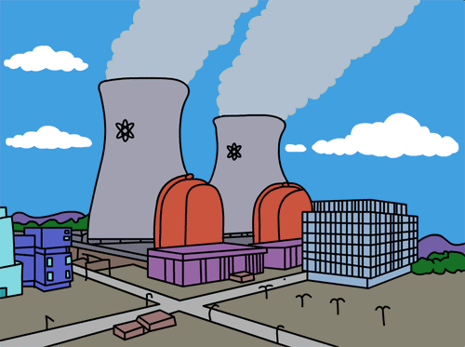
Electrical Power
Electric companies charge for use of electricity based off of amount of energy used
Remember P=W/t so W=P x t
The amount of electrical energy used is electrical power x time
Units: kilowatt-hour (1000 W x 3600 s)

Slide 22
Electrical Power
A calculator has a 0.01-A current flowing through it. It operates with a potential difference of 9 V. How much power does it use?
GIVEN:
I = 0.01 A
V = 9 V
P = ?
WORK:
P = I · V
P = (0.01 A) (9 V)
P = 0.09 W
P
I
V

Slide 23
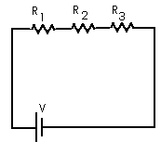
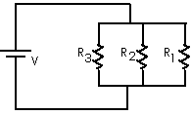
Circuits
Circuit – closed path through which electrons can flow

Slide 24
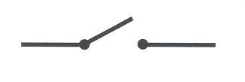
Circuit Components – Symbols
Battery
Resistor
Wire
Junction
Light bulb
Switch

Slide 25
Circuit Components - Diagram
E
F
A - battery C - light bulb E - wire
B - switch D - resistor F - junction

Slide 26
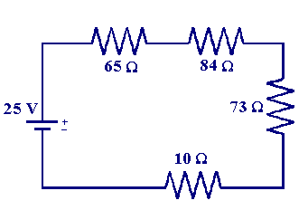
Series Circuits
Objects are arranged one after another.
Current only has one path to travel.
Current is the same through all objects.

Slide 27
Series Circuits
current travels in a single path
one break stops the flow of current
current is the same throughout circuit
lights are equal brightness
each device receives a fraction of the total voltage
get dimmer as lights are added

Slide 28
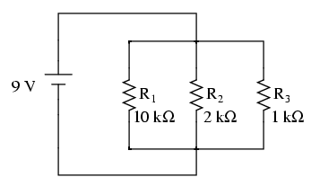
Parallel Circuits
Objects are arranged one beside another.
Current has more than one path to travel.
Current is split up between paths.

Slide 29
Parallel Circuits
current travels in multiple paths
one break doesn’t stop flow
current varies in different branches
takes path of least resistance
“bigger” light would be dimmer
each device receives the total voltage
no change when lights are added

Slide 30
Household Circuits
Combination of parallel circuits
too many devices can cause wires to overheat
Safety Features:
fuse - metal melts, breaking circuit
circuit breaker - bimetallic strip bends when hot, breaking circuit

