Slide 1
Energetics
Honors Chemistry
Enloe High School

Slide 2
Phase Diagrams and Physical States
Phase Diagram: graphical way to show the conditions where the physical states are in equilibrium
Allows us to predict the phase of a substance that is stable at any given temperature and pressure
Normal freezing/melting point: the freezing/melting point of a substance at 1 atm
Normal condensation/boiling point: the condensation/boiling point of a substance at 1 atm
Critical point: temperature and pressure where a substances liquid and vapor phases are indistinguishable

Slide 3
Phase Diagrams and Physical States
Triple Point: Pressure and temperature where all three phases are in equilibrium
Melting/freezing: the equilibrium state between the solid and liquid phases
Boiling/Condensation: the equilibrium state between the liquid and gas phases
Sublimation/deposition: the equilibrium state between the solid and gas phases

Slide 4
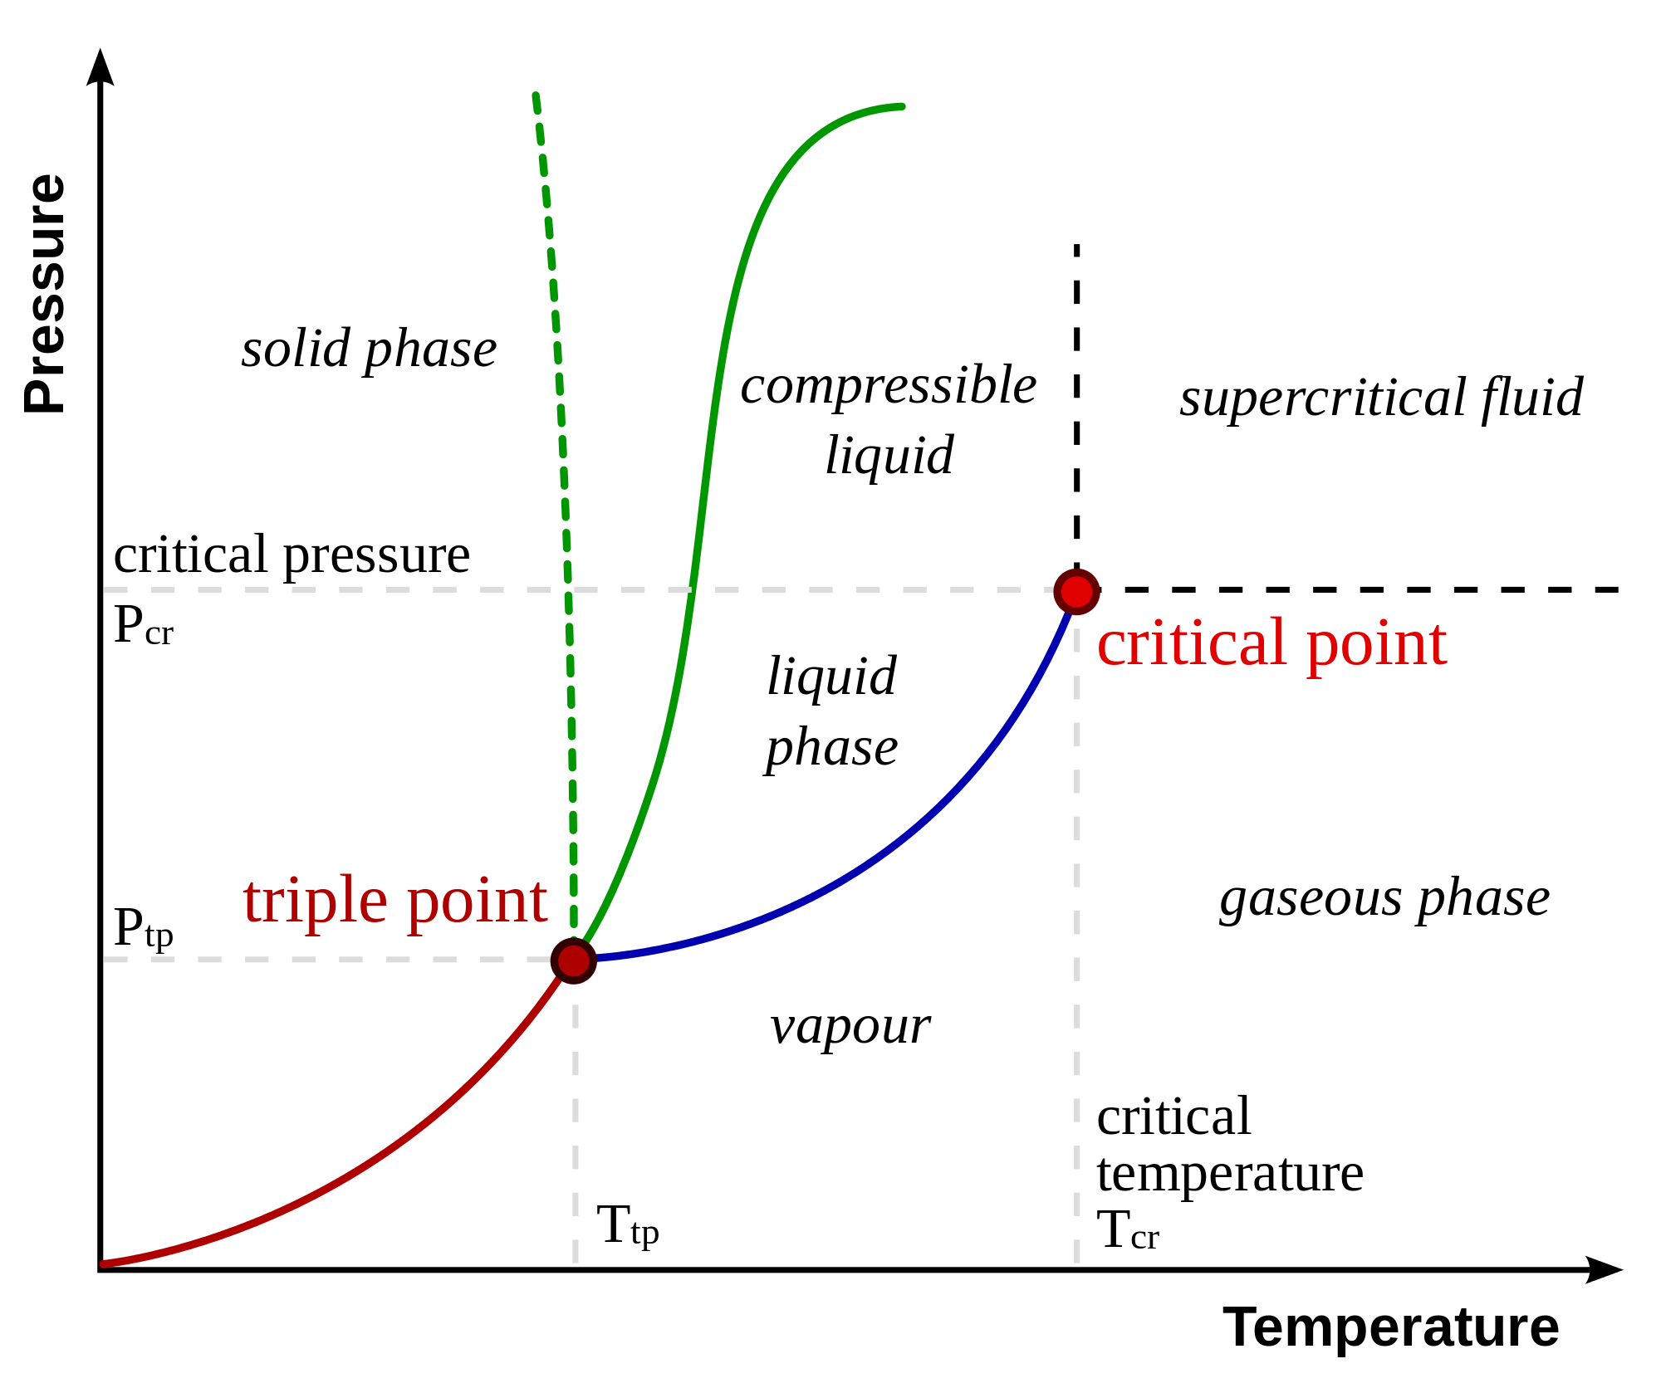

Slide 5
Vapor Pressure Curve
Diagram that shows the temperatures and pressures at which a substance is in equilibrium with the liquid and gas
Vapor Pressure equilibrium condition where the pressure exerted by the gas has attained a constant value
The lower the vapor pressure, the more volatile the liquid will be
Vapor pressure will increase as the temperature of the substance increases
Vapor pressure will also give us information about the intermolecular forces present in a substance

Slide 6
Chemical Kinetics
Area of chemistry concerned with the speeds or rates at which a chemical reaction or process occurs
Another aspect is looking at the change of the concentration of the reactants and products over time
In any reaction the concentration of the reactants decreases and the concentration of the products increases

Slide 7
Collision Theory
A chemical reaction will occur when an effective collision takes place
An effective collision occurs when
The particles have enough energy
AND the proper orientation
Activation Energy: the minimum energy needed in order for a reaction to take place
Activated Complex: A temporary, high energy species formed by the reactant molecules before the products form

Slide 8
Factors that Affect Reaction Rate
Since reactions require effective collisions if we can increase the number of effective collisions, then the reaction will proceed more quickly
Nature of reactants: reactions that require the fewest changes in bond arrangement or ionic compounds that take place in water solutions
Concentration of reactants: when you increase the concentration of a reactant you increase the chances for an effective collision

Slide 9
Factors that Affect Reaction Rate
Temperature: measure of the average kinetic energy of the particles in a system
Higher temperatures correspond to higher energy of the particles.
As a result more collisions occur in a given period of time
Surface area: Increasing the area of contact between two reactants increases the rate
Catalyst: A substance the provides a lower energy pathway for the reaction to take place
The catalyst is not used up during a chemical reaction

Slide 10
Energy Changes/Energy Diagrams
Energy is an extensive property which means it is dependent on the amount of substance present
When we exam energy we are concerned on the path that the energy moves
System: where a reaction takes place
Surroundings: everything that is around the reaction
Energy moves between the surroundings and the system and vice versa

Slide 11
Energy Changes/Energy Diagrams
An open system can exchange mass and energy with the surroundings
A closed system will exchange only heat with the surroundings
When energy enters the system the process is endothermic
When energy leaves the system the process is exothermic
Enthalpy: accounts for the heat flow in a chemical change when the pressure is constant
Change in Enthalpy (ΔH): H_{products} – H_{reactants}
When enthalpy is positive the process is endothermic
When enthalpy is negative the process is exothermic

Slide 12
Energy Diagrams
An energy diagram is a graphical way to show the enthalpy change of a chemical reaction
On an energy diagram we can identify the energy associated with the reactants, products, the activated complex, the net energy change of the forward and reverse reactions, and the activation energy of the forward and reverse reaction

Slide 13
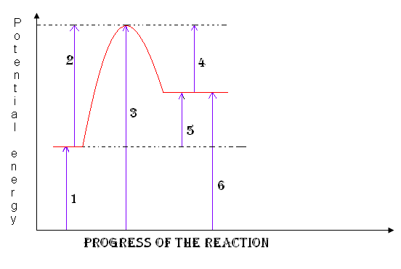

Slide 14
Calorimetry
The study of heat transfer in chemical reactions
Specific Heat Capacity: energy required to raise 1 gram of any substance by 1ºC
Energy is measured in Joules, calories, and hartrees
Heat: transfer of energy from a hotter object to a colder one
Heat capacity: temperature change experienced by an object when it absorbs a certain amount of energy

Slide 15
Relationship between Heat and Temperature
While heat and temperature are different they are related by the following equation:
$q=mCpΔT$
q = heat/energy
m = mass
C_{p} = specific heat capacity
ΔT = change in temperature
Remember the sign of q tells us the direction that energy is being transferred

Slide 16
Heat and Temperature
During any process the Law of Conservation of Energy must be obeyed
The energy lost by one object is transferred to another
This is most easily observed in an insulated/closed system
m₁Cp₁ΔT₁ = m₂Cp₂ ΔT₂

Slide 17
Calorimetry
How many kilojoules of heat are needed to raise the temperature of 2.06 kg of water from 35.14ºC to 76.37ºC?
Calculate the amount of heat lost when 62.75 g of water is cooled from 65.5ºC to 20.0ºC.
A piece of metal with a mass of 3.90 g at a temperature of 99.3ºC is dropped into an insulated container of water. The mass of water is 10.0 g and its temperature before adding the metal is 22.6ºC. The final temperature of the system is 28.5^{O}C. What is the specific heat of the metal?

Slide 18
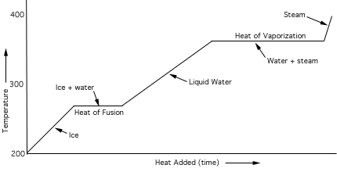
Heating and Cooling Curves

Slide 19
Heating and Cooling Curves
Each graph shows the temperatures at which the phase changes for a substance occur as well as the amount of heat added over a given time period
When a solid, liquid, or gas is being heated there is a change in the kinetic energy
When a phase change is taking place, energy is being added but it is being stored as potential energy
Heat of fusion: energy required to melt 1 gram of a substance
Heat of vaporization: energy required to vaporize 1 gram of a substance

Slide 20
Energy Calculations with Curves
Phase changes present us with an interesting challenge, up to this point all energy calculations have dealt with changes in temperature
To calculate the energy of a phase change use the following equations:
q = mH_{f}
q =mH_{v}

Slide 21
Energy Calculations with Curves
If you have 46.0 grams of water at a temperature of -58ºC, how much energy is needed to heat the water to 114ºC?

