Slide 1
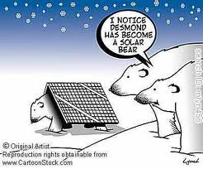
Energy
Physical Science

Slide 2
What is Energy???
Energy is all around us
How do you know that energy is here?
Can you feel energy?
Can you see energy?
Can you hear energy?
Energy is the capacity for doing work, which causes change
Energy can be in many different forms

Slide 3
Types of Energy
THERMAL
The ability to cause change.
ENERGY
NUCLEAR
joules (J)
MECHANICAL
SOUND
ELECTRICAL
LIGHT
CHEMICAL

Slide 4
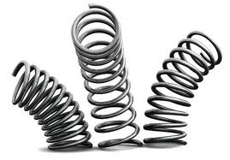
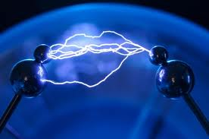
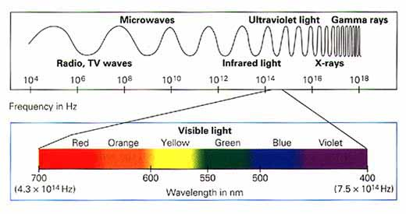
Energy
Elastic Potential Energy –
energy stored in springs
Light Energy –
energy associated with
electromagnetic radiation
Electrical Energy – energy from the flow of electrical charge

Slide 5
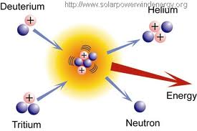
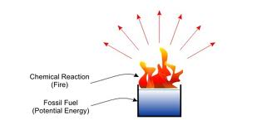
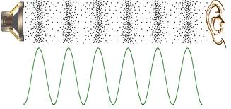
Nuclear Energy –
energy released from
a nuclear reaction
(ie. fission and fusion)
Chemical Potential Energy –
potential of a substance to
undergo a transformation
through a chemical reaction
Sound Energy –
energy produced
by vibrating matter

Slide 6
Energy
Kinetic Energy (KE)
Energy in the form of motion
Depends on mass and velocity
KE = ½ m v²
Units – Joules (J)
Which has the most KE?
80 km/h truck
Which has the least KE?
80 km/h
50 km/h motorcycle
50 km/h
80 km/h

Slide 7
Energy
Potential Energy (PE)
Stored energy
Depends on position of an object
PE = m g h = F_{g} h
Units – Joules (J)
Which boulder has greater gravitational PE?

Slide 8
Mechanical Energy
Energy associated with motion and position
Sum of the Kinetic Energy and Potential energy
ME = KE + PE

Slide 9
Thermal Energy
Measure of the total energy of the PARTICLES in a material
KE - movement of particles
PE - forces within or between particles due to position
Depends on temperature, mass, and type of substance
Measured in Calories or Joules
1 calorie = 4.18400 joules

Slide 10
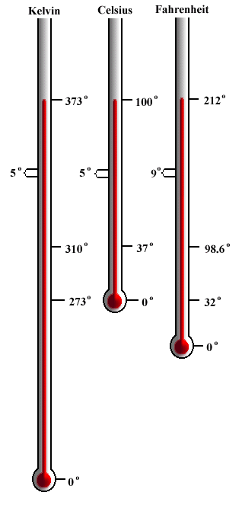
Temperature
Measure of the average KE of the particles in a sample of matter
NOT THE SAME AS THERMAL ENERGY OR HEAT
Measured in °C, °F, Kelvin (SI Unit)

Slide 11
Thermal Energy
Which beaker of water has more thermal energy?
B same temp, more mass
80ºC
80ºC
A
B
400 mL
200 mL

Slide 12
Conservation of Energy
Law of Conservation of Energy:
Energy may change forms, but it cannot be created or destroyed!

Slide 13
Conservation of Mechanical Energy
Without friction: mechanical energy of a system is conserved
Initial ME = Final ME
Recall: ME= KE + PE
With friction: some mechanical energy is not lost, it is converted into heat
Initial ME = Final ME + heat
Total energy is conserved!

Slide 14
Conservation of a Roller Coaster

Slide 15
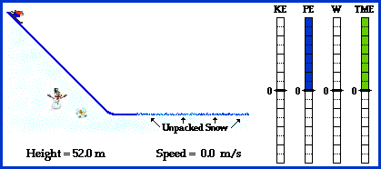
Conservation of a Skier

Slide 16
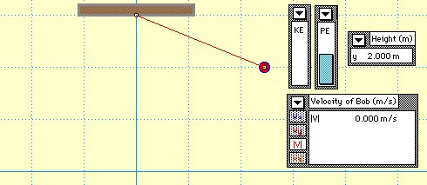
Conservation of a Pendulum

Slide 17
Energy Transfer
Work/Devices
Heat Transfer
Waves

Slide 18
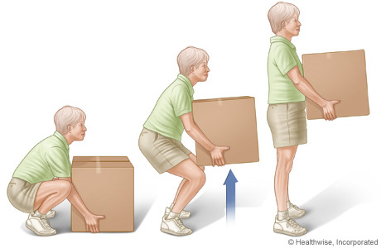
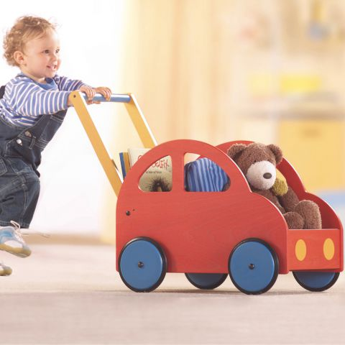
Work
We had two definitions for work:
Force exerted through a distance
Transfer of energy through motion
When work is done, energy changes forms.
Ex: lifting a box, work
converts your food (chemical
potential) energy into
gravitational potential energy
Ex: pushing on a wagon,
work converts your food
(chemical potential) energy
into kinetic energy
Work is a transfer of energy

Slide 19
Let’s Think About This… Give an example of each transfer
Kinetic → Electric
Chemical Potential → Kinetic
Gravitation Potential → Kinetic
Chemical Potential → Thermal
Electrical → Sound/Light
Electric generator
Gasoline engine
Roller coaster
Burning wood
Light bulb

Slide 20
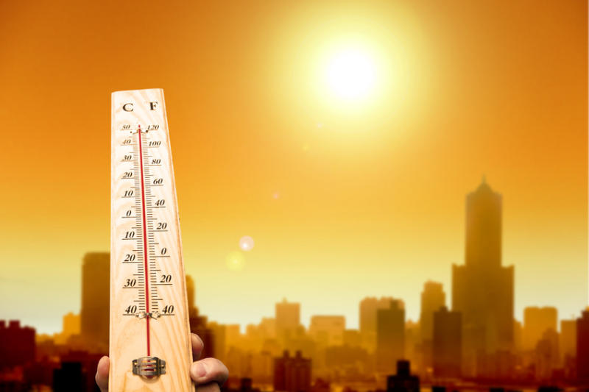
Transfer of Thermal Energy
Heat
thermal energy that flows from a warmer material to a cooler material
Like work, heat is...
measured in joules (J)
a transfer of energy

Slide 21
Heat Transfer
Why does A feel hot and B feel cold?
Heat flows from A to your hand = hot.
Heat flows from your hand to B = cold.
80ºC
10ºC
A
B

Slide 22
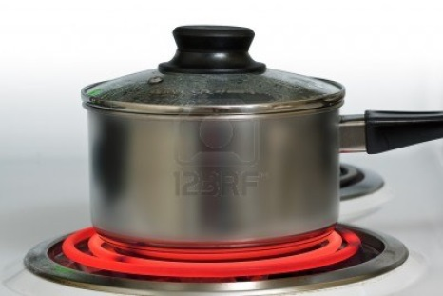
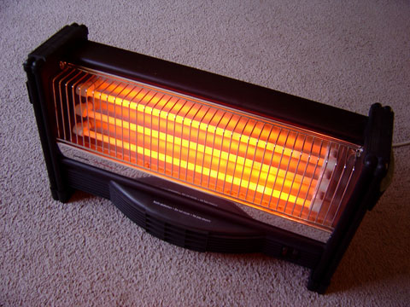
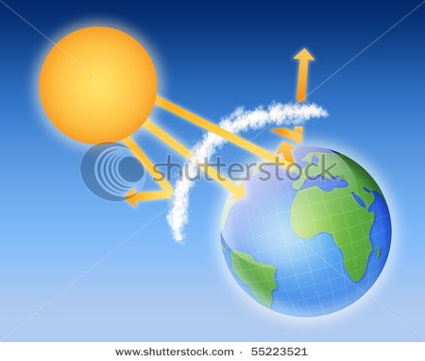
Methods of Heat Transfer
Conduction – transfer of heat energy from one form of matter to another by direct contact.
Example: Electric stove. The hot coil is in contact with the pot and this contact makes it hot.
Convection – transfer of heat energy in fluids from rising and falling currents in a liquid or gas.
Example: Heater. The heater heats air around it, but the air currents transfer heat throughout the room.
Radiation – transfer of heat energy in the form of electromagnetic waves.
Example: Sunlight. It is an electromagnetic wave that travels through space without a medium and heats the earth surface.

Slide 23
Waves
Waves
Rhythmic disturbances that transfer energy through matter or space
Medium
Material used by wave to transport energy
Could be solid, liquid, gas, or combination
Electromagnetic waves don’t need a medium (e.g. visible light)

Slide 24
Types of Waves
Mechanical waves
Longitudinal waves
Transverse waves
Surface waves
Electromagnetic waves

Slide 25
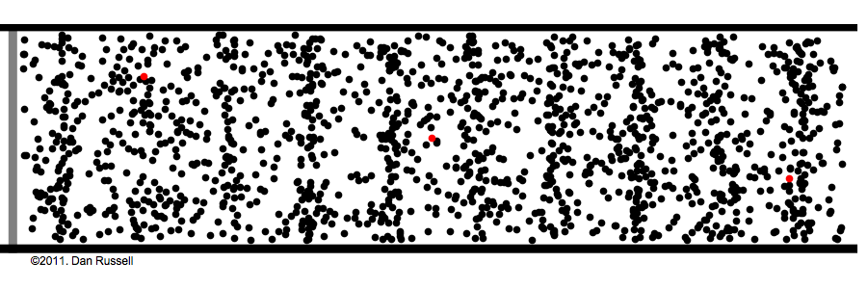
Mechanical Waves
Waves that require a medium through which to travel.
Two types:
Longitudinal (a.k.a. compressional) – Medium moves in the same direction as wave motion. Ex: SOUND
Transverse – medium moves perpendicular to the direction of wave motion

Slide 26
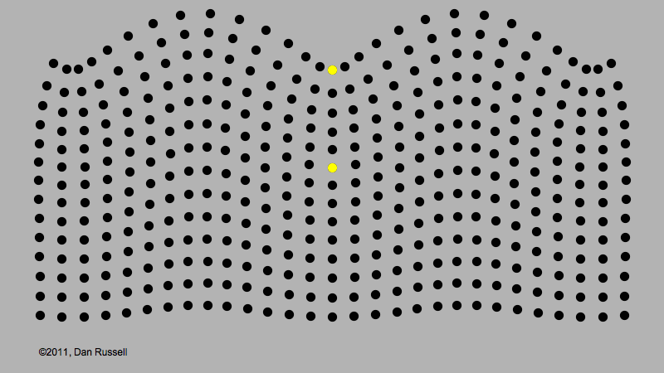
Surface Waves
Surface Waves:
Medium moves in a longitudinal and compressional motion
Water Earthquake: Rayleigh surface waves

Slide 27
EM Radiation
Electromagnetic Waves (light)
Waves produced by the motion of electrically charged particles
Move through electric and magnetic fields, does not require a medium
All light travels at the same speed in a vacuum = 300,000,000 m/s

Slide 28
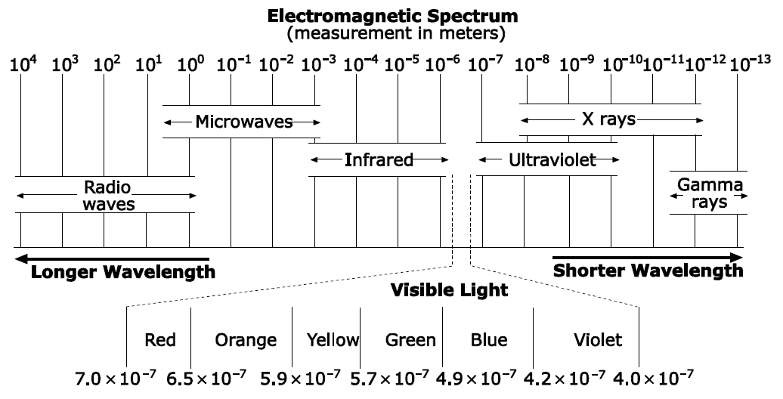
Electromagnetic Spectrum
Arranged by wavelength
Longer wavelength: lower frequency, lower energy
Shorter wavelength: higher frequency, higher enerygy

Slide 29
Seeing Colors
Stimulates red & green cones
Different colors of light have different wavelengths
White light has all colors
The human eye retina contains…
Rods - dim light, black & white
Cones - color
red - absorb red & yellow
green - absorb yellow & green
blue - absorb blue & violet
Stimulates all cones

Slide 30
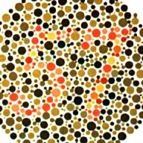
Seeing Colors
Color Blindness
one or more sets of cones do not function properly
Test for red-green color blindness.

Slide 32
Negative Afterimage - One set of cones gets tired, and the remaining cones produce an image in the complimentary color.

Slide 33
Wave Parts
Wavelength (λ) – distance between one point on a wave and the nearest point just like it
Distance – measured in meters (m)
Amplitude (A) – measure of the amount of energy in a wave
Period (T)– amount of time it takes one wavelength to pass a point
Time – measured in seconds (s)
Frequency (f)– number of wavelengths that pass by a point each second
Equal to 1/period
Large period = small frequency
1/time – measured in Hertz (Hz). 1 Hz = 1/s

Slide 34
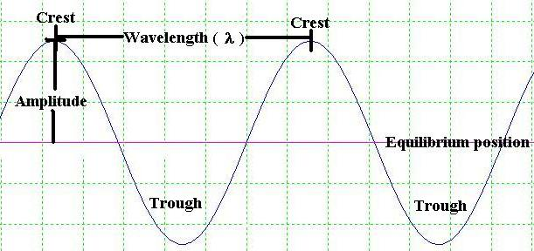
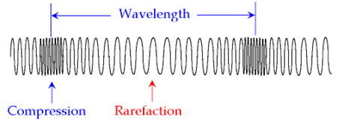
Wave Parts
Transverse Wave
Equilibrium – rest position of particles
Longitudinal Wave
Compression – where particles are tightly spaced together
Rarefaction – where particles are spread apart

Slide 35
Measuring Waves
Velocity ( v )
Speed of a wave as it moves forward
Depends on wave type and medium
Equation: v = λ f
v: velocity(m/s)
λ: wavelength (m)
f: frequency (Hz)
v
λ
f

Slide 36
Measuring Waves
EX: Find the velocity of a wave in a wave pool if its wavelength is 3.2 m and its frequency is 0.60 Hz.
GIVEN:
v = ?
λ = 3.2 m
f = 0.60 Hz
WORK:
v = λ × f
v = (3.2 m)(0.60 Hz)
v = 1.92 m/s
v
λ
f

Slide 37
Measuring Waves
EX: An earthquake produces a wave that has a wavelength of 417 m and travels at 5000 m/s. What is its frequency?
GIVEN:
λ = 417 m
v = 5000 m/s
f = ?
WORK:
f = v ÷ λ
f = (5000 m/s) ÷ (417 m)
f = 12 Hz
v
λ
f

Slide 38
Wave Properties
Wave Properties
Reflection
Refraction
Interference

Slide 39
Reflection
When a wave strikes an object and bounces off
Ex: Mirror
Ex: Sound echoing off a gym wall
Light reflects at same angle from the normal
Normal – imaginary line perpendicular to the surface
Normal
incident beam
reflected beam

Slide 40
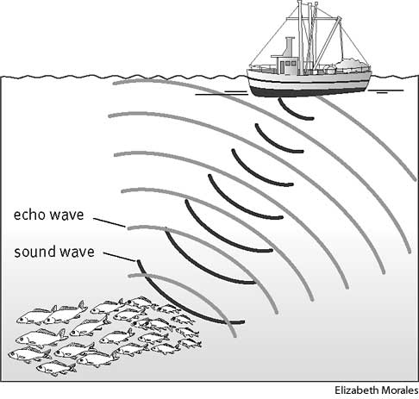
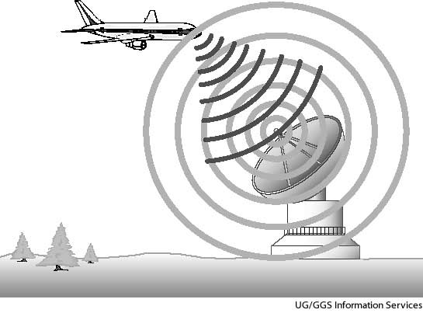
SONAR and RADAR
SONAR (sound navigation and ranging) – system that uses the reflection of sound waves to detect objects underwater
RADAR (radio detection and ranging) – system that uses the reflection of radio (form of EM) waves to find position and movement of objects

Slide 41
Refraction
Bending of waves when passing from one medium to another
Caused by a change in speed
slower (more dense) ⇒ light bends toward the normal
faster (less dense) ⇒ light bends away from the normal
SLOWER
FASTER

Slide 42
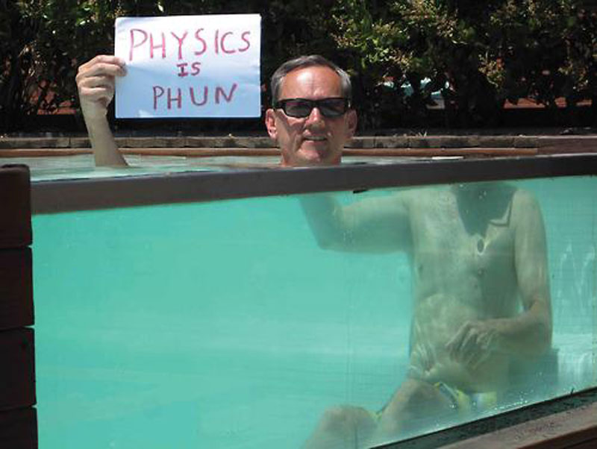
Refraction
Example:

Slide 43
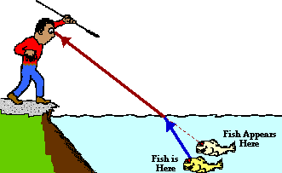
Refraction
Example:

Slide 44
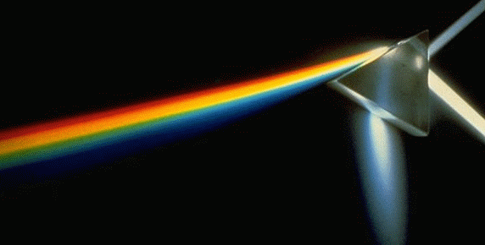
Refraction
Example
Amount of diffraction depends on wavelength of the light - shorter wavelengths (blue) bend more
Prism: white light enters, different colors bend a different amount

Slide 45
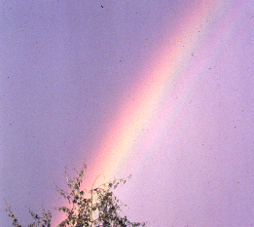
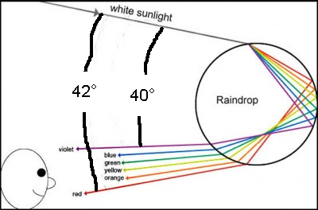
Refraction
Rainbows
White light from sun enters rain drop, it refracts, reflects, and refracts again.

Slide 46
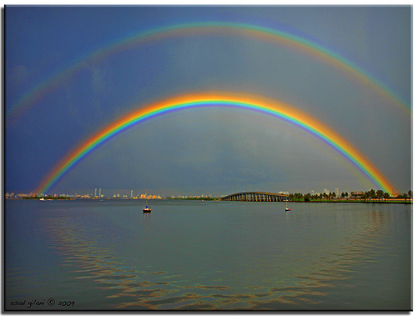
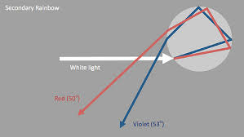
Refraction
Double Rainbows
Light reflects twice inside rain drop

Slide 47
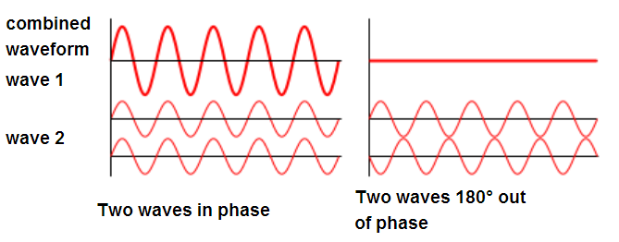
Interference
When two waves combine, they add
Two waves at the same point (in phase): highs add to be even higher
Waves at opposite points (out of phase): highs and lows can add to zero

Slide 48
Interference
Interference
constructive ⇒ brighter light (highs add to be higher)
destructive ⇒ dimmer light (highs and lows add to 0)

