Slide 1
Motion & Forces
Newton’s Laws of Motion
“If I have seen far, it is because I have stood on the shoulders of giants.”
- Sir Isaac Newton
(referring to Galileo)

Slide 2
Force
Force
a push or pull that one body exerts on another
What forces are being exerted on the football?
F_{kick}
F_{grav}

Slide 3
Newton’s Laws of Motion

Slide 4
Newton’s First Law
Newton’s First Law of Motion
“Law of Inertia”
Inertia
tendency of an object to resist any change in its motion
increases as mass increases

Slide 5
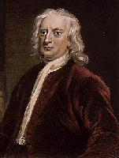
Newton’s First Law
Newton’s First Law of Motion
An object at rest will remain at rest and an object in motion will continue moving at a constant velocity unless acted upon by a net force.

Slide 6
Newton’s First Law
Balanced Forces
forces acting on an object that are opposite in direction and equal in size
no change in velocity

Slide 7
What if the forces aren’t balanced?
Net Force
unbalanced forces that are not opposite and equal
velocity changes (object accelerates)
F_{net}
F_{friction}
F_{pull}
N
N
W

Slide 8
Newton’s Second Law
Newton’s Second Law of Motion
The acceleration of an object is directly proportional to the net force acting on it and inversely proportional to its mass.
F = ma

Slide 9
Newton’s Second Law
F
F
m
m
a
F = ma
F: force (N)
m: mass (kg)
a: accel (m/s²)
1 N = 1 kg ·m/s²

Slide 10
Calculations
What force would be required to accelerate a 40 kg mass by 4 m/s²?
GIVEN:
F = ?
m = 40 kg
a = 4 m/s²
WORK:
F = ma
F = (40 kg)(4 m/s²)
F = 160 N
F
m
a

Slide 11
Calculations
A 4.0 kg shotput is thrown with 30 N of force. What is its acceleration?
GIVEN:
m = 4.0 kg
F = 30 N
a = ?
WORK:
a = F ÷ m
a = (30 N) ÷ (4.0 kg)
a = 7.5 m/s²
F
m
a

Slide 12
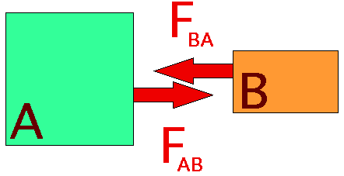
Newton’s Third Law
Newton’s Third Law of Motion
When one object exerts a force on a second object, the second object exerts an equal but opposite force on the first.

Slide 13
Newton’s Third Law
Problem:
How can a horse pull a cart if the cart is pulling back on the horse with an equal but opposite force?
Aren’t these “balanced forces” resulting in no acceleration?
NO!!!

Slide 14
Newton’s Third Law
Explanation:
forces are equal and opposite but act on different objects
they are not “balanced forces”
the movement of the horse depends only on the forces acting on the horse

Slide 15
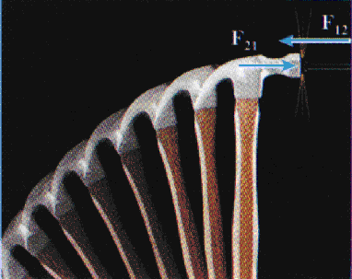
Newton’s Third Law
Action-Reaction Pairs
The hammer exerts a force on the nail to the right.
The nail exerts an equal but opposite force on the hammer to the left.

Slide 16
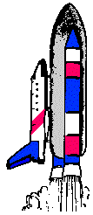
Newton’s Third Law
Action-Reaction Pairs
The rocket exerts a downward force on the exhaust gases.
The gases exert an equal but opposite upward force on the rocket.
F_{G}
F_{R}

Slide 17
Newton’s Third Law
Action-Reaction Pairs
Both objects accelerate.
The amount of acceleration depends on the mass of the object.
F
m
Small mass ⇒ more acceleration
Large mass ⇒ less acceleration

Slide 18
Types of Different Forces

Slide 19
Gravity
Gravity
force of attraction between any two objects in the universe
increases as...
mass increases
distance decreases

Slide 20
Gravity
Who experiences more gravity - the astronaut or the politician?
Which exerts more gravity - the Earth or the moon?
more mass
less distance

Slide 21
Gravity
Would you weigh more on Earth or Jupiter?
Jupiter because...
greater mass
greater gravity
greater weight

Slide 22
Gravity
Weight
the force of gravity on an object
This follows Newton’s Second Law!
W = mg
W: weight (Newtons)
m: mass (kg)
g: acceleration due to gravity (m/s²)

Slide 23
Gravity
Mass vs. Weight
Mass – always the same! (kg)
Weight – Depends on gravity (N)
Would you weigh more on Earth or Jupiter?
Jupiter – it’s gravity and stronger than Earth’s. Your MASS would be the same on Jupiter.

Slide 24
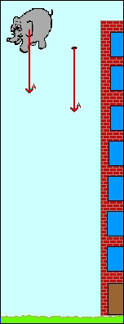
Gravity
Accel. due to gravity (g)
Without air resistance, all falling objects have the same acceleration!
On Earth: g = 9.8 m/s²
elephant
feather
Animation from “Multimedia Physics Studios.”
Notes:
Ended 7th 9/27

Slide 25
Calculations
Mrs. J. weighs 557 N. What is her mass?
GIVEN:
F(W) = 557 N
m = ?
g = 9.8 m/s²
WORK:
m = F ÷ g
m = (557 N) ÷ (9.8 m/s²)
m = 56.8 kg
F
m
g
Notes:
Ended 8th 9/27

Slide 26
Concept Test
Is the following statement true or false?
An astronaut has less mass on the moon since the moon exerts a weaker gravitational force.
False! Mass does not depend on gravity, weight does. The astronaut has less weight on the moon.

Slide 27
Friction
Friction
force that opposes motion between 2 surfaces
depends on the:
types of surfaces
force between the surfaces

Slide 28
Friction
Friction is greater...
between rough surfaces
when there’s a greater force between the surfaces (e.g. more weight)

Slide 29
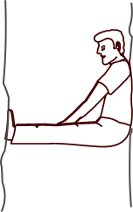
Friction
Static Friction
Prevents two surfaces
from sliding past
each other
No motion!

Slide 30
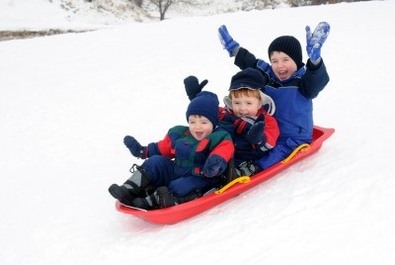
Friction
Kinetic (sliding) Friction
Opposes the motion of two surfaces sliding past each other
Requires motion!

Slide 31
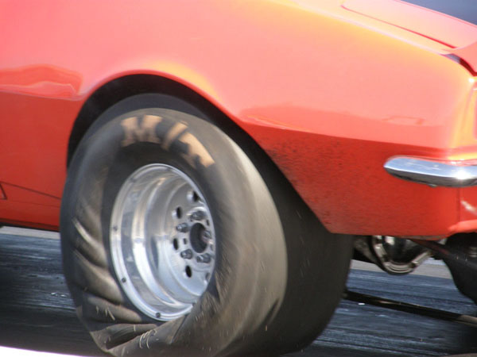
Friction
Rolling Friction
Frictional force between a rolling object and the surface it rolls on

Slide 32
Air Resistance
Air Resistance
a.k.a. “fluid friction” or “drag”
force that air exerts on a moving object to oppose its motion
depends on:
speed
surface area
shape
density of fluid

Slide 33
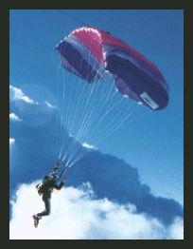
Air Resistance
Terminal Velocity
maximum velocity reached by a falling object
reached when… F_{grav} = F_{air}
F_{air}
no net force
⇒ no acceleration
⇒ constant velocity
F_{grav}

Slide 34
Air Resistance
Falling with air resistance
heavier objects fall faster because they accelerate to higher speeds before reaching terminal velocity
F_{grav} = F_{air}
larger F_{grav}
⇒ need larger F_{air}
⇒ need higher speed
Animation from “Multimedia Physics Studios.”

Slide 35
Momentum

Slide 36
Momentum
Momentum
quantity that describes the motion
p = mv
p
p: momentum (kg ·m/s)
m: mass (kg)
v: velocity (m/s)
m
v

Slide 37
Momentum
Find the momentum of a bumper car if it has a total mass of 280 kg and a velocity of 3.2 m/s.
GIVEN:
p = ?
m = 280 kg
v = 3.2 m/s
WORK:
p = mv
p = (280 kg)(3.2 m/s)
p = 896 kg·m/s
p
m
v

Slide 38
Momentum
The momentum of a second bumper car is 675 kg·m/s. What is its velocity if its total mass is 300 kg?
GIVEN:
p = 675 kg·m/s
m = 300 kg
v = ?
WORK:
v = p ÷ m
v = (675 kg·m/s)÷(300 kg)
v = 2.25 m/s
p
m
v

Slide 39
Conservation of Momentum
Law of Conservation of Momentum
The total momentum in a group of objects doesn’t change unless outside forces act on the objects.
p_{before} = p_{after}

Slide 40
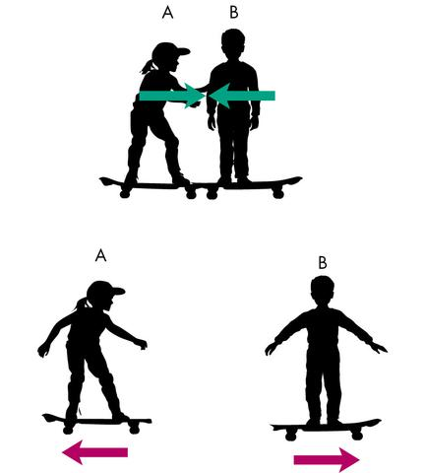
Conservation of Momentum
Newton’s 3rd Law Revisited
Example: Two people push off each other.
Newton’s 3rd Law says the forces are opposite.
Result: one positive, one negative velocity.
Total momentum is conserved!

Slide 41
Conservation of Momentum
A 5-kg cart traveling at 4.2 m/s strikes a stationary 2-kg cart and they connect. Find their speed after the collision.
BEFORE
Cart 1:
m = 5 kg
v = 4.2 m/s
Cart 2 :
m = 2 kg
v = 0 m/s
AFTER
Cart 1 + 2:
m = 7 kg
v = ?
p = 21 kg·m/s
p
m
v
p = 0
v = p ÷ m
v = (21 kg·m/s) ÷ (7 kg)
v = 3 m/s
p_{before} = 21 kg·m/s
p_{after} = 21 kg·m/s

Slide 42
Impulse
Impulse is the product of average force and time.
Impulse = FΔt
Impulse is equal to change in momentum.
Recall: F=ma, or F=mΔv/Δt
This means FΔt = mΔv

Slide 43
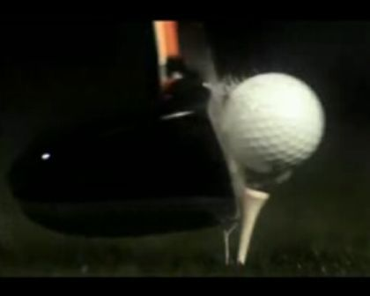
Impulse
A larger change in momentum can be caused by:
Larger force
Longer
contact time
of force

Slide 44
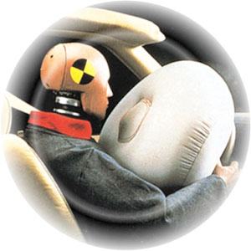
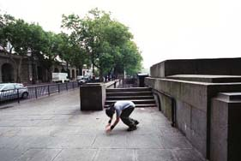
Impulse
OR, for the same change in momentum:
Larger contact time = smaller force
Shorter contact time = larger force
Examples:

