Slide 1
Chemical Reactions
Unit 3
Enloe High School

Slide 2
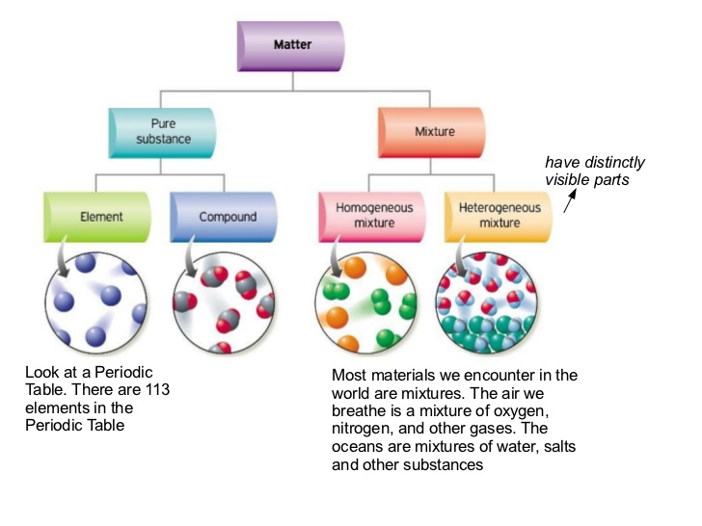
Matter is anything that has mass and volume
All matter is either a pure substance or a mixture

Slide 3
Types of pure Substances
Element – any substance made up of only one
type of atom
oxygen, helium, silver, carbon
http://periodictable.com/
Compound – a substance in which two or more elements are combined
Chlorine Gas + Sodium metal = Sodium Chloride (salt)
Cl₂ + Na = NaCl

Slide 4
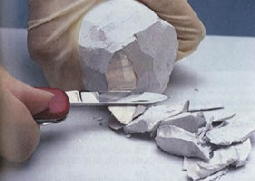
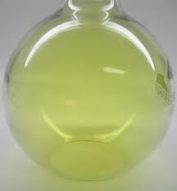
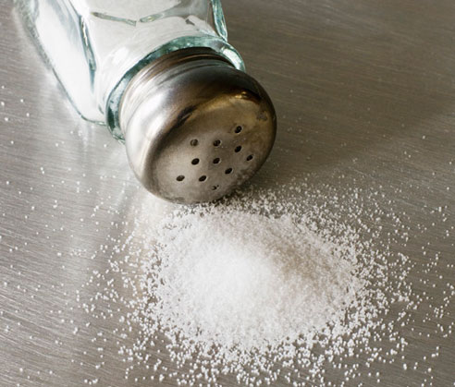
Forming Compounds: Sodium metal + chlorine gas = Sodium Chloride (salt) Na + Cl₂ NaCl :
sodium
Chlorine
Sodium chloride

Slide 5
Each pure substance is unique because it always has a constant composition and can be identified by a chemical symbol or chemical formula and distinct properties.
Examples:
Water is known as H₂0. It has a melting point of 0º and a boiling point of 100º.
“Salt” commonly means NaCl and is a white crystal that tastes good on food
Aluminum has the symbol Al and is a shiny, silver metal.

Slide 6
Law of Conservation of Mass
During physical or chemical changes matter is neither created nor destroyed.
Chemical reactions do involve the separation, combination, or rearrangement of atoms.
Mass of products = mass of reactants
The number of atoms of each element must be the same on both sides of the equation

Slide 7
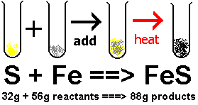
The Law of conservation of Mass
Matter cannot be created or destroyed

Slide 8
Physical Change v. Chemical Change
Remember pure substances or just ‘substances’ is the term used to describe elements and compounds. Chemical formulas can be written for them.
Physical Change does not create new substances
Chemical Change creates a new substance

Slide 9
Physical Properties
Characteristics that can be observed or measured without changing the composition
Examples:
Phase
Density
Viscosity
Conductivity
Solubility
Boiling/Condensing Point
Melting/Freezing Point
Mass
Volume
Color
Shape
Specific heat

Slide 10
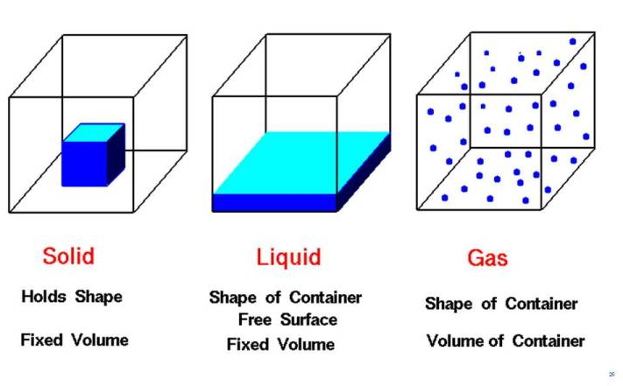
Phases of matter
Phase (or state) of matter refers to its form
Solid – particles are very close together and vibrating in fixed positions. It has a definite shape and volume
Liquid – particles are more disorganized and can move relative to the other particles. It has a definite volume, no definite shape
Gas – particles are completely free to move and have no order or structure. It has no definite volume or definite shape

Slide 11
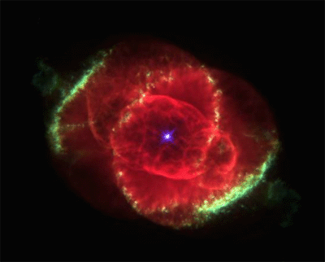
Other Phases of matter
Plasma
very high KE - particles collide with enough energy to break into charged particles (+/-)
gas-like, indefinite shape & volume
stars, fluorescent light bulbs, TV tubes

Slide 12
Other Phases of matter
Bose-Einstein condensates
In 1995, technology enabled scientists to create a new state of matter, the Bose-Einstein condensate (BEC).
At an extremely low temperature, molecular motion comes very close to stopping altogether. Since there is almost no kinetic energy being transferred from one atom to another, the atoms begin to clump together.
There are no longer thousands of separate atoms, just one “super atom”
A BEC also has many of the properties of a superfluid — flowing without friction.
BECs are also used to simulate conditions that might apply in black holes.

Slide 13
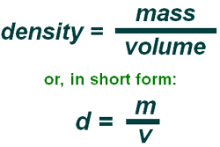
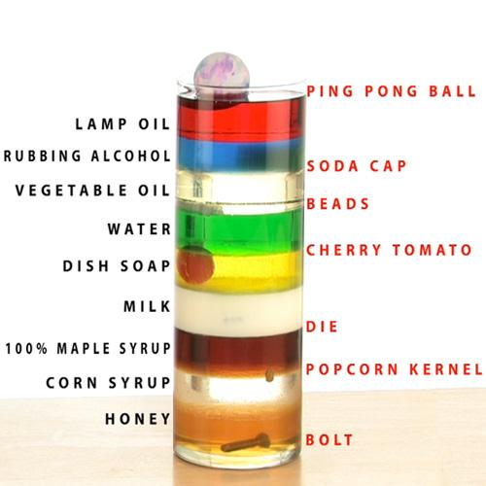
More Physical properties:
M
D
V

Slide 14
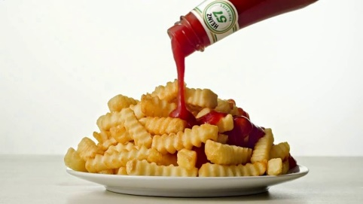
Even More Physical properties!
Viscosity – measure of a fluids resistance to flow
Conductivity – measure of a material’s ability to move electrical current
Solubility – maximum amount of a substance that will dissolve under standard conditions
Think sugar and water

Slide 15
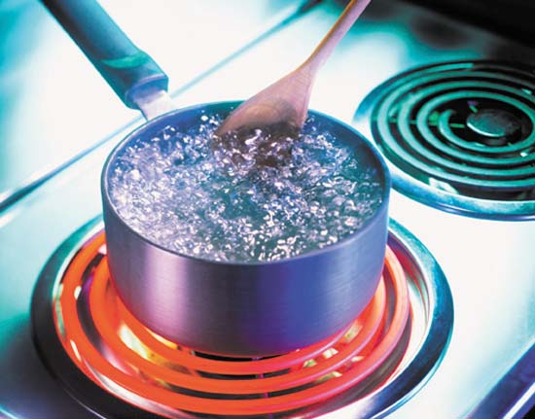
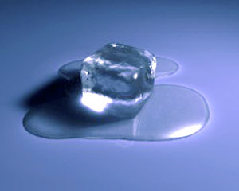
Physical Properties
Boiling point is the temperature at which a liquid becomes a gas or a gas becomes a liquid.
Melting point is the temperature at which a solid becomes a liquid. The same temperature is known as the freezing point when a liquid becomes a solid.

Slide 16
More physical Properties!
Mass is the measurement of the quantity of matter and is measured in grams
Volume is the measurement of the space occupied by matter and is measured in mL or cm³
Color is the property of things that is caused by differing qualities of the light reflected or emitted by them
Shape is the characteristic surface outline or contour of an object

Slide 17
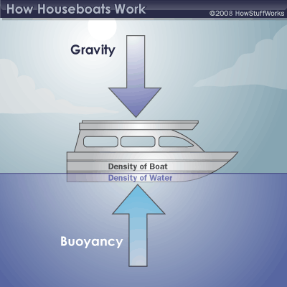
Buoyancy is the tendency of matter to float in a liquid or rise up in the air

Slide 18
What are some Physical Changes?
Evaporating
Condensing
Freezing
Melting
Sublimation
Deposition
Expanding
Cutting
Breaking
Conducting
Mixing
Bending

Slide 19
Physical changes Phase changes
Melting
solid to liquid
Freezing
liquid to solid melting point = freezing point
Vaporization (boiling)
liquid to gas at the boiling point
Evaporation
liquid to gas below the boiling point
Condensation
gas to liquid
Sublimation
solid to gas
EX: dry ice, freeze drying, iodine

Slide 21
Cutting, breaking and tearing matter into smaller pieces.
Mixing is when two or more substances are blended and each substance keeps its unique properties.

Slide 22
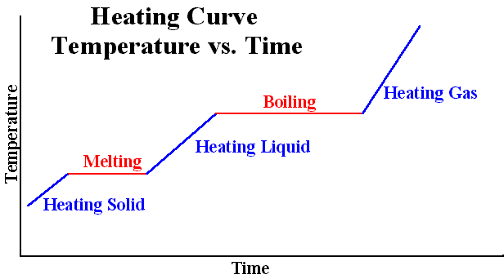
Lets Heat things up!!!
We can use a heating curve to help us understand how substances undergo a phase change from a solid to a gas

Slide 23
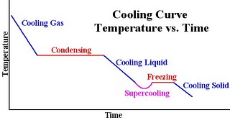
Now cool it down…
Opposite of heating is cooling
Phase change of a gas to a solid

Slide 24
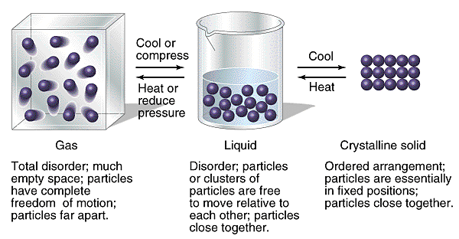
Kinetic Molecular Theory
Kinetic Theory KMT of matter describes the movement of matter.
Kinetic Energy is the energy of motion. Temperature is the measure of the average kinetic energy of the particles in matter
Potential energy is the energy of position. Temperature is constant when the average distance between particles changes

Slide 25
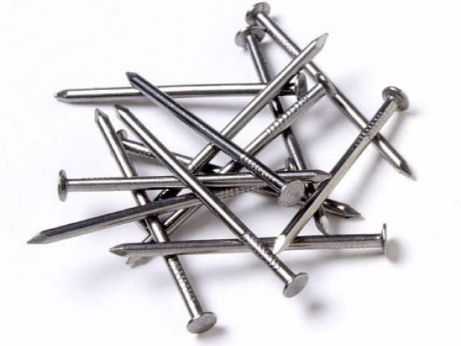
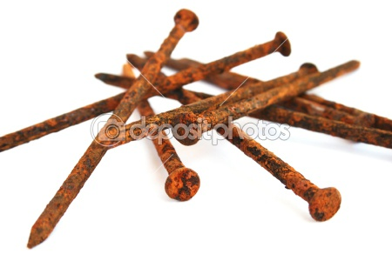
Chemical Properties
Describes a specific chemical change that alters the composition of a substance
Reactivity-is the tendency of a substance to undergo chemical reaction, either by itself or with other materials.
Flammability- is the tendency of a substance to burn in the presence of oxygen
Light Exposure

Slide 26
Chemical Changes
Any change that results in the formation of new substances
Examples:
Combustion – combines with oxygen and burns
Corrosion – weakening/discoloration of metals
Oxidation – substances combine with oxygen
Growth – combines small substances to form larger more complex substances
Decomposition and decay – breaks down large structures into smaller ones
In all examples… the key is that there is a formation of a new material!

Slide 27
Indicators of a Chemical Change
Change in energy
a. Change in temperature
b. Emission of light
Formation of a precipitate (solid forms from solution in a chemical reaction)
Liberation of a gas
Color Change (understand the difference between the color change due to a chemical reaction and one due to dilution)
Note: Just because you see one or more of these doesn’t always mean you’ve seen a chemical change. These are used in addition to other scientific evidence of new substances

Slide 28
Product Testing
Burning Splint
What happens to the splint in the presence of each of the following?
H₂ – gets brighter
O₂ – gets brighter
CO₂ – gets dimmer
Lime Water
CO₂ – white precipitate

Slide 29
Chemical Equation
Expression that shows the elements or compounds that take part in a reaction, the new substances formed in the reaction, and any conditions necessary for the reaction.
Cl₂(g) + 2HBr(aq) → 2HCl(aq) + Br₂(l)

Slide 30
Symbols and Terms
+ on reactants side – “reacts with”
+ on products side – “and”
→ “produces” or “yields”
Reactants – starting substances, left side
Products – new substances formed, right side
Coefficients – numbers placed in front of a symbol or formula to indicate the number of particles or moles of that substance
Balanced – same number of atoms or ions of each type on both sides of the equation

Slide 31
Balancing Chemical Equations
Write a skeleton equation that shows the correct chemical formula for reactants and products.
Determine the __________ of ________ of each type on each side of the equation.
Use _________________ to balance the equation. _________________ SHOULD NEVER BE CHANGED.
Make sure that you have the smallest possible whole number coefficients.
Explain and give an example to demonstrate how changing a subscript is different from changing a coefficient.

Slide 32
Symbols
(g) – gas
(l) – liquid
(s) – solid
(aq) – aqueous; dissolved in water
∆ – heat
- electricity
hν – electromagnetic radiation
Any other conditions for the reaction are shown above or below the yield sign.

Slide 33
Identifying Physical States in Chemical Reactions
Elements
(l) Hg, Br₂
(g) H₂ , N₂, O₂ , F₂ , Cl₂
(s) all other elements

Slide 34
Identifying Physical States in Chemical Reactions
Organic Compounds
(g) Hydrocarbons C_{x}H_{y}
(l) alcohols C_{x}H_{y}OH
(s) sugar C_{x}H_{y}O_{z}

Slide 35
Identifying Physical States in Chemical Reactions
Ionic Compounds
(s) in synthesis and decomposition
(aq) in single replacement
Refer to solubility rules to determine the physical state in double replacement reactions

Slide 36
Identifying Physical States in Chemical Reactions
Other Compounds
H₂O (l) unless otherwise specified
(g) Other nonmetal oxides: CO_{2,} NO₂, SO₂, SO₃

Slide 37
Identifying Physical States in Chemical Reactions
Acids
Acids are aqueous (aq) HCl, HNO₃, H₂SO₄, HClO₃, HC₂H₃O₂, etc.
Binary compounds with hydrogen are gases unless otherwise specified: (g) H₂S, NH₃, CH₄, HCl

Slide 38
Electrolytes
Substance that separates into ions when dissolved in H₂O. The solution conducts electricity.
Strong electrolytes – exists ONLY as IONS in soln.

Slide 39
Electrolytes
Strong Acids
HCl (aq)
HNO₃ (aq)
HClO₄ (aq)
HBr (aq)
H₂SO₄ (aq)
HI (aq)
HClO₃ (aq)

Slide 40
Weak Electrolytes
Weak electrolytes exists as molecules and ions in solution.
Weak Acids
HF (aq)
HC₂H₃O₂ (aq)
Weak Bases
NH₃ (g)

Slide 41
Nonelectrolytes
Nonelectrolytes exists as molecules in solution
Substances that are NOT Acids, Bases or soluble ionic compounds

Slide 42
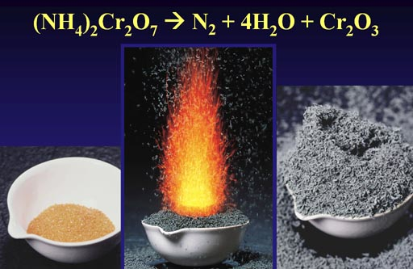
Types of Chemical Reactions

Slide 43
1. Synthesis reaction
When two or more substances combine to make a more complex single substance
2H₂ + O₂ →2H₂O
Example: hydrogen and oxygen to make water
A + B → AB

Slide 44
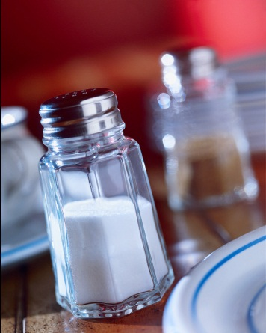
Synthesis
Have the general formula..
A + B → AB
Element
Or
Compound
Element
Or
Compound
+ Compound
Ex. 4Fe_{(s)} + 3 O_{2(g)}→2Fe₂O_{3(s)}
. 2CO + O₂ → 2CO₂
2Na + Cl₂ → 2NaCl

Slide 45
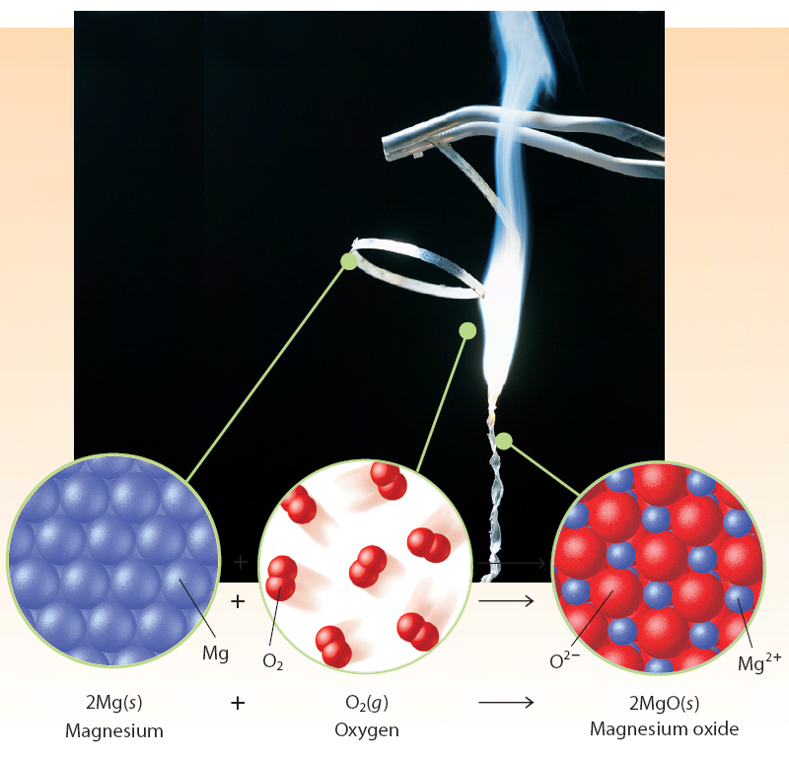
Synthesis Reaction

Slide 46
2. Decomposition reaction
Breaking down compounds into simpler products
2H₂O₂ → 2H₂O + O₂
Example: Hydrogen peroxide decomposes into water and oxygen gas
AB → A + B

Slide 47
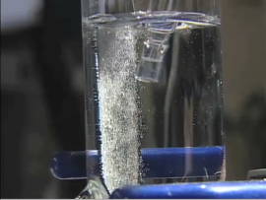
Decomposition
Have the general formula..
AB → A + B
Element
Or
Compound
Element
Or
Compound
Compound +
A single compound is broken down into 2 simpler substances
Ex. 2H₂O_{(l)} →2H_{2(g)} + O_{2(g)}
2NaCl → 2Na + Cl₂

Slide 48
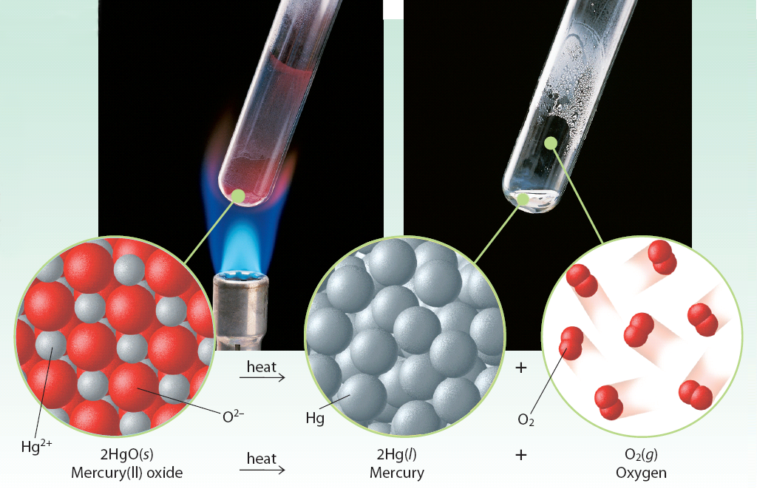
Decomposition Reaction

Slide 49
Which one is a Synthesis reaction?
Which one is a Decomposition reaction?
2K + Br₂ → 2KBr
2H₂0 → 2H₂ + O₂
2NaCl → 2Na + Cl₂
4Au + 3O₂ → 2Au₂O₃
2Na + 2HCl → 2NaCl + H₂
Cu + Br₂→ CuBr₂
Zn + S → ZnS
8. 2Na + Br₂ → 2NaBr
9. 2HgO → 2Hg + O₂
10. 2Na + I₂ → 2NaI
11. CuCl₂ → Cu + Cl₂
12. 3Hf + 2N₂ → Hf₃N₄
13. Zn + 2HCl → ZnCl₂ + H₂
14. 2NaOH → 2Na + O₂+ H₂

Slide 50
3. Single Replacement reaction
When one element replaces another in a compound
Single (one element replaces another)
Zn + 2HCl → ZnCl₂ + H₂
A + BC → AC + B

Slide 51
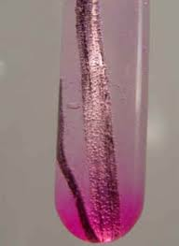
Single Replacement
Have the general formula..
A + BC → AC + B
Element
Element
+
Compound
Compound
+
Note: a metal replaces a metal; nonmetal replaces a nonmetal
Ex.Mg_{(s)}+ 2HCl_{(aq)}→H_{2(g)}+ MgCl_{2(aq)}

Slide 52
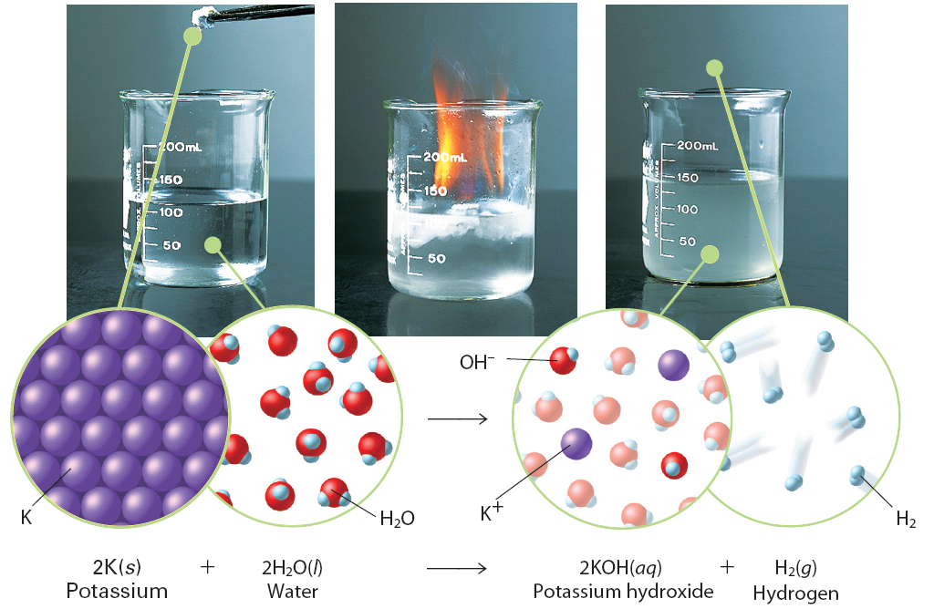
Single Replacement Reaction

Slide 53
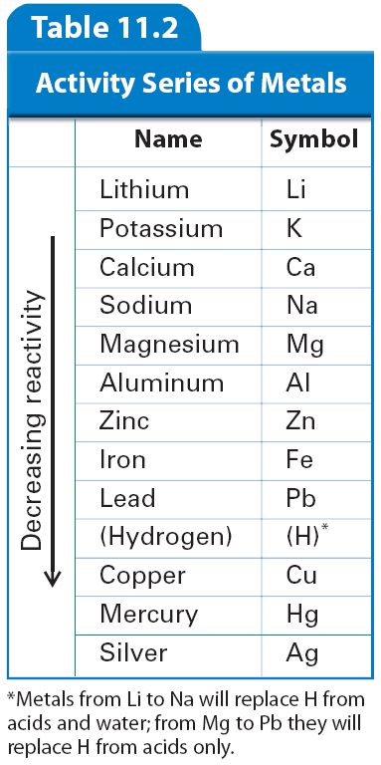
The activity series of metals lists metals in order of decreasing reactivity.
Table J in Chemistry Reference Tables

Slide 54
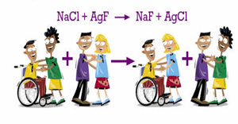
3. Double Replacement reaction
When two elements in different compounds trade places
Reactions where compounds on the left switch partners to form the products on the right
AB + CD → AC + BD

Slide 55
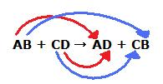
Double Replacement

Slide 56
Double Replacement
AgNO₃ + NaBr → AgBr + NaNO₃

Slide 57
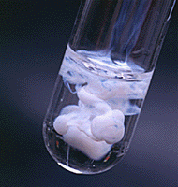
Double Replacement
Have the general formula..
AB + CD → AD + CB
Compound
+
Compound
Compound
+
Compound
Ex. AgNO_{3(aq)} + NaCl_{(aq)} →AgCl_{(s)}+ NaNO_{3(aq)}

Slide 58
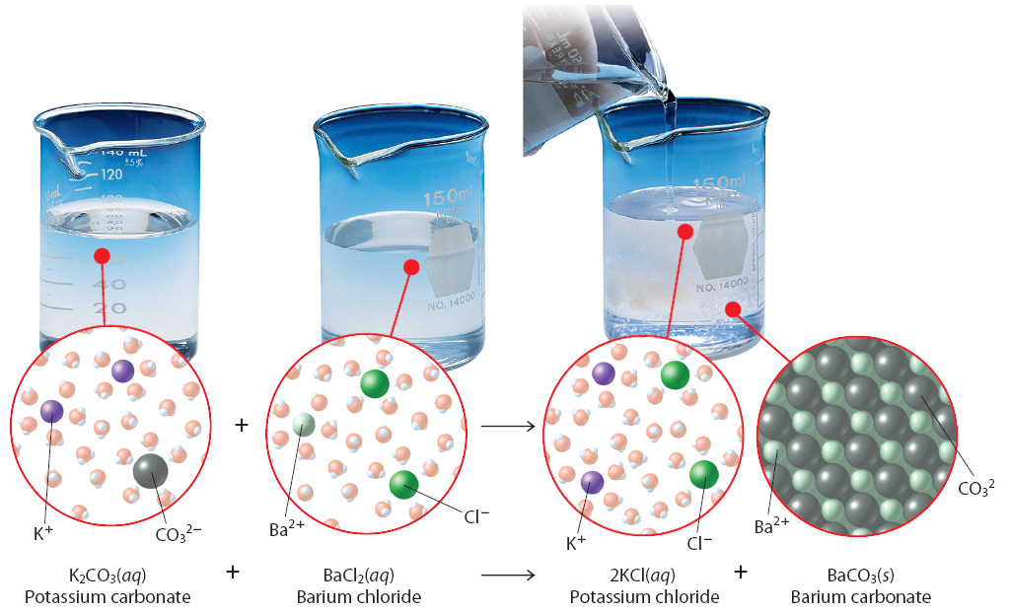
Double Replacement Reactions

Slide 59
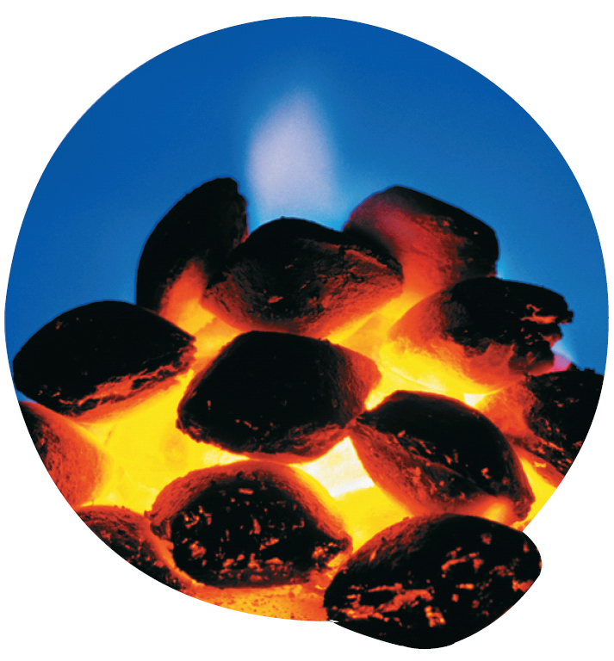
Combustion
Any hydrocarbon + O₂ →CO₂ +H₂O
Any compound containing C’s and H’s
Reaction in which a hydrocarbon reacts with oxygen to produce energy in the form of heat and light

Slide 60
Combustion Reactions
CH_{4(g)} + O_{2(g)} →CO_{2(g)}+ H₂O_{(g)}+ energy
ALWAYS involves O₂ as a reactant
The other reactant is always a hydrocarbon ( a compound composed of H and C)
The products are always CO₂ and water

Slide 61
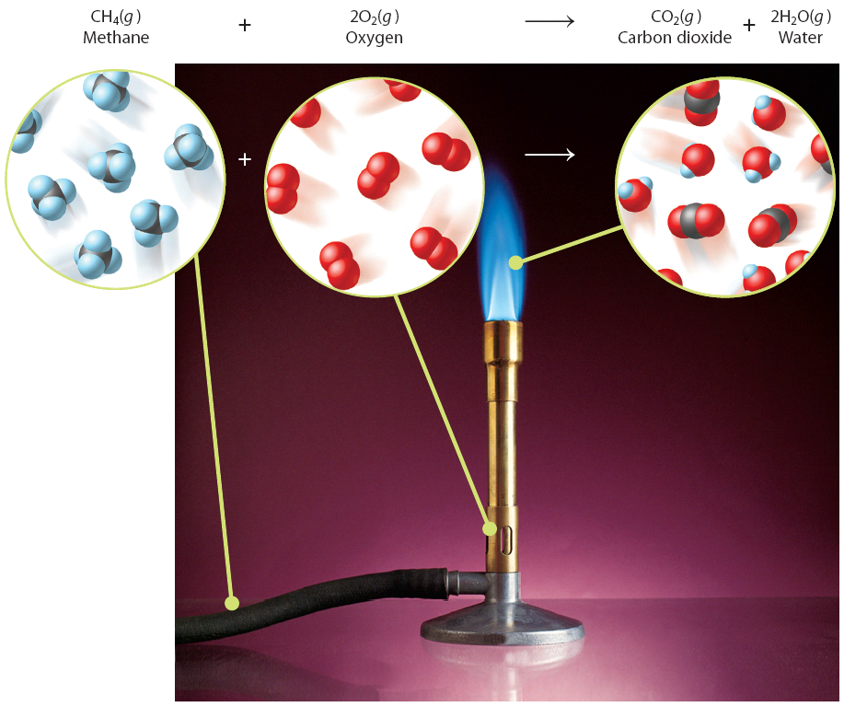
Combustion Reaction

Slide 62
Classify these reactions
2NaCl → 2Na + Cl₂
2. H₂ + O₂ → 2HCl
3. 2C₆H₆ + 15O₂ → 12CO₂ + 6H₂O
4. 2KBr + H₂SO₄ → K₂SO₄ + 2HBr
5. H₂SO₃→ H₂O + SO₂
6. NaCl + AgNO₃ → NaNO₃ + AgCl
7. 2C₃H₆ + 9O₂ → 6CO₂ + 6H₂O
8. Mg + HCl → MgCl₂ + H₂
9. 2Na + I₂ → 2NaI
10. 3H₂ + N₂ → 2NH₃
11. Zn + 2HCl → ZnCl₂ + H₂
12. 2Na + Br₂ → 2NaBr

Slide 63
Synthesis
The combining of two substances to produce a new compound.
A + B → AB
2Na (s) + Cl₂ (g) → 2NaCl (s)

Slide 64
Decomposition
The breaking apart of a compound into two or more new substances.
AB → A + B
CaCO₃ (s) → CaO (s) + CO₂ (g)
^{heat}

Slide 65
Single Replacement
An element replaces another element in a compound
A + BC → AC + B
2Al(s) + 3Fe(NO₃)₂(aq) → 2Al(NO₃)₃(aq) + 3Fe(s)

Slide 66
Double Replacement
The ions of two compounds exchange places in an aqueous solution to form two new compounds.
AB + CD → AD + CB
Al₂(SO₄)₃(aq) + 6AgBr(aq) → 2AlBr₃(aq) + 3Ag₂SO₄ (s)

Slide 67
Acid – Base Neutralization
An acidic solution and a basic solution react to form a neutral solution.
Acid + Base → H₂O + Salt
HCl(aq) + NaOH(aq) → H₂O(l) + NaCl(aq)

Slide 68
Combustion Reaction
A substance combines with oxygen, releasing a large amount of energy in the form of light and heat.
Combustion of a hydrocarbon is when a compound that contains carbon and hydrogen (and sometimes oxygen) combusts.
Hydrocarbon + O₂(g) → CO₂(g) + H₂O(l)
CH₄(g) + 2O₂(g) → CO₂(g) + 2H₂O(l)

