Slide 1
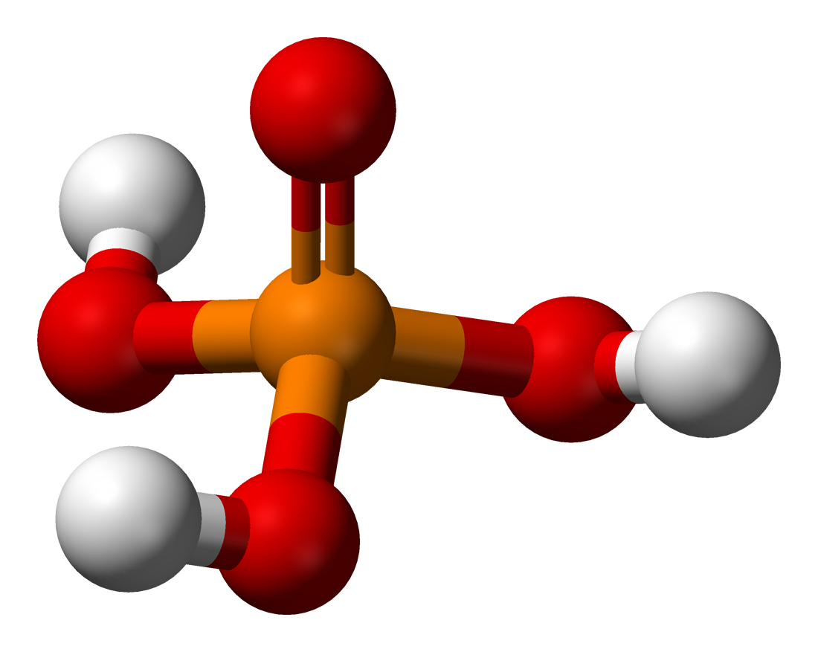
lithium nitrate
lead (II) sulfide
lithium nitride
barium sulfide
Chemistry
lithium nitrite
sulfur dioxide
Unit 5: Bonding and
Inorganic Nomenclature
NaClO₃
NO₂
Fe(ClO₃)₂
N₂O₄
Fe(ClO₃)₃
N₂O₅

Slide 2
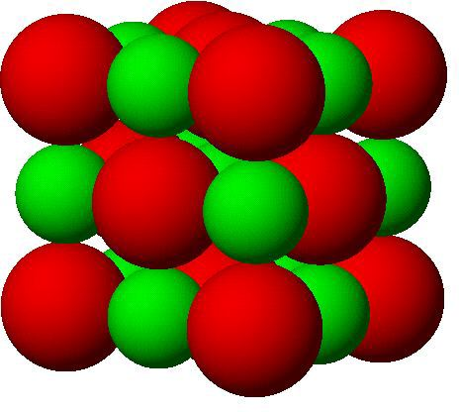
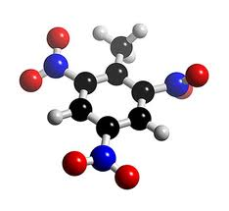
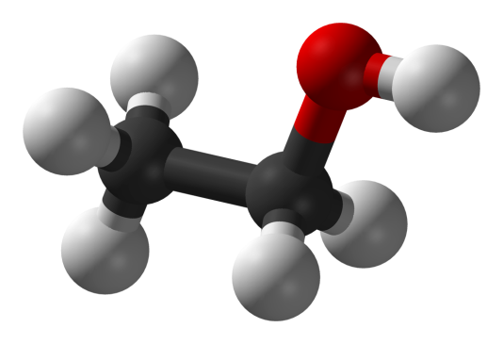

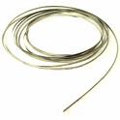
Bonding Types
Ionic Bonding
  with ions (+/- charges)
  atoms gaining/losing e-
  M + NM
Covalent Bonding
  atoms sharing e-
  NM + NM
Metallic Bonding
  metals share e- freely
  “sea of e-”
  good conductors

Slide 3
Chemical Bonding
Ionic Bonds: atoms give up or gain e– and
are attracted to each other by
coulombic attraction
loses e–
gains e–
Na
Na⁺
Cl
Cl–
Na⁺ + Cl–
NaCl
ionic bonds:
M + NM
cation + anion
ionic compounds = salts
K⁺ + NO₃–
KNO₃
where NO₃– is a polyatomic ion:
a charged group of
atoms that stay together

Slide 4
Common Polyatomic Ions
Names of Common Polyatomic Ions
Ion Name Ion Name
NH₄ ⁺ ammonium CO₃ ²⁻ carbonate
*NO₂ ⁻ *nitrite HCO₃ ⁻ bicarbonate
NO₃ ⁻ nitrate *IO₃⁻ *iodate
*SO₃ ²⁻ *sulfite *IO₄⁻ *periodate
SO₄ ²⁻ sulfate *ClO ⁻ *hypochlorite
HSO₄⁻ hydrogen sulfate *ClO₂ ⁻ *chlorite
OH ⁻ hydroxide ClO₃ ⁻ chlorate
CN ⁻ cyanide *ClO₄ ⁻ *perchlorate
C₂H₃O₂⁻ acetate *BrO₃⁻ *bromate
MnO₄ ⁻ permanganate C₂O₄²⁻ oxalate
PO₄ ³⁻ phosphate Cr₂O₇ ²⁻ dichromate
*PO₃ ³⁻ *phosphite CrO₄ ²⁻ chromate
H₂PO₄ ⁻ dihydrogen phosphate O₂ ²⁻ peroxide
Memorize the BOLD ions
* = you will also be responsible for knowing these
Zumdahl, Zumdahl, DeCoste, World of Chemistry 2002, page 100

Slide 5
Polyatomic Ion Trends
*Charges NEVER change between different forms
+1 oxygen
“Per____ate”
-1 oxygen
“-ite” form
-2 oxygens
“hypo___ite”
 | “Normal” “–ate” form
 | BrO₃⁻ bromate
 | ClO₃⁻ chlorate
 | IO₃⁻ iodate
 | NO₃⁻ nitrate
 | CO₃²⁻ carbonate
 | SO₄²⁻ sulfate
 | PO₄³⁻ phosphate
BrO₄⁻
ClO₄⁻
IO₄⁻
BrO₂⁻
ClO₂⁻
IO₂⁻
NO₂⁻
CO₂²⁻
SO₃²⁻
PO₃³⁻
BrO⁻
ClO⁻
IO⁻
perbromate
bromite
hypobromite
perchlorate
chlorite
hypochlorite
periodate
iodite
hypoiodite
nitrite
carbonite
sulfite
phosphite

Slide 6

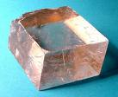
Properties of Ionic Salts
1. very hard
each ion is bonded
to several oppositely
charged ions
2. high melting points
many bonds must be
broken
3. brittle
with sufficient force,
like atoms are
brought next to
each other and repel
calcite

Slide 7
Writing Formulas of Ionic Compounds
chemical formula:
has neutral charge;
shows types of atoms
and how many of each
To write an ionic compound’s formula, we need:
1. the two types of ions
(i.e., cations and anions)
2. the charge on each ion
Na⁺ and F–
NaF
Ba²⁺ and O^{2–}
BaO
Na⁺ and O^{2–}
Na₂O
Ba²⁺ and F–
BaF₂

Slide 8
Notice that the pink pieces are cations (metals) and the blue are anions (non-metals)
K
Br
K⁺
e⁻
e⁻
Br ⁻
potassium atom
bromine atom
potassium ion
bromide ion
potassium bromide
KBr
Br ⁻
K⁺
Mg²⁺
O²⁻
Br ⁻
K⁺
1 Mg²⁺
2 Br ⁻
potassium oxide
MgBr₂
K₂O
magnesium bromide

Slide 9
Chemical Bonding Activity Examples
N³⁻
Na⁺
OH ⁻
Pb⁴⁺
1 Na ⁺
1 OH ⁻
N³⁻
Pb⁴⁺
N³⁻
NaOH
Pb⁴⁺
OH ⁻
Mg²⁺
N³⁻
OH ⁻
Pb⁴⁺ N³⁻
Pb₃N₄
Pb⁴⁺
1 Mg²⁺
2 OH ⁻
N³⁻
Mg OH ₂

Slide 10
criss-cross rule:
charge on cation / anion
“becomes” subscript of anion / cation
** Warning:
Reduce to lowest terms
Al³⁺ and O^{2–}
Ba²⁺ and S^{2–}
In³⁺ and Br^{1–}
Al O
Ba S
In Br
2
3
2
2
1
3
Al₂O₃
BaS
InBr₃

Slide 11
Writing Formulas w/Polyatomic Ions
Parentheses are required only when you need more
than one “bunch” of a particular polyatomic ion
Ba²⁺ and SO₄^{2–}
BaSO₄
Mg²⁺ and NO₂–
Mg(NO₂)₂
NH₄⁺ and ClO₃–
NH₄ClO₃
Sn⁴⁺ and SO₄^{2–}
Sn(SO₄)₂
Fe³⁺ and Cr₂O₇^{2–}
Fe₂(Cr₂O₇)₃
NH₄⁺ and N^{3–}
(NH₄)₃N

Slide 12
The Importance of Parentheses
Calcium hydrox
ide
ide
Ca²⁺
OH⁻
H
CaOH₂
Ca - O
H
vs.
Ca(OH)₂
HO - Ca - OH
The formulas imply two totally different compounds!

Slide 13
Charges Reminder!
Group 1:
Group 2:
Group 3:
Group 5:
Group 6:
Group 7:
Group 8:
1+
2+
3+
3–
1+
2–
0
2+
1–
3+
3–
2–
1–
0

Slide 14



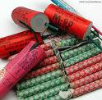
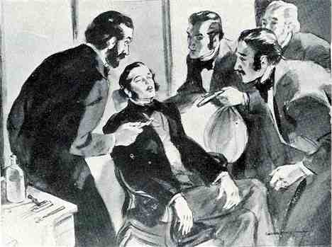
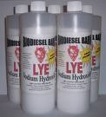
Inorganic Nomenclature
potassium
nitrate
copper (II)
sulfate
sodium
hydroxide
KNO₃
CuSO₄
NaOH
dinitrogen monoxide
N₂O

Slide 15

Nomenclature - Humor
Fe²⁺
Fe²⁺
Fe²⁺
Fe²⁺
BaNa₂
Fe²⁺
Fe²⁺
Fe²⁺
Fe²⁺
“BaNaNa”
“Ferrous Wheel”
What weapon can you make
from the elements nickel,
potassium and iron?
Fe = iron (Latin = ferrum)
Fe²⁺ = lower oxidation state = ferrous
Fe³⁺ = higher oxidation state = ferric
A KNiFe

Slide 16
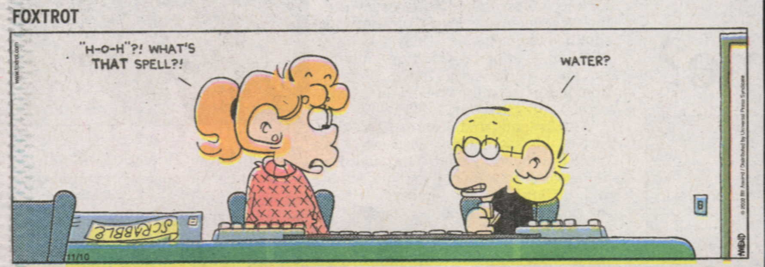
Teacher: What is the formula for water?
Student: H, I, J, K, L, M, N, O
Teacher: That’s not what I taught you.
Student: But you said the formula for water was…H to O.
"H-O-H"?! WHAT'S
THAT SPELL?!
mis
WATER?
“Little Johnny took a drink,
Now he shall drink no more.
For what he thought was H₂O,
Was H₂SO₄.”
Under aged Pb walks into a bar and the bartender turns to the gold
Bouncer and says, “Au, get the lead out!”
Notes:
A sign outside the chemistry hotel reads “Great Day Rates, Even Better NO₃⁻¹s”
What do you do with a dead chemist? Barium

Slide 17

“Perhaps one of you gentlemen would mind telling me just
what is outside the window that you find so attractive..?”
Image courtesy NearingZero.net

Slide 18
Ionic Compounds (cation/anion combos)
Fixed-Charge Cations with Elemental Anions
i.e., “pulled off the
Table” anions
The fixed-charge cations are:
groups 1, 2, 13, Ag⁺ and Zn²⁺
1+
2+
3+
3–
2–
1–

Slide 19
Fixed-Charge Exceptions
Start with Al
Go backwards down the stairs
Decrease the charge after
each stair
3+
3+
Al
13
2+
Zn
30
Ag
47
+

Slide 20
Fixed-charge cations
1+
Variable-charge cations
H
1
He
2
H
1
Elemental anions
1
2+
3+
3-
2-
1-
2
Li
3
Be
4
B
5
C
6
N
7
O
8
F
9
Ne
10
3
Na
11
Mg
12
Al
13
Si
14
P
15
S
16
Cl
17
Ar
18
4
K
19
Ca
20
Sc
21
Ti
22
V
23
Cr
24
Mn
25
Fe
26
Co
27
Ni
28
Cu
29
Zn
30
Ga
31
Ge
32
As
33
Se
34
Br
35
Kr
36
5
Rb
37
Sr
38
Y
39
Zr
40
Nb
41
Mo
42
Tc
43
Ru
44
Rh
45
Pd
46
Ag
47
Cd
48
In
49
Sn
50
Sb
51
Te
52
I
53
Xe
54
6
Cs
55
Ba
56
∗
Hf
72
Ta
73
W
74
Re
75
Os
76
Ir
77
Pt
78
Au
79
Hg
80
Tl
81
Pb
82
Bi
83
Po
84
At
85
Rn
86
7
Fr
87
Ra
88
Ω
Rf
104
Db
105
Sg
106
Bh
107
Hs
108
Mt
109
La
57
Ce
58
Pr
59
Nd
60
Pm
61
Sm
62
Eu
63
Gd
64
Tb
65
Dy
66
Ho
67
Er
68
Tm
69
Yb
70
Lu
71
Ac
89
Th
90
Pa
91
U
92
Np
93
Pu
94
Am
95
Cm
96
Bk
97
Cf
98
Es
99
Fm
100
Md
101
No
102
Lr
103

Slide 21
1+
Na
2+
3+
3–
1–
2–
A. To name, given
the formula:
Ba
1. Use name of cation
2. Use name of anion (it has the ending “ide”)
NaF
sodium fluoride
BaO
barium oxide
Na₂O
sodium oxide
BaF₂
barium fluoride

Slide 22
Zn
Ca
1+
3+
3–
1–
2+
Ag
2–
B. To write formula,
given the name:
1. Write symbols for the two types of ions
2. Balance charges to write formula
silver sulfide
Ag⁺
S^{2–}
Ag₂S
zinc phosphide
Zn²⁺
P^{3–}
Zn₃P₂
calcium iodide
Ca²⁺
I–
CaI₂

Slide 23
Variable-Charge Cations with Elemental Anions
i.e., “pulled off the
Table” anions
The variable-charge cations are:
Pb, Sn, and the transition metals
(but – of course! – not Ag or Zn)

Slide 24
A. To name, given the formula:
Cu
Fe
Figure out charge on
cation.
2. Write name of cation.
3. Write Roman numerals
in ( ) to show cation’s charge.
Stock System
of nomenclature
4. Write name of anion.
- 6
iron oxide
Fe²⁺
FeO
Fe?
O^{2–}
iron (II) oxide
iron oxide
Fe₂O₃
Fe?
Fe?
O^{2–}
Fe³⁺
Fe³⁺
O^{2–}
O^{2–}
iron (III) oxide
CuBr
copper bromide
Cu?
Br –
copper (I) bromide
Cu⁺
CuBr₂
copper bromide
Cu²⁺
Br –
copper (II) bromide
Cu?
Br –

Slide 25
Roman Numeral Review
Greek Number | Roman Numeral
1 | I
2 | II
3 | III
4 | IV
5 | V
6 | VI
7 | VII
8 | VIII
9 | IX
10 | X
Number | Roman Numeral
50 | L
100 | C
500 | D
1000 | M

Slide 26
B. To find the formula, given the name:
1. Write symbols for the two types of ions.
2. Balance charges to write formula.
Co
Sn
cobalt (III) chloride
Co³⁺
Cl–
CoCl₃
tin (IV) oxide
Sn⁴⁺
O^{2–}
SnO₂
tin (II) oxide
Sn²⁺
O^{2–}
SnO

Slide 27
Ionic Nomenclature Practice
sodium hydroxide
HgSO₄
3. lead (II) phosphate
4. (NH₄)₂S
5. aluminum chlorate
6. Cu₂CO₃
manganese (IV) oxide
MnSO₄
9. iron (III) oxide
10. Mg(NO₃)₂
11. calcium sulfide
K₂O
13. magnesium chloride
Cr₂O₃
gold (III) bromide
Zn(NO₂)₂
NaOH
Fe₂O₃
mercury (II) sulfate
magnesium nitrate
Pb₃(PO₄)₂
CaS
ammonium sulfide
potassium oxide
Al(ClO₃)₃
MgCl₂
copper (I) carbonate
chromium (III) oxide
MnO₂
AuBr₃
manganese (II) sulfate
zinc nitrite

Slide 28
Traditional System of Nomenclature
…used historically (and still some today) to name
compounds w/multiple-charge cations
To use:
1. Use Latin root of cation.
2. Use -ic ending for higher charge;
-ous ending for lower charge.
3. Then say name of anion, as usual.

Slide 29
Element Latin root -ic -ous
gold, Au aur- Au³⁺ Au⁺
lead, Pb plumb- Pb⁴⁺ Pb²⁺
tin, Sn stann- Sn⁴⁺ Sn²⁺
copper, Cu cupr- Cu²⁺ Cu⁺
iron, Fe ferr- Fe³⁺ Fe²⁺
Write formulas:
Write names:
Pb₃P₄
cuprous sulfide
Pb₃P₄
cuprous sulfide
Pb⁴⁺
P^{3–}
Pb?
Cu⁺
S^{2–}
Cu₂S
plumbic phosphide
auric
Pb₃P₂
auric nitride
Pb₃P₂
Pb?
Pb²⁺
P^{3–}
Au³⁺
N³⁻
AuN
plumbous phosphide
Sn
ferrous fluoride
SnCl₄
ferrous fluoride
Sn?
Cl–
Sn⁴⁺
Fe²⁺
F–
FeF₂
stannic chloride

Slide 30
Compounds Containing Polyatomic Ions
Insert name of ion
where it should go
in the compound’s
name.
Write formulas:
iron (III) nitrite
Fe³⁺
NO₂–
Fe(NO₂)₃
iron (III) nitrite
ammonium phosphide
(NH₄)₃P
ammonium phosphide
NH₄⁺
P^{3–}
ammonium chlorate
NH₄⁺
ClO₃–
NH₄ClO₃
ammonium chlorate
zinc phosphate
Zn²⁺
PO₄^{3–}
Zn₃(PO₄)₂
zinc phosphate
lead (II) permanganate
lead (II) permanganate
Pb²⁺
MnO₄–
Pb(MnO₄)₂

Slide 31
Write names:
(NH₄)₂S₂O₃
(NH₄)₂S₂O₃
ammonium thiosulfate
AgBrO₃
silver bromate
AgBrO₃
(NH₄)₃N
(NH₄)₃N
ammonium nitride
CrO₄^{2–}
U⁶⁺
uranium (VI) chromate
U(CrO₄)₃
U?
CrO₄^{2–}
U(CrO₄)₃
CrO₄^{2–}
Cr₂(SO₃)₃
Cr₂(SO₃)₃
Cr?
chromium (III) sulfite
Cr³⁺
SO₃^{2–}
Cr³⁺
Cr?
SO₃^{2–}
SO₃^{2–}

Slide 32
Self-Test Quiz
1. lithium nitrate
9. Never show charges
in a compound’s formula. (T/F)
2. lithium nitride
10. When writing names with
Group 9 cations, you need to
use Roman numerals. (T/F)
3. lithium nitrite
4. NaClO₃
5. Fe(ClO₃)₂
11. When using an anion off the
polyatomic ion sheet, change
name’s ending to “-ide.” (T/F)
6. Fe(ClO₃)₃
7. lead(II) sulfide
12. A Roman numeral indicates
the charge on the anion. (T/F)
8. barium sulfide

Slide 33
Self-Test Quiz
Answers
1. lithium nitrate
LiNO₃
2. lithium nitride
Li₃N
3. lithium nitrite
LiNO₂
4. NaClO₃
sodium chlorate
5. Fe(ClO₃)₂
iron(II) chlorate
6. Fe(ClO₃)₃
iron(III) chlorate
7. lead(II) sulfide
PbS
8. barium sulfide
BaS

Slide 34
Self-Test Quiz
Answers
T
9. Never show charges
in a compound’s formula.
T
10. When writing names with
Group 9 cations, you need to
use Roman numerals.
F
11. When using an anion off the
polyatomic ion sheet, change
the name’s ending to “-ide.”
F
12. A Roman numeral indicates
the charge on the anion.

Slide 35
Covalent Bonds (2 nonmetals)
…atoms share e– to get a full valence shell
C 1s² 2s² 2p²
F 1s² 2s² 2p⁵
Both need 8 valence e⁻ for a full outer shell…
otherwise known as the octet rule
4 valence e-
7 valence e-
o
x
x
C
F
o
o
x
x
x
x
o
x

Slide 36
Draw the Lewis dot structure for the following elements:
Si
O
P
B
Ar
Br
1s² 2s² 2p⁶ 3s² 3p²
4 valence e-
1s² 2s² 2p⁴
6 valence e-
1s² 2s² 2p⁶ 3s² 3p³
5 valence e-
3 valence e-
1s² 2s² 2p¹
1s² 2s² 2p⁶ 3s² 3p⁶
8 valence e-
1s² 2s² 2p⁶ 3s² 3p⁶ 4s² 3d¹⁰ 4p⁵
7 valence e-

Slide 37
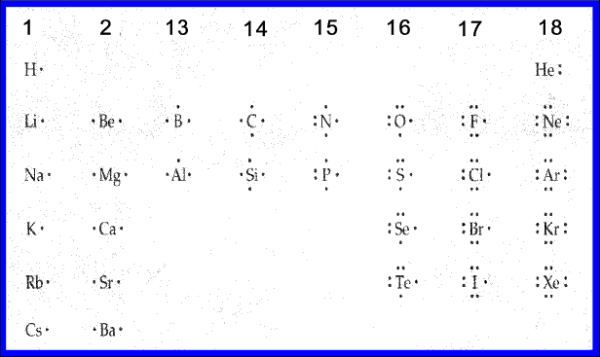
Notice any trends…?

Slide 38
Drawing Lewis Structures
Lewis structure:
a model of a covalent molecule that
shows all of the valence e–
1. Two shared e– make a single covalent bond,
four make a double bond, etc.
2. unshared pairs: pairs of unbonded valence e–
3. Each atom needs a full outer shell, i.e., 8 e–.
Exception: H needs 2 e–

Slide 39

Let’s bond two F atoms together…
Each F has 7 v.e. and each needs 1 more e-
F
F
F
F
F₂
Now let’s bond C and F atoms together…
carbon tetrafluoride (CF₄)
F
F
F
C
F
F
C
F
F
F

Slide 40
And now,
a video break…

Slide 41

nitrogen triiodide (NI₃)
x
x
x
I
x
x
x
x
x
I
o
x
o
x
o
x
x
N o
x
x
x
x
x
I
o
x
x
x
x
x
x
x
o
x
o
x
I
x
I
o
x
N o
x
x
x
x
x
x
o
x
x
x
I
x
x
x
x
x
carbon dioxide (CO₂)
x
o
x
x
O
o
x
C
x
x
o
x
o
x
O
x
x x
x x
x
x
x
O
o
x
O = C = O
o
x
C
x
x
o
x
x
x
o
x
x
x x
x x
O
x
x
x

Slide 42

covalent compounds = molecular compounds
-- have lower melting points
than do ionic compounds
(consist of two or more
nonmetal elements)
butter

Slide 43



Dihydrogen Monoxide:
A Tale of Danger and Irresponsibility
major component of acid rain
found in all cancer cells
inhalation can be deadly
excessive ingestion results in
acute physical symptoms:
e.g., frequent urination,
bloated sensation,
profuse sweating
often an industrial byproduct of chemical
reactions; dumped wholesale into rivers and lakes

Slide 44
Covalent Compounds
-- contain two types of
nonmetals
nonmetals
** Key:
FORGET CHARGES!
Use Greek prefixes to indicate how
many atoms of each element, but
don’t use “mono” on first element.
What to do:
1 –
mono
6 –
hexa
2 –
di
7 –
hepta
3 –
tri
8 –
octa
4 –
tetra
9 –
nona
5 –
penta
10 –
deca

Slide 45
EXAMPLES:
carbon dioxide
CO₂
CO
carbon monoxide
dinitrogen trioxide
N₂O₃
N₂O₅
dinitrogen pentoxide
carbon tetrachloride
CCl₄
NI₃
nitrogen triiodide

Slide 46

Metallic Bonds
In metals, valence shells of atoms overlap, so v.e–
are free to travel between atoms through material.
In insulators (like wood),
the v.e– are attached
to particular atoms.
Not so in metals.

Slide 47
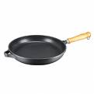
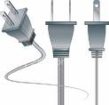
Properties of Metals
ductile
conduct heat and electricity
All due to free-moving v.e–.
malleable

Slide 48

Other Types of Forces/Attractions
dipole-dipole forces
hydrogen bonds
London dispersion forces
ion-dipole forces
boiling H₂O
DNA
These are much weaker than ionic, covalent, or metallic bonds, but very important in determining states of matter, boiling and melting points, and molecular shape (among other things).

Slide 49
Empirical Formula and Molecular Formula
lowest-terms
formula
shows the true number
and type of atoms in a m’cule
Compound | Molecular Formula | Empirical Formula
glucose | C₆H₁₂O₆
propane | C₃H₈
butane | C₄H₁₀
naphthalene | C₁₀H₈
sucrose | C₁₂H₂₂O₁₁
octane | C₈H₁₈
CH₂O
C₃H₈
C₂H₅
C₅H₄
C₁₂H₂₂O₁₁
C₄H₉

Slide 50

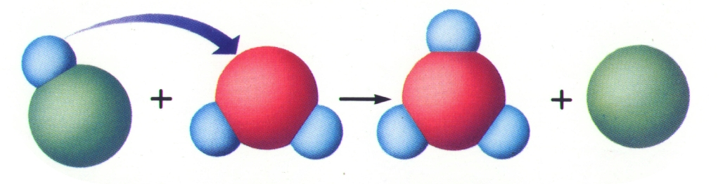
Definitions
Acids
  Ionize to form hydrogen ions (H⁺) in water

Slide 51
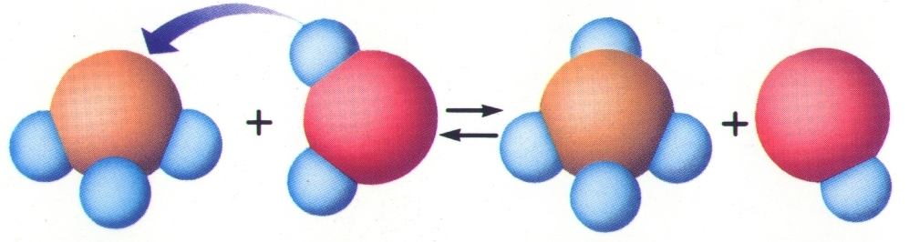
Definitions
Bases
  Dissociate or ionize to form hydroxide ions (OH⁻) in water
NH₃ + H₂O → NH₄⁺ + OH⁻

Slide 52
Definitions
Indicator
  substance that changes color in an acid or base
Examples:
  litmus - red/blue
  phenolphthalein - colorless/pink
  goldenrod - yellow/red
  red cabbage juice - pink/green

Slide 53
Properties
ACIDS
BASES
pH < 7
sour taste
turn litmus red
react with metals to form H₂ gas
Releases H⁺ ions
pH > 7
bitter taste
turn litmus blue
Slippery feel
Releases OH⁻ ions

Slide 54
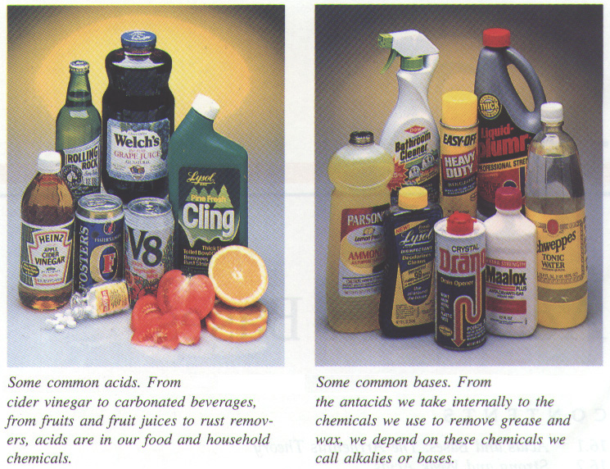
Uses
ACIDS
H₃PO₄ - soft drinks, fertilizer, detergents
H₂SO₄ - fertilizer, car batteries
HCl - gastric juice
HC₂H₃O₂ - vinegar

Slide 55
Uses
BASES
NaOH - lye, drain and oven cleaner
Mg(OH)₂ - laxative, antacid
NH₃ - cleaners, fertilizer

Slide 57
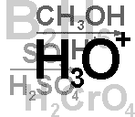
Nomenclature Review
Flow Chart

Slide 58
Formula → Name?
Metal + Nonmetal?
(Including NH₄⁺)
Two Nonmetals?
Ionic
d,f-block
Pb,Sn
Columns 1, 2, 13
Ag⁺, Zn²⁺
Metal Type?
Variable
Fixed
Covalent
Steps 1 & 4 ONLY
Write name of cation (metal)
Determine the charge on the metal by balancing the (-) charge from the anion
Write the charge of the metal in Roman Numerals and put in parentheses
Write name of anion
(Individual anions need –ide ending!)
Use Prefixes!
*Mono* Hexa
Di Hepta
Tri Octa
Tetra Nona
Penta Deca
Add –ide to 2nd element

Slide 59
Name → Formula?
No Prefixes?
Prefixes?
Ionic
Covalent
Determine the ions present
and the charge on each (Roman Numeral = cation charge, otherwise use PT)
Balance formula (criss-cross)
Reduce subscripts (if needed)
FORGET CHARGES!!!
Use prefixes to determine subscripts
Do NOT reduce subscripts!

Slide 60
Covalent
Ionic Compounds
Two nonmetals
Variable-charge cation
Fixed-charge
carbon tetrabromide
rubidium sulfate
sulfur dichloride
NH₄ClO₃
N₂O₅
NCl₃
barium oxide
vanadium (II) chromate
KI
niobium (V) perchlorate
Mn₂S₅
Pt(IO₃)₄
Greek prefixes
Roman
numeral
Roman numeral
for name only
Charge
Don’t know the charge from PT
Know the charge from PT
Polyatomic ions
OK
Polyatomic ions OK
Criss-
Cross
Rule
Where would you file this?
VCrO₄
VCrO₄
dinitrogen pentoxide
dinitrogen pentoxide
BaO
BaO
platinum (IV) iodate
platinum (IV) iodate
CBr₄
CBr₄
ammonium chlorate
ammonium chlorate
Roman
numeral
Nb(ClO₄)₅
Nb(ClO₄)₅
potassium iodide
potassium iodide
SCl₂
SCl₂
nitrogen trichloride
nitrogen trichloride
Rb₂SO₄
Rb₂SO₄
manganese (V) sulfide
manganese (V) sulfide

Slide 61
Overall Nomenclature Practice
Ir
Ca
Ti
H
Ba
N₃
H
Zn
N
Au
Na
Ionic/variable
Ionic/fixed
Ionic/variable
Acid
Ionic/fixed
Covalent
Acid
Ionic/fixed
Covalent
Ionic/variable
Ionic/fixed
F₃
S
S₂
Cl(aq)
Br₂
P₂
F(aq)
I₂
Cl₄
₂O₃
₃P
iridium (III)
calcium
titanium (IV)
hydrochloric acid
barium
trinitrogen
hydrofluoric acid
zinc
nitrogen
gold (III)
sodium
fluoride
sulfide
sulfide
bromide
diphosphide
iodide
tetrachloride
oxide
phosphide

Slide 62
Ionic Nomenclature Practice
Ir₂
Ca
H
Pt
H
Sr
K
Zn
Mn
Au
H₂
Ionic/variable
Ionic/fixed
Acid
Ionic/variable
Acid
Ionic/fixed
Ionic/fixed
Ionic/fixed
Ionic/variable
Ionic/variable
Acid
(Cr₂O₇)₃
(OH)₂
NO₃ (aq)
(CH₃COO)₂
BrO₂(aq)
SO₄
CN
(NO₂)₂
(ClO₃)₄
PO₄
SO₃ (aq)
iridium (III)
calcium
nitric
platinum (II)
bromous
strontium
potassium
zinc
manganese (IV)
gold (III)
sulfurous
dichromate
hydroxide
acid
acetate
acid
sulfate
cyanide
nitrite
chlorate
phosphate
acid

Slide 63
Write the compound formed by the following ions:
1) Al³⁺ S²⁻
2) Mg²⁺ PO₄³⁻
When a formula is given…write the proper name.
When a name is given…write the proper formula.
3) BaO
4) lithium bromide
5) Ni₂S₃
    6) triphosphorus heptoxide
7) N₂O₅
8) molybdenum (VI) nitride
9) trinitrotoluene (TNT)… CH₃C₆H₂(NO₂)₃
10) phosphoric acid H₃PO₄
Write the total number of atoms that make up each compound.
Extra credit: What is the formula for plumbic iodide? (Hint: lead is Pb²⁺ or Pb⁴⁺)

Slide 64
POP
QUIZ
Write the compound formed by the following ions:
1) Al³⁺ S²⁻
2) Mg²⁺ PO₄³⁻
When a formula is given…write the proper name.
When a name is given…write the proper formula.
3) BaO
4) lithium bromide
5) Ni₂S₃
    6) triphosphorus heptoxide
7) N₂O₅
8) molybdenum (VI) nitride
9) trinitrotoluene (TNT)… CH₃C₆H₂(NO₂)₃
10) phosphoric acid H₃PO₄
Write the total number of atoms that make up each compound.
Extra credit: What is the formula for plumbic iodide? (Hint: lead is Pb²⁺ or Pb⁴⁺)

Slide 65
Answer Key
Write the compound formed by the following ions:
1) Al³⁺ S²⁻
2) Mg²⁺ PO₄³⁻
When a formula is given…write the proper name.
When a name is given…write the proper formula.
3) BaO
4) lithium bromide
5) Ni₂S₃
    6) triphosphorus heptoxide
7) N₂O₅
8) molybdenum (VI) nitride
9) trinitrotoluene (TNT)… CH₃C₆H₂(NO₂)₃
10) phosphoric acid H₃PO₄
Al₂S₃
Mg₃(PO₄)₂
barium oxide
LiBr
nickel (III) sulfide
P₃O₇
dinitrogen pentoxide
MoN₂
Write the total number of atoms that make up each compound.
21
8
Extra credit: What is the formula for plumbic iodide? (Hint: lead is Pb²⁺ or Pb⁴⁺)
PbI₄

Slide 66
Writing Chemical Names
Use poly.
ion sheet?
Formula
RN/GP/neither
Name
1. Ni₂ S₃
RN
no
nickel (III) sulfide
2. N F₃
GP
no
nitrogen trifluoride
3. Na BrO₃
neither
yes
sodium bromate
4. S F₆
GP
no
sulfur hexafluoride
5. Fe (NO₃)₃
RN
yes
iron (III) nitrate
6. Sr SO₄
neither
yes
strontium sulfate

Slide 67
Writing Chemical Formulas
Use poly.
ion sheet?
Name
Charges matter?
Formula
1. copper (II) phosphide
yes
no
Cu₃P₂
2. lithium phosphate
yes
yes
Li₃PO₄
3. phosphorus triiodide
no
no
PI₃
4. zinc arsenate
yes
yes
Zn₃(AsO₄)₂
5. silver nitride
yes
no
Ag₃N
6. sulfur dibromide
no
no
SBr₂
7. dinitrogen pentasulfide
no
no
N₂S₅
8. tin (IV) nitride
yes
no
Sn₃N₄
9. rubidium nitrite
yes
yes
RbNO₂
10. oxygen difluoride
no
no
OF₂
11. iron (III) sulfite
yes
yes
Fe₂(SO₃)₃
12. ammonium oxide
yes
yes
(NH₄)₂O

Slide 68
Writing Chemical Names
Use poly.
ion sheet?
Formula
RN/GP/neither
Name
7. S O₃
GP
no
sulfur trioxide
8. Sn Br₄
neither
no
tin (IV) bromide
9. K₃ PO₄
neither
yes
potassium phosphate
10. NH₄ OH
neither
yes
yes
ammonium hydroxide
11. C S₂
GP
no
carbon disulfide
12. Cu F
RN
no
copper (I) fluoride

Slide 69
Writing Chemical Formulas
Use poly.
ion sheet?
Name
Charges matter?
Formula
1. copper (II) phosphide
yes
no
Cu₃P₂
2. lithium phosphate
yes
yes
Li₃PO₄
3. phosphorus triiodide
no
no
PI₃
4. zinc arsenate
yes
yes
Zn₃(AsO₄)₂
5. silver nitride
yes
no
Ag₃N
6. sulfur dibromide
no
no
SBr₂
7. dinitrogen pentasulfide
no
no
N₂S₅
8. tin (IV) nitride
yes
no
Sn₃N₄
9. rubidium nitrite
yes
yes
RbNO₂
10. oxygen difluoride
no
no
OF₂
11. iron (III) sulfite
yes
yes
Fe₂(SO₃)₃
12. ammonium oxide
yes
yes
(NH₄)₂O

Slide 70
Writing Chemical Formulas
Use poly.
ion sheet?
Name
Charges matter?
Formula
1. copper (II) phosphide
yes
no
Cu₃P₂
2. lithium phosphate
yes
yes
Li₃PO₄
3. phosphorus triiodide
no
no
PI₃
4. zinc arsenate
yes
yes
Zn₃(AsO₄)₂
5. silver nitride
yes
no
Ag₃N
6. sulfur dibromide
no
no
SBr₂
7. dinitrogen pentasulfide
no
no
N₂S₅
8. tin (IV) nitride
yes
no
Sn₃N₄
9. rubidium nitrite
yes
yes
RbNO₂
10. oxygen difluoride
no
no
OF₂
11. iron (III) sulfite
yes
yes
Fe₂(SO₃)₃
12. ammonium oxide
yes
yes
(NH₄)₂O

Slide 71
Writing Chemical Names
Use poly.
ion sheet?
Formula
RN/GP/neither
Name
1. Ni₂ S₃
RN
no
nickel (III) sulfide
2. N F₃
GP
no
nitrogen trifluoride
3. Na BrO₃
neither
yes
sodium bromate
4. S F₆
GP
no
sulfur hexafluoride
5. Fe (NO₃)₃
RN
yes
iron (III) nitrate
6. Sr SO₄
neither
yes
strontium sulfate
7. S O₃
GP
no
sulfur trioxide
8. Sn Br₄
neither
no
tin (IV) bromide
9. K₃ PO₄
neither
yes
potassium phosphate
10. NH₄ OH
neither
yes
ammonium hydroxide
11. C S₂
GP
no
carbon disulfide
12. Cu F
RN
no
copper (I) fluoride

Slide 72
Writing Chemical Formulas
Use poly.
ion sheet?
Name
Charges matter?
Formula
1. copper (II) phosphide
yes
no
Cu₃P₂
2. lithium phosphate
yes
yes
Li₃PO₄
3. phosphorus triiodide
no
no
PI₃
4. zinc arsenate
yes
yes
Zn₃(AsO₄)₂
5. silver nitride
yes
no
Ag₃N
6. sulfur dibromide
no
no
SBr₂
7. dinitrogen pentasulfide
no
no
N₂S₅
8. tin (IV) nitride
yes
no
Sn₃N₄
9. rubidium nitrite
yes
yes
RbNO₂
10. oxygen difluoride
no
no
OF₂
11. iron (III) sulfite
yes
yes
Fe₂(SO₃)₃
12. ammonium oxide
yes
yes
(NH₄)₂O

