Slide 1
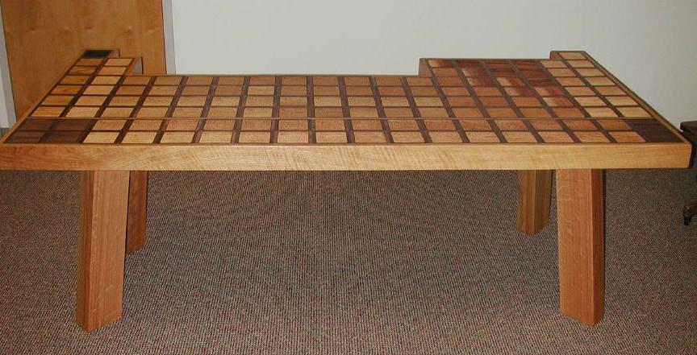
The Periodic Table

Slide 2
The Periodic Table
In Chemistry, we have organized the elements that compose our world into the Periodic Table of Elements
The word periodic means “repeated in a pattern”

Slide 3
The Periodic Table
History

Slide 4

Dmitri Mendeleev (Russian, 1869)
  Ordered elements based on similar properties.
  Started with 63 known elements
  Organized a table by increasing atomic mass.
  His pattern formed columns where all of the elements in the columns showed similar physical and chemical properties.
  He predicted the atomic masses
  and properties of unknown elements
  where there were blank spaces!

Slide 5
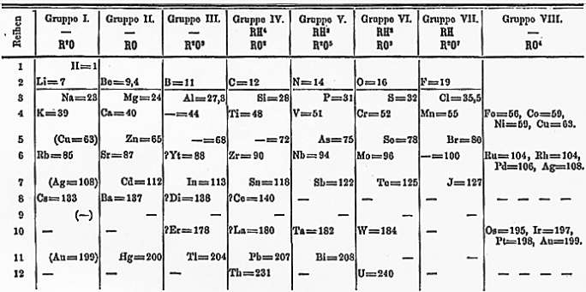
Mendeleev’s Periodic Table (1871)

Slide 6
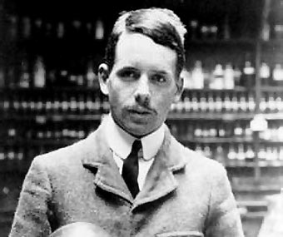
Henry Mosely (British, 1913)
  Organized elements by
  increasing atomic number.
  Fixed the few problems in
  Mendeleev’s arrangement.
  Elements with similar physical and chemical properties fell into place without exception, and became our modern periodic table.

Slide 7
The Periodic Table
Organization of Periodic Table

Slide 8
Organization of Table
Groups or Families – vertical columns
Periods – horizontal rows

Slide 9
Vertical Columns – Groups or Families
Elements in the same family have similar properties and the same number of valence electrons.
Group 1 - Alkali Metals
Group 2 - Alkaline Earth Metals
Groups 3-12 – Transition Metals
Group 13 - Boron Family
Group 14 - Carbon Family
Group 15 - Nitrogen Family
Group 16 - Oxygen Family
Group 17 - Halogens
Group 18 - Noble Gases
1
1A
18
8A
2
2A
13 14 15 16 17
3A 4A 5A 6A 7A
3
3B
4
4B
5
5B
6
6B
7
7B
8
8B
9
8B
10
8B
11
1B
12
2B

Slide 10
Rare Earth Metals
Rare earth metals (green) belong between Families 3 and 4
They are typically moved below the rest of the table to save space

Slide 11
Vertical Columns – Groups or Families
Number of valence electrons increases as you move to the right
With the exception of the transition elements (yellow), the lower number tells you the number of valence electrons
1
1A
18
8A
2
2A
13 14 15 16 17
3A 4A 5A 6A 7A
3
3B
4
4B
5
5B
6
6B
7
7B
8
8B
9
8B
10
8B
11
1B
12
2B

Slide 12
Horizontal Rows - Periods
The period number tells you how many energy levels there are in an atom.
  Increases as you move DOWN rows.
Elements in the same period do not have the same properties
1A
8A
2A
3A 4A 5A 6A 7A

Slide 13
The Periodic Table
Diagrams

Slide 14
Diagrams
Two types of diagrams are used to show the configuration of electrons in an atom
  Bohr diagrams – show all electrons in their different energy levels
  Dot diagrams – show only the valence electrons (outermost energy level)

Slide 15
Bohr Diagrams
Find your element on the periodic table.
Determine the number of electrons – it is the same as the atomic number for a neutral atom.
Determine the number of energy levels – it is the number of its row down the table
(Carbon has 6)
(Carbon is in the 2nd row so it has 2)

Slide 16
Bohr Diagrams
Atomic energy levels can only hold so many electrons
Higher energy levels hold more electrons
  1st level – 2 electrons
  2nd level – 8 electrons
This gives periodic table its shape!

Slide 17
Bohr Diagrams
The number of energy levels is represented by rings. Carbon had 2
C

Slide 18
Bohr Diagrams
The electrons are represented by dots, filling from inside out.
Carbon had 6.
2 can fit in 1st level.
The rest (4) fit in 2nd level.
C

Slide 19
Bohr Diagrams
Al
3
13
2 can fit in 1st level
8 can fit in 2nd level
The rest (3) fit in 3rd level.
Harder example:
Energy levels:
Total electrons:
Al

Slide 20
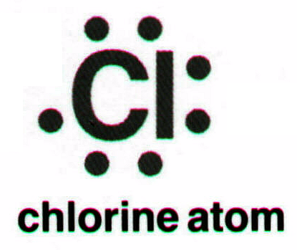
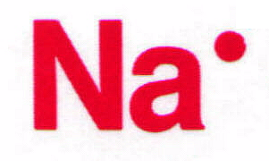
Dot Diagrams
Only the valence electrons are shown
  Determine # valence electrons
  Draw dots around the symbol
EX: Sodium
v.e. = 1
EX: Chlorine
v.e. = 7

Slide 21
The Periodic Table
Metallic Character

Slide 22
Metallic Character
Metals
Nonmetals
Metalloids

Slide 23
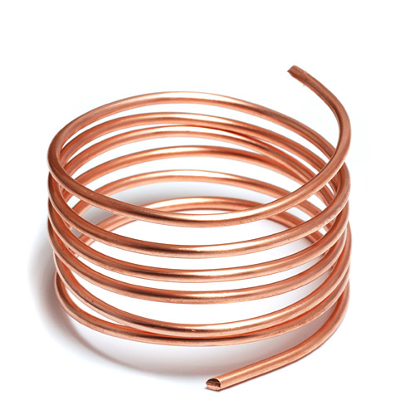
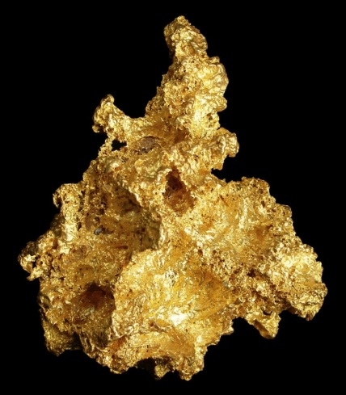
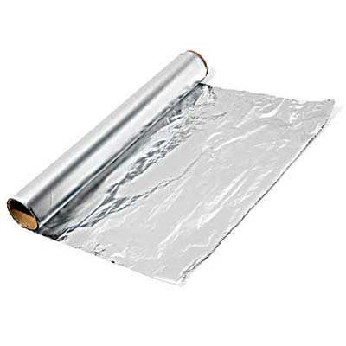
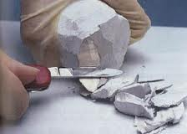
Metals
Located to the left of the “staircase”
Physical Properties
  Luster – shiny
  Malleable – pounded into different shapes
  Ductile – stretched into wires
  Solid at room temperature (except Mercury)
  Good conductors of heat and electricity

Slide 24
Metals Continued
Chemical Properties:
  Corrosive – gradual wearing away of a metal due to a chemical reaction
      Metal converted into a metallic compound
  Often lose electrons in a chemical reaction

Slide 25
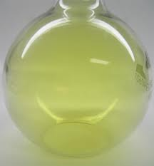
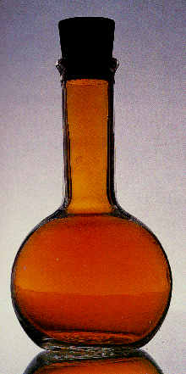
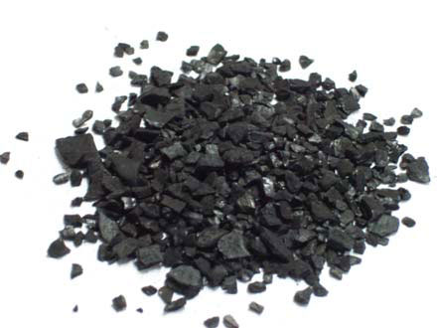
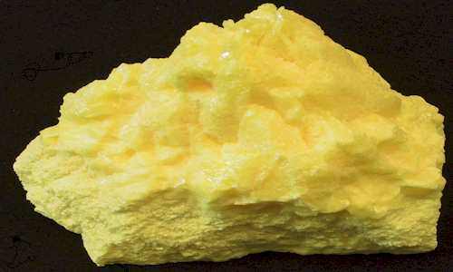
Nonmetals
Located to the right of the “staircase”
Physical Properties:
  Dull in appearance – no luster
  Brittle – breaks apart easily
  Most are gasses at room temperature (Bromine is a liquid, a few are solids)
  Poor conductor of heat and electricity

Slide 26
Nonmetals Continued
Chemical Properties
  React with metals
  Gain Valence electrons
  Elements with 8 valence electrons do not react with other elements

Slide 27
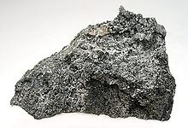
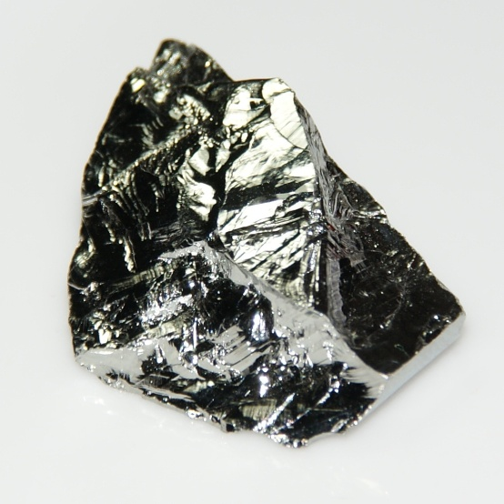
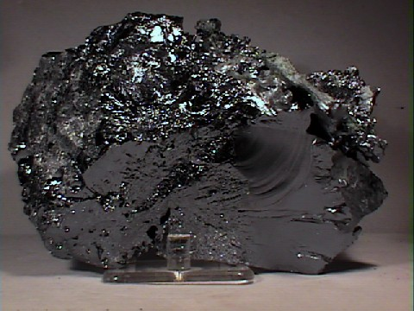
Metalloids
Border the “staircase”
Have properties of both metals and nonmetals

Slide 28
The Periodic Table
Reactivity

Slide 29
Stability
An atom is chemically stable when its outer energy level is complete
Atoms will gain or lose electrons to become stable
  If an atom has 1-4 valence electrons, it will empty its current outer shell (lose electrons)
  If an atom has 5-8 valence electrons, it will add to its shell (gain electrons)

Slide 30
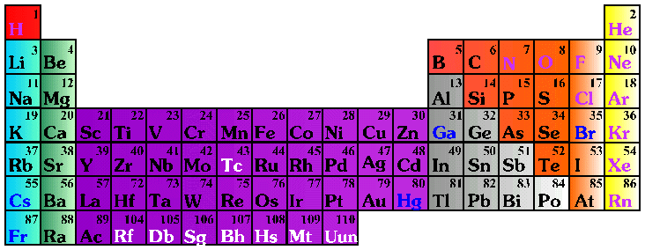
Oxidation Number
When the atoms gain or lose electrons, they form ions
The charge on these ions is called the oxidation number
1+
0
2+
3+
4+
3-
2-
1-

Slide 31
Reactivity
Chemical reactivity is a measure of how actively a substance reacts with another substance
It is related to oxidation number
  An oxidation number of 0 does not react (it is already stable)
  Low oxidation numbers (+1, -1) are more reactive than high ones (+4, -4)
Heavy metals and light nonmetals are more reactive

Slide 32
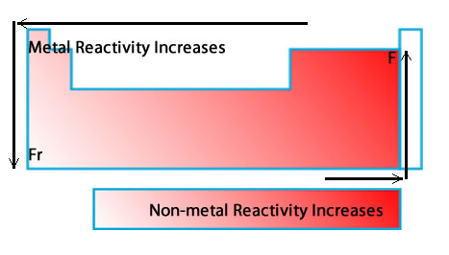
Reactivity

Slide 33
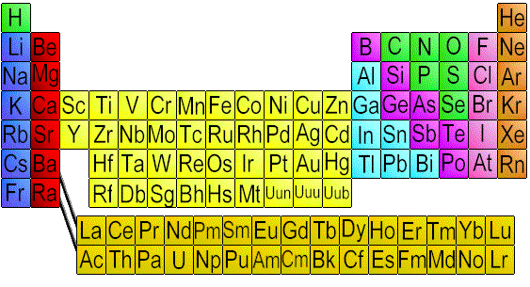
More reactive Metal: Mg or Al?

Slide 34
More reactive Metal: Na or Fr?

Slide 35
More Reactive Non-Metal: B or O?

Slide 36
More Reactive Non-Metal: F or Br?

