Slide 1
Periodic Trends

Slide 2
Periodic Law
When elements are arranged in order of increasing atomic number, there is a periodic pattern in their physical and chemical properties.

Slide 3
Elements’ Electron Configuration
Elements in same column have similar valence e⁻ configurations
Explains similarity of chemical properties
All alkali readily give up s orbital e⁻
Noble gases have filled energy levels, therefore unreactive
Transition metals are filling the d orbitals, therefore colorful and multi-valanced ions
Helps explains periodic trends

Slide 4
Effective Nuclear Charge, Z_{eff}
“Actual Positive Charge” felt by a valence e⁻
Z_{eff} ≈ Z – core e⁻
Z
Core e⁻
Z_{eff}
Na
11
10
1
Mg
12
10
2
Al
13
10
3
Si
14
10
4

Slide 5
Trend in Effective Nuclear Charge
Increases as you move from left to right across a period.
Stays the same as you move down a group.

Slide 6
Effective Nuclear Charge for Na
11p⁺
2 e⁻
1s²
2 e⁻
2s²
6 e⁻
2p⁶
1 e⁻
3s¹
Z_{eff} for outermost e⁻ = +1

Slide 7
Effective Nuclear Charge for Mg
12 p⁺
2 e⁻
1s²
2 e⁻
2s²
6 e⁻
2p⁶
2 e⁻
3s²
Z_{eff} for each outermost e⁻ = +2

Slide 8
Effective Nuclear Charge for P
15 p⁺
2 e⁻
1s²
2 e⁻
2s²
6 e⁻
2p⁶
5 e⁻
3s² 3p³
Z_{eff} for each outermost e⁻ = +5

Slide 9
Shielding
Screening effect of core e⁻
Reduces effective pull of p⁺ in nucleus for valence e⁻
Core e⁻ shield view of an equivalent # of p⁺ in nucleus
Therefore any one valence e⁻ sees lower # of p⁺ at the nucleus

Slide 10
Trend in Shielding
Stays the same moving from left to right across the periodic table.
Increases as you move down a group.

Slide 11
Going From Left to Right in a Row
Z_{eff} increases
Shielding remains the same
Protons increase
Core e⁻ remain the same
Additional valence e⁻ screen each other ineffectively

Slide 12
Going Down a Group
Distance of valence e⁻ from nucleus increases.
Therefore attraction between valence e⁻ and protons in nucleus decreases (Coulomb's Law.)
Because of this there will be less of an attraction for electrons from other atoms and electrons that are there aren’t as tightly held on.

Slide 13
Reasons for the Trends
Z_{eff} increases across a period. Attraction or Pull from the nucleus increases!
Distance from nucleus increases down a group. Decreased attraction down a group due to increased distance from nucleus. (Coulomb’s Law!)

Slide 14
Periodic Trends
Prediction of periodic atomic properties
Atomic Radius
Ionic radius
Cations
Anions
Ionization energy
Electronegativity
Metallic Character/Reactivity
Nonmetallic Character/Reactivity
Oxidation States

Slide 15
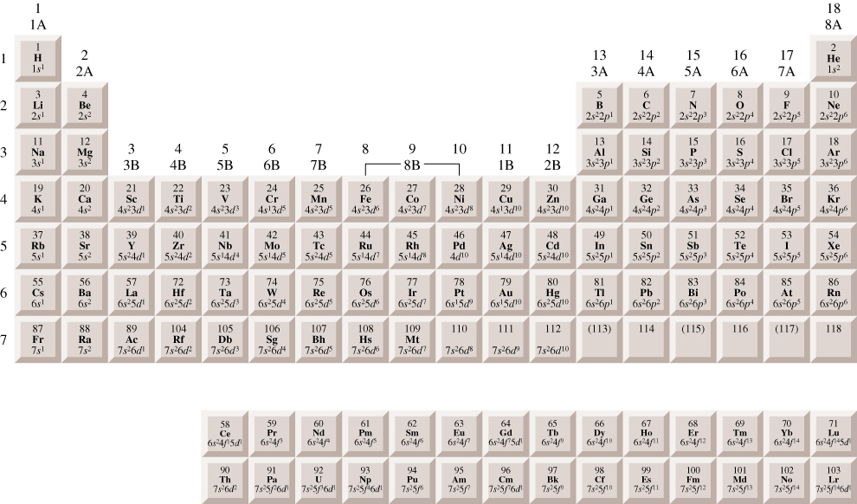
Ground State e⁻ Configurations
ns² nd¹⁰ np⁶
ns¹
ns² nd¹⁰ np¹
ns² nd¹⁰ np²
ns² nd¹⁰ np³
ns² nd¹⁰ np⁴
ns² nd¹⁰ np⁵
ns²
ns² nd¹
ns² nd⁵
ns² nd¹⁰
4f
5f

Slide 16
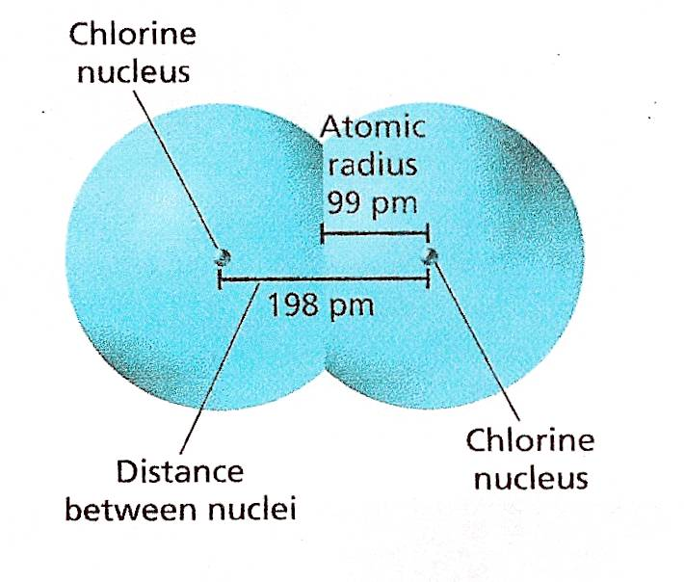
Atomic Radius
½ the distance between nuclei of identical atoms that are bonded together

Slide 17
Atomic Radii Trends
Across a period, radii decreases from left to right.
Z_{eff} increases thus increasing the pull from the nucleus.
Down a family radii increase.
The highest energy level occupied by electrons increases. Distance electrons are from nucleus increases.

Slide 18
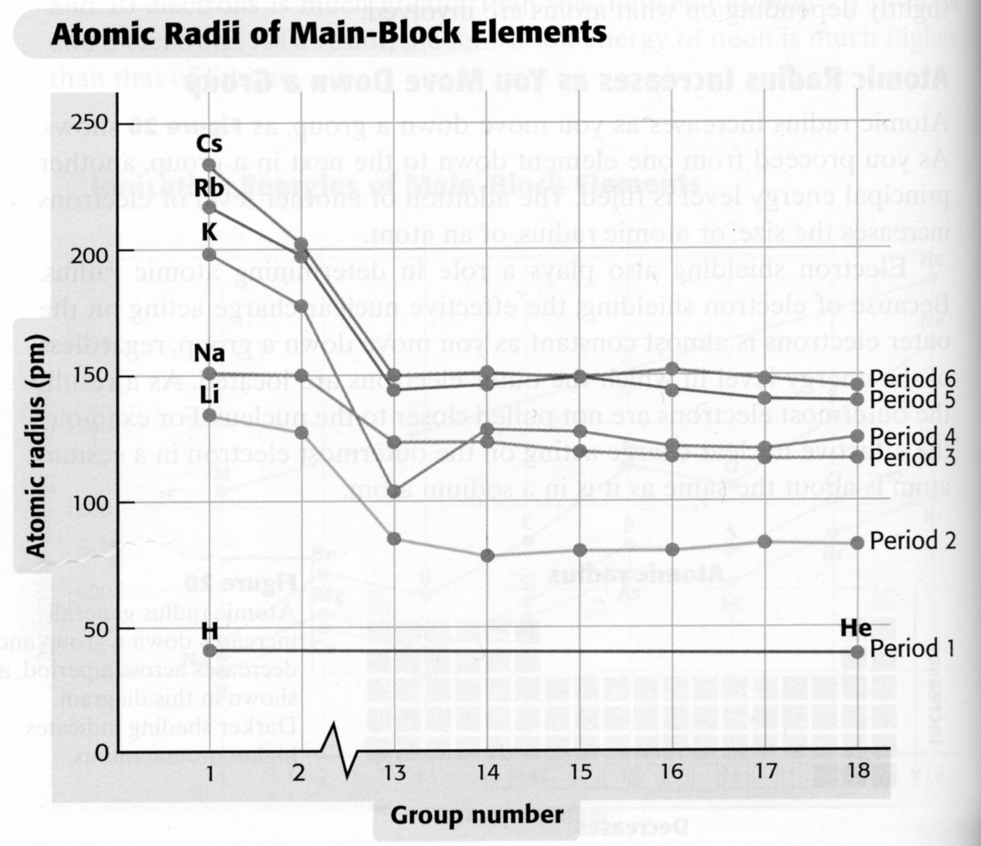
Atomic Radii vs. Group Number

Slide 19
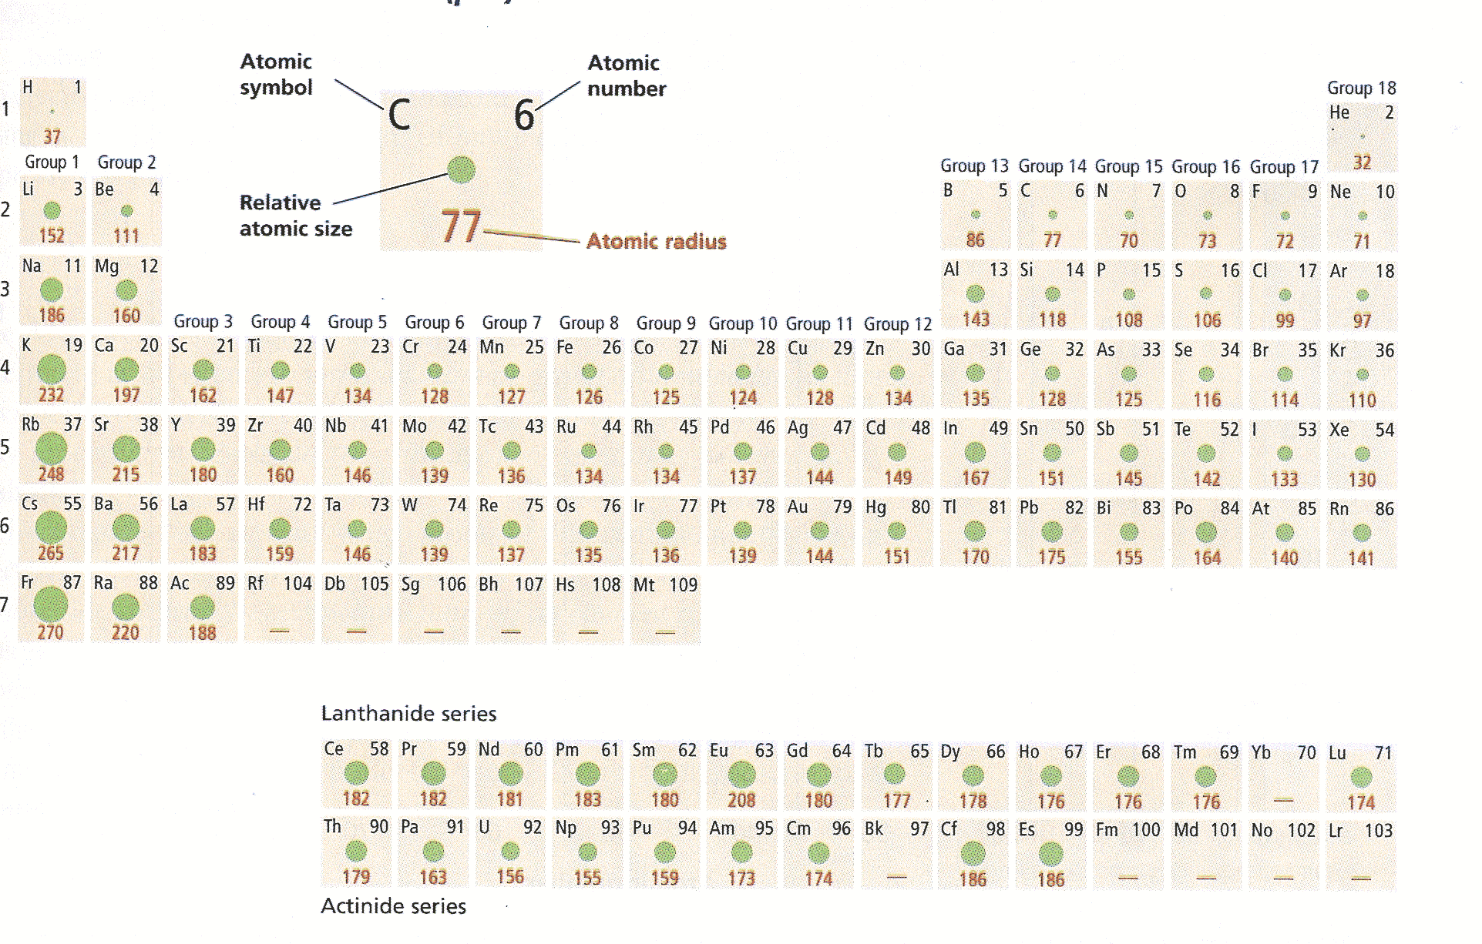
Atomic Radii Values

Slide 20
Ion size - Cations
Cations are smaller than parent atom
Cations sizes generally decrease from left to right as Z_{eff} increases
Cations sizes increase down a family as valence electrons distance from nucleus increases

Slide 21
Ion Size - Anions
Anions are larger than parent element
For isoelectronic anions
Ionic radii decrease across row from left to right as Z_{eff} increases.
Ionic radii increase down a family as valence electrons distance from nucleus increases.

Slide 22
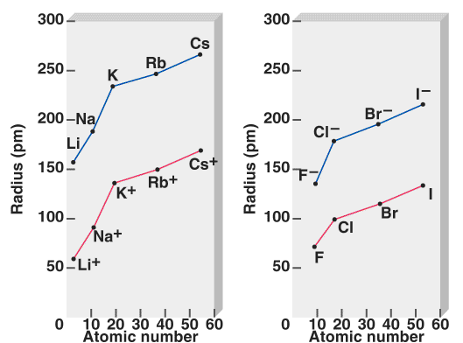
Atom vs. Ion Radii

Slide 23
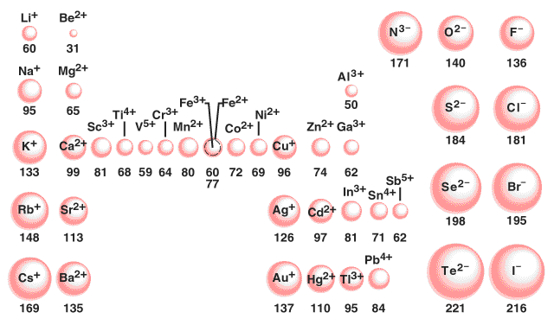
Ion Radii

Slide 24
First Ionization Energy, IE₁
Energy necessary to remove the outermost e⁻ from a gaseous atom
IE₁ increases generally from left to right because of increasing Z_{eff}
IE₁ decreases down a group as valence e⁻ get farther from the nucleus (distance increases)

Slide 25
First Ionization Energy, IE₁
Energy necessary to remove the outermost e⁻ from a gaseous atom
IE₁ increases generally from left to right because of increasing Z_{eff}
IE₁ decreases down a group as valence e⁻ get farther from the nucleus (distance increases)

Slide 26
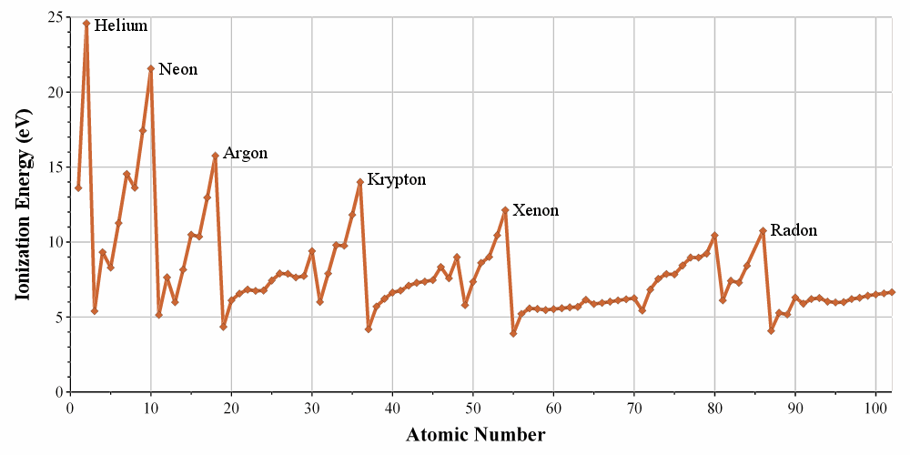
First Ionization Energy Graph

Slide 27
First, Second, Third, etc IE
Ionization Energies in kJ/mol

Slide 28
Second, Third, and Fourth Ionization Energies
Ionization Energies in kJ/mol
Ionization Energies in kJ/mol
 | 1 | 2 | 3 | 4 | 5 | 6 | 7 | 8
H | 1312
He | 2372 | 5250
Li | 520 | 7297 | 11810
Be | 899 | 1757 | 14845 | 21000
B | 800 | 2426 | 3659 | 25020 | 32820
C | 1086 | 2352 | 4619 | 6221 | 37820 | 47260
N | 1402 | 2855 | 4576 | 7473 | 9442 | 53250 | 64340
O | 1314 | 3388 | 5296 | 7467 | 10987 | 13320 | 71320 | 84070
F | 1680 | 3375 | 6045 | 8408 | 11020 | 15160 | 17860 | 92010
Ne | 2080 | 3963 | 6130 | 9361 | 12180 | 15240
Na | 496 | 4563 | 6913 | 9541 | 13350 | 16600 | 20113 | 25666
Mg | 737 | 1450 | 7731 | 10545 | 13627 | 17995 | 21700 | 25662

Slide 29
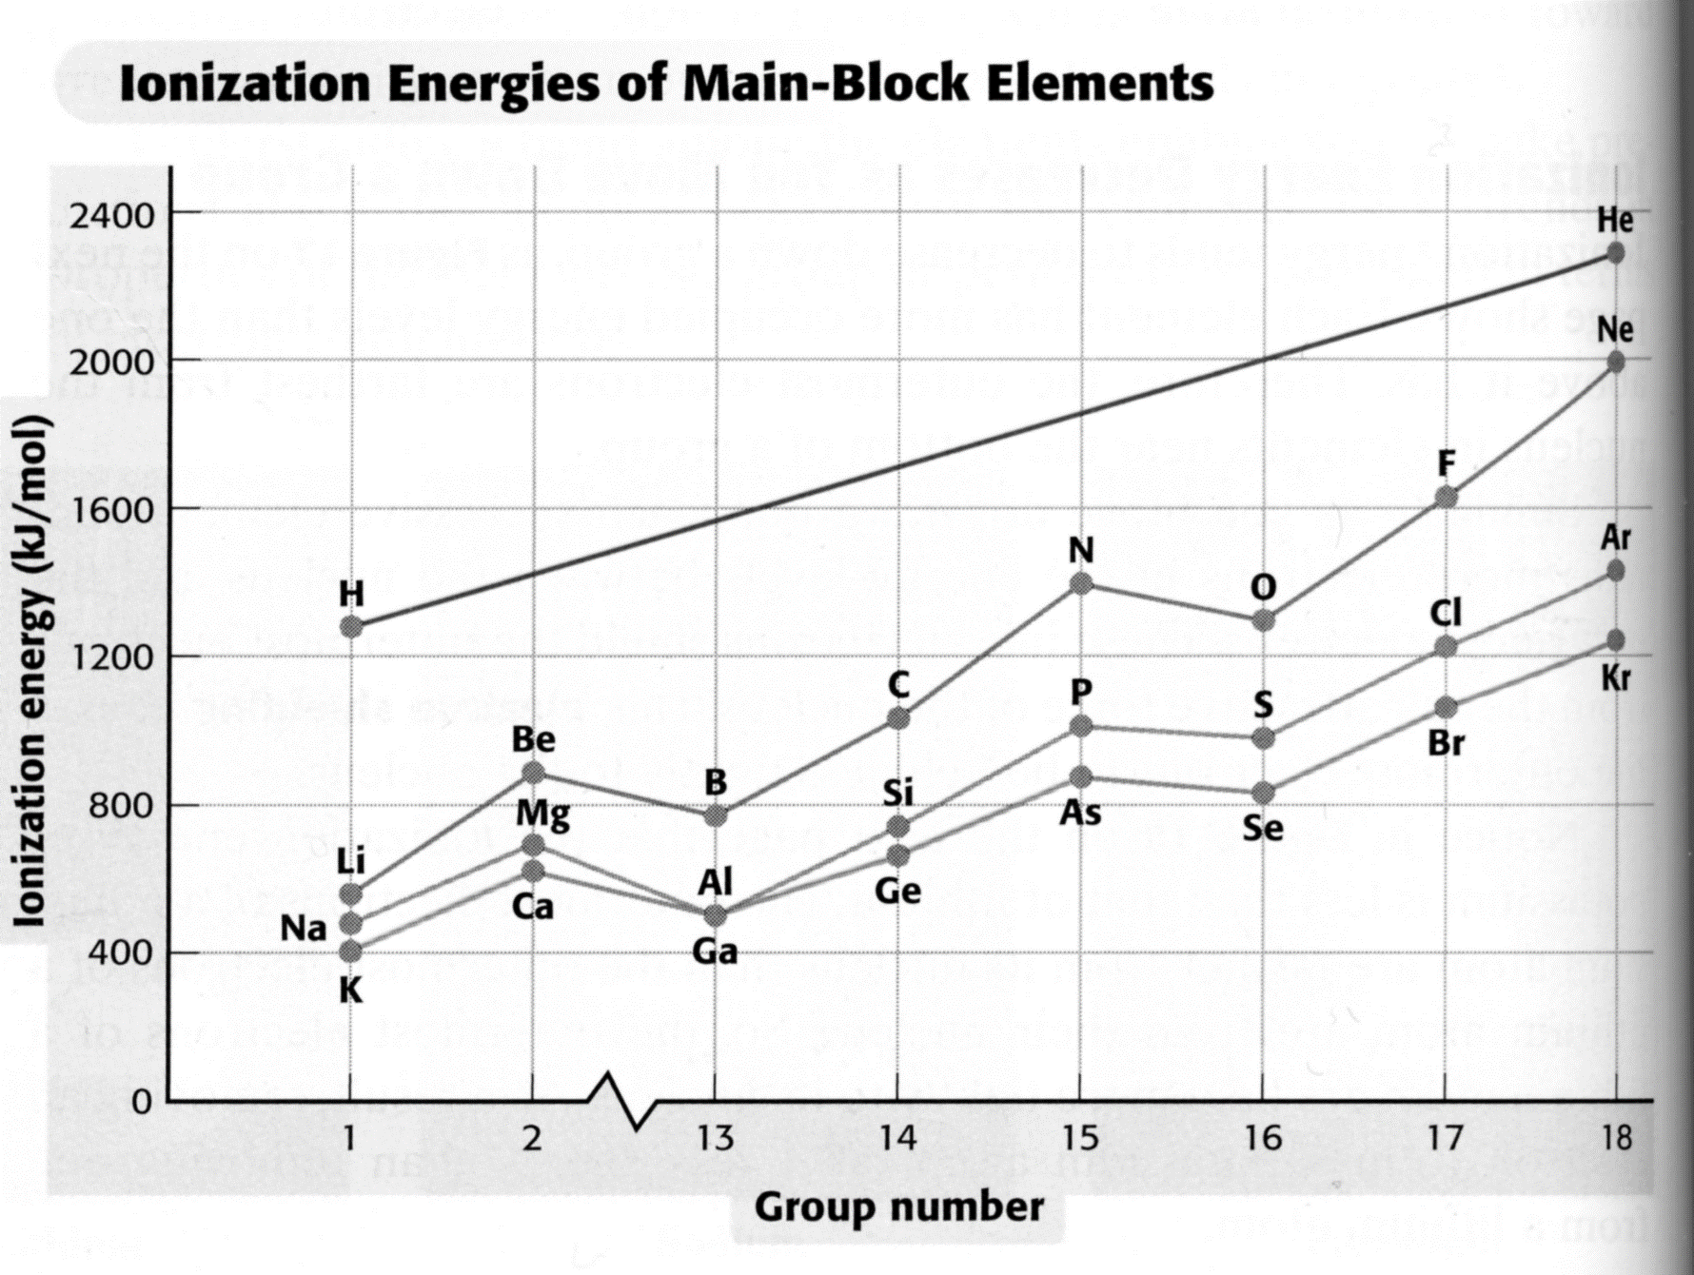
IE vs Group Number

Slide 30
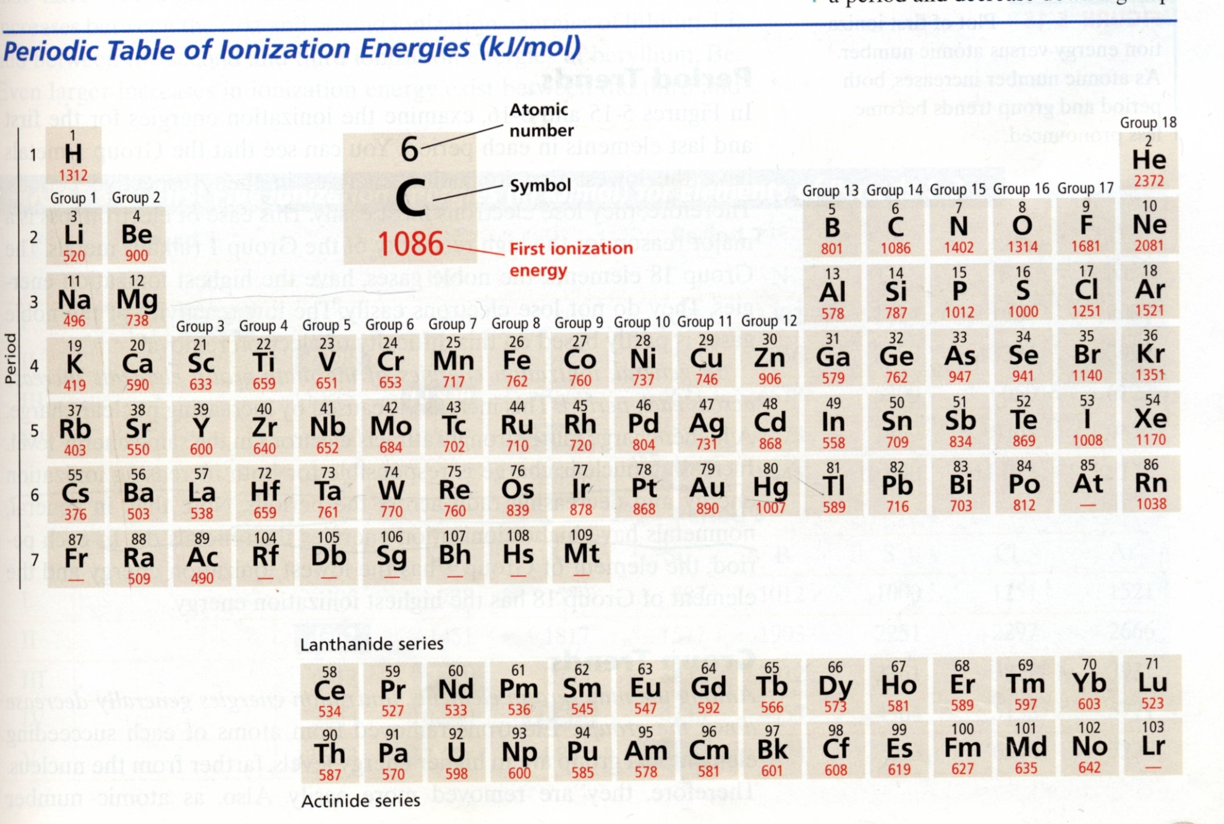
IE₁ Trends
Increasing First Ionization Energy
Increasing First Ionization Energy

Slide 31
Electronegativity
Relative tendency of an atom to attract e⁻s to itself when chemically combined with another atom
Na < B < S < F

Slide 32
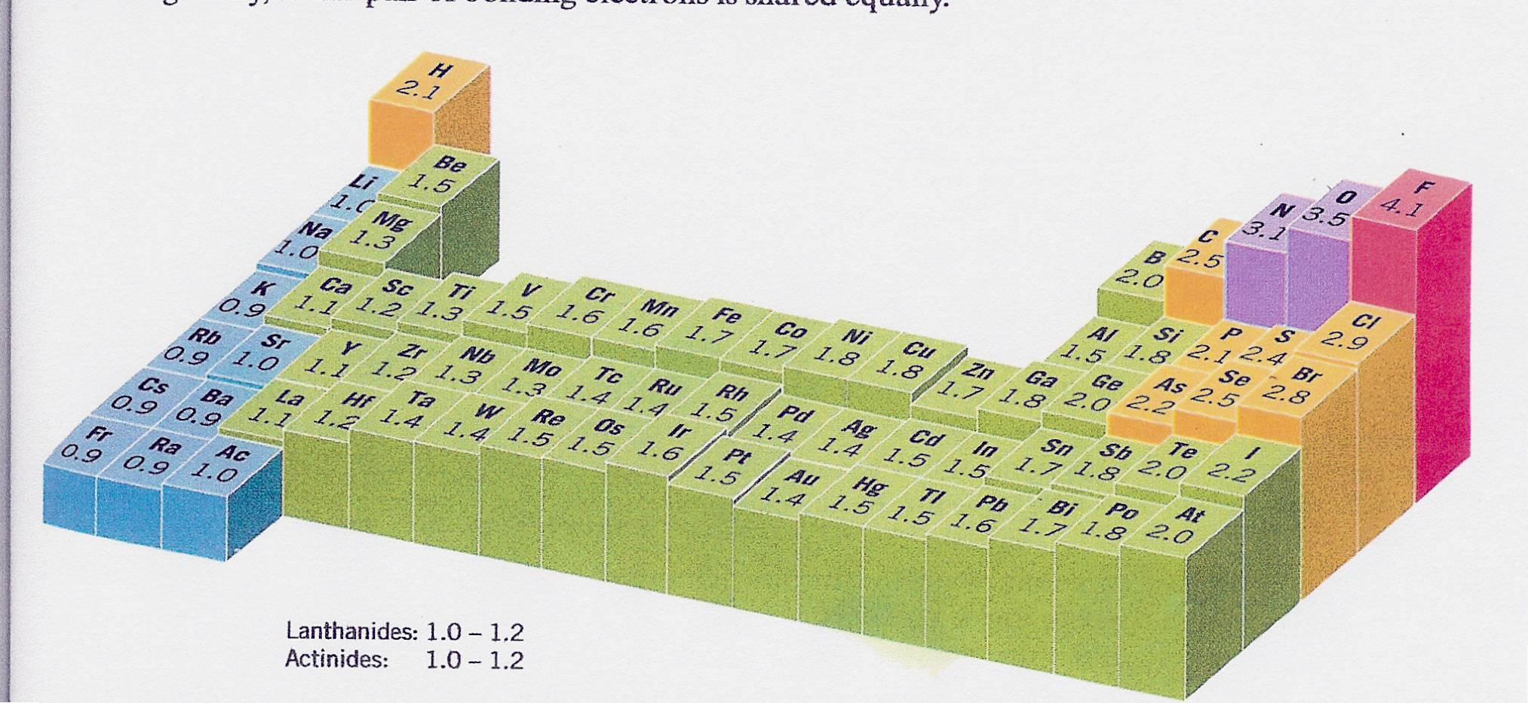
EN Values

Slide 33
Summary
Across a row
Z_{eff}
IE, EA*, EN
Radii
_____________________________________
d
IE, EA*, EN
Radii
Down a
Group
*Did not discuss 17-18

Slide 34
e⁻ Configurations of Anions & Cations
Na: [Ne]3s¹
Na⁺: [Ne]
Metals lose electrons so that cation has a noble-gas outer electron configuration.
Ca: [Ar]4s²
Ca²⁺: [Ar]
Al: [Ne]3s²3p¹
Al³⁺: [Ne]
Non-metals gain electrons so that anion has a noble-gas outer electron configuration.
H 1s¹
H⁻ 1s² or [He]
F 1s²2s²2p⁵
F⁻ 1s²2s²2p⁶ or [Ne]
O 1s²2s²2p⁴
O²⁻ 1s²2s²2p⁶ or [Ne]
N 1s²2s²2p³
N³⁻ 1s²2s²2p⁶ or [Ne]
Na⁺, Al³⁺, F⁻, O²⁻, N³⁻, are isoelectronic with Ne

Slide 35
Transition & Other Metal Cations
For cations of transition and other metals
e⁻s removed in following order
np > ns > (n – 1)d orbitals
V: [Ar]4s²3d³
Cu: [Ar]4s¹3d¹⁰
V⁺²: [Ar]4s⁰3d³ or [Ar]3d³
Cu⁺: [Ar]4s⁰3d¹⁰
V⁺⁵: [Ar]4s⁰3d⁰ or [Ar]
Cu⁺²: [Ar]4s⁰3d⁹
As: [Ar]4s²3d¹⁰4p³
Mn: [Ar]4s²3d⁵
As⁺³ : [Ar]4s²3d¹⁰4p⁰
Mn²⁺: [Ar]4s⁰3d⁵ or [Ar]3d⁵
As⁺⁵ : [Ar]4s⁰3d¹⁰4p⁰
Mn⁷⁺: [Ar]4s⁰3d⁰ or [Ar]
As⁻³ : [Ar]4s²3d¹⁰4p⁶
Fe: [Ar]4s²3d⁶
Pb: [Ar]6s²4f¹⁴5d¹⁰6p²
Fe²⁺: [Ar]4s⁰3d⁶ or [Ar]3d⁶
Pb⁺²: [Ar]6s²4f¹⁴5d¹⁰6p⁰
Fe³⁺: [Ar]4s⁰3d⁵ or [Ar]3d⁵
Pb⁺⁴: [Ar]6s⁰4f¹⁴5d¹⁰6p⁰

Slide 36
Relationship to Periodic Table
+1
+2
+3
-3
-2
-1
+2, +5
+2, +7
+2, +3
+2, +4

Slide 37
Metallic Character
Metallic Character and Reactivity increases as you go from right to left across a period
Metallic character and reactivity increase as you move down a group

Slide 38
Nonmetallic Character and Reactivity
Nonmetallic character and reactivity increases as you go from left to right across a period.
Nonmetallic character and reactivity increase as you move up a group.

