Slide 1
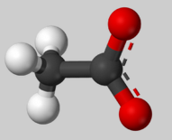
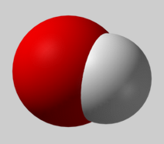
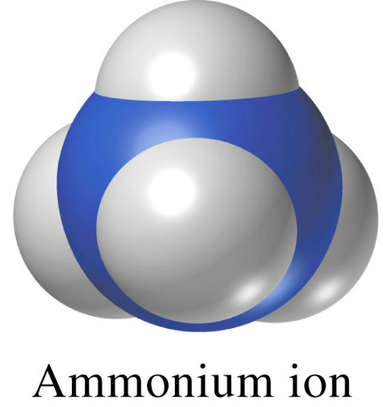
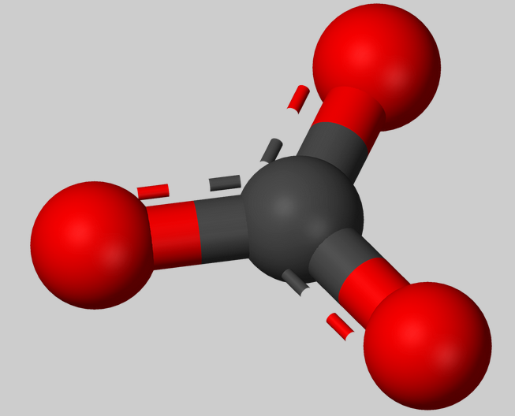
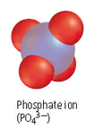
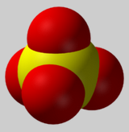
Polyatomic Ions

Slide 2
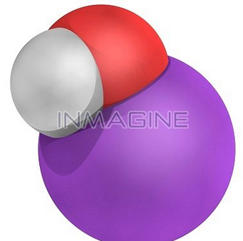
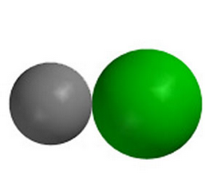
What is the difference between the two different compounds?
Binary compound
(composed on 2 elements)
Ternary compounds (3 different elements) includes a polyatomic ion

Slide 3
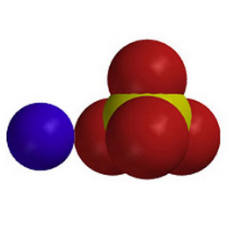
Polyatomic Ions
Polyatomic ions – two or more different atoms covalently bonded together with an overall charge. These groups of atoms will bond to other ions to form compounds.
Example
SO₄⁻² Sulfate ion
Compound: MgSO₄

Slide 4
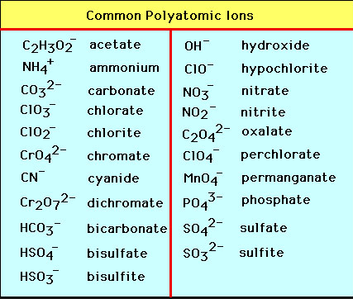
List of polyatomic ions
Note: most polyatomic ions (exceptions include hydroxide, peroxide and cyanide) end in either “ate” or “ite” while elements end in “ide”.

Slide 5
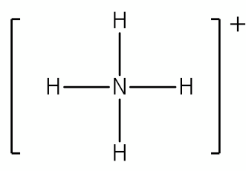
7 Polyatomic Ions to Memorize, Name, Formula and Charge
Name Formula and Charge
1) Ammonium NH₄⁺

Slide 6
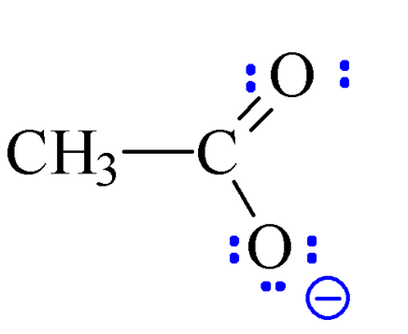
7 Polyatomic Ions to Memorize, Name, Formula and Charge
Name Formula and Charge
2) Acetate CH₃CO₂ ⁻¹

Slide 7
7 Polyatomic Ions to Memorize, Name, Formula and Charge
Name Formula and Charge
3) Hydroxide OH⁻¹

Slide 8
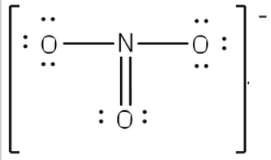
7 Polyatomic Ions to Memorize, Name, Formula and Charge
Name Formula and Charge
4) Nitrate NO₃⁻¹

Slide 9
7 Polyatomic Ions to Memorize, Name, Formula and Charge
Name Formula and Charge
5) Carbonate CO₃⁻²

Slide 10
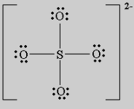
7 Polyatomic Ions to Memorize, Name, Formula and Charge
Name Formula and Charge
6) Sulfate SO₄⁻²

Slide 11
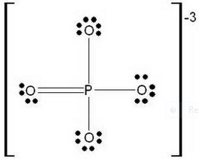
7 Polyatomic Ions to Memorize, Name, Formula and Charge
Name Formula and Charge
7) Phosphate PO₄⁻³

Slide 12
Concept Check: How many IONS are present in each of the following?
(Hints for a-c each ion is enclosed in [ ];
A) [K]⁺[OH]⁻
B) [Na]⁺[CO₃⁻² ] [Na]⁺
C) [Na]⁺ [PO₄]⁻³ [Na]⁺ [Na]⁺
Ans: 2
Ans: 3
Ans: 4

Slide 13
Concept Check
For D- I, circle the polyatomic ion and give the total # of ions (from both monoatomic ions such as Na⁺¹ or Ca⁺² and polyatomic ions).
D) NaOH E) Na₂SO₄ F) Ca₃(PO₄)₂
G) NH₄OH H) (NH₄)₂S I) Al(NO₃)₃
Total ions = 2
Total ions = 3
Total ions = 5
Total ions = 2
Total ions = 3
Total ions = 4

Slide 14
Naming Ternary Salts (compounds with a polyatomic ion)
Simple Naming Rule: Give each ion its name
Example - Name the following
NaNO₃
Na₂CO₃
sodium nitrate
sodium carbonate

Slide 15
Practice: Name the following:
NaOH
Ans: sodium hydroxide
Mg(C₂H₃O₂)₂
Ans: magnesium acetate
NH₄Cl
Ans: ammonium chloride

Slide 16
Writing Formulas
Find charges of monoatomic ions from periodic table
Look up or memorize charges of polyatomic ions
Sum of charges must total zero; use criss-cross if necessary
If more than one polyatomic ion use ( )

Slide 17
Examples of writing formulas from names:
Ammonium hydroxide =
NH₄⁺¹ OH⁻¹ → NH₄OH
Calcium phosphate =
Ca⁺² (PO₄⁻³) →
Ca₃(PO₄ )₂

Slide 18
Practice Formulas
calcium nitrate
Ans: Ca(NO₃)₂
Cesium hydroxide
Ans: CsOH
Gallium carbonate
Ans: Ga₂(CO₃)₃

Slide 19
Review Practice Formulas
calcium nitrate
Ans: Ca(NO₃)₂
calcium nitride
Ans: Ca₂N₃
calcium nitrite
Ans: Ca(NO₂)₂

